Slide 1
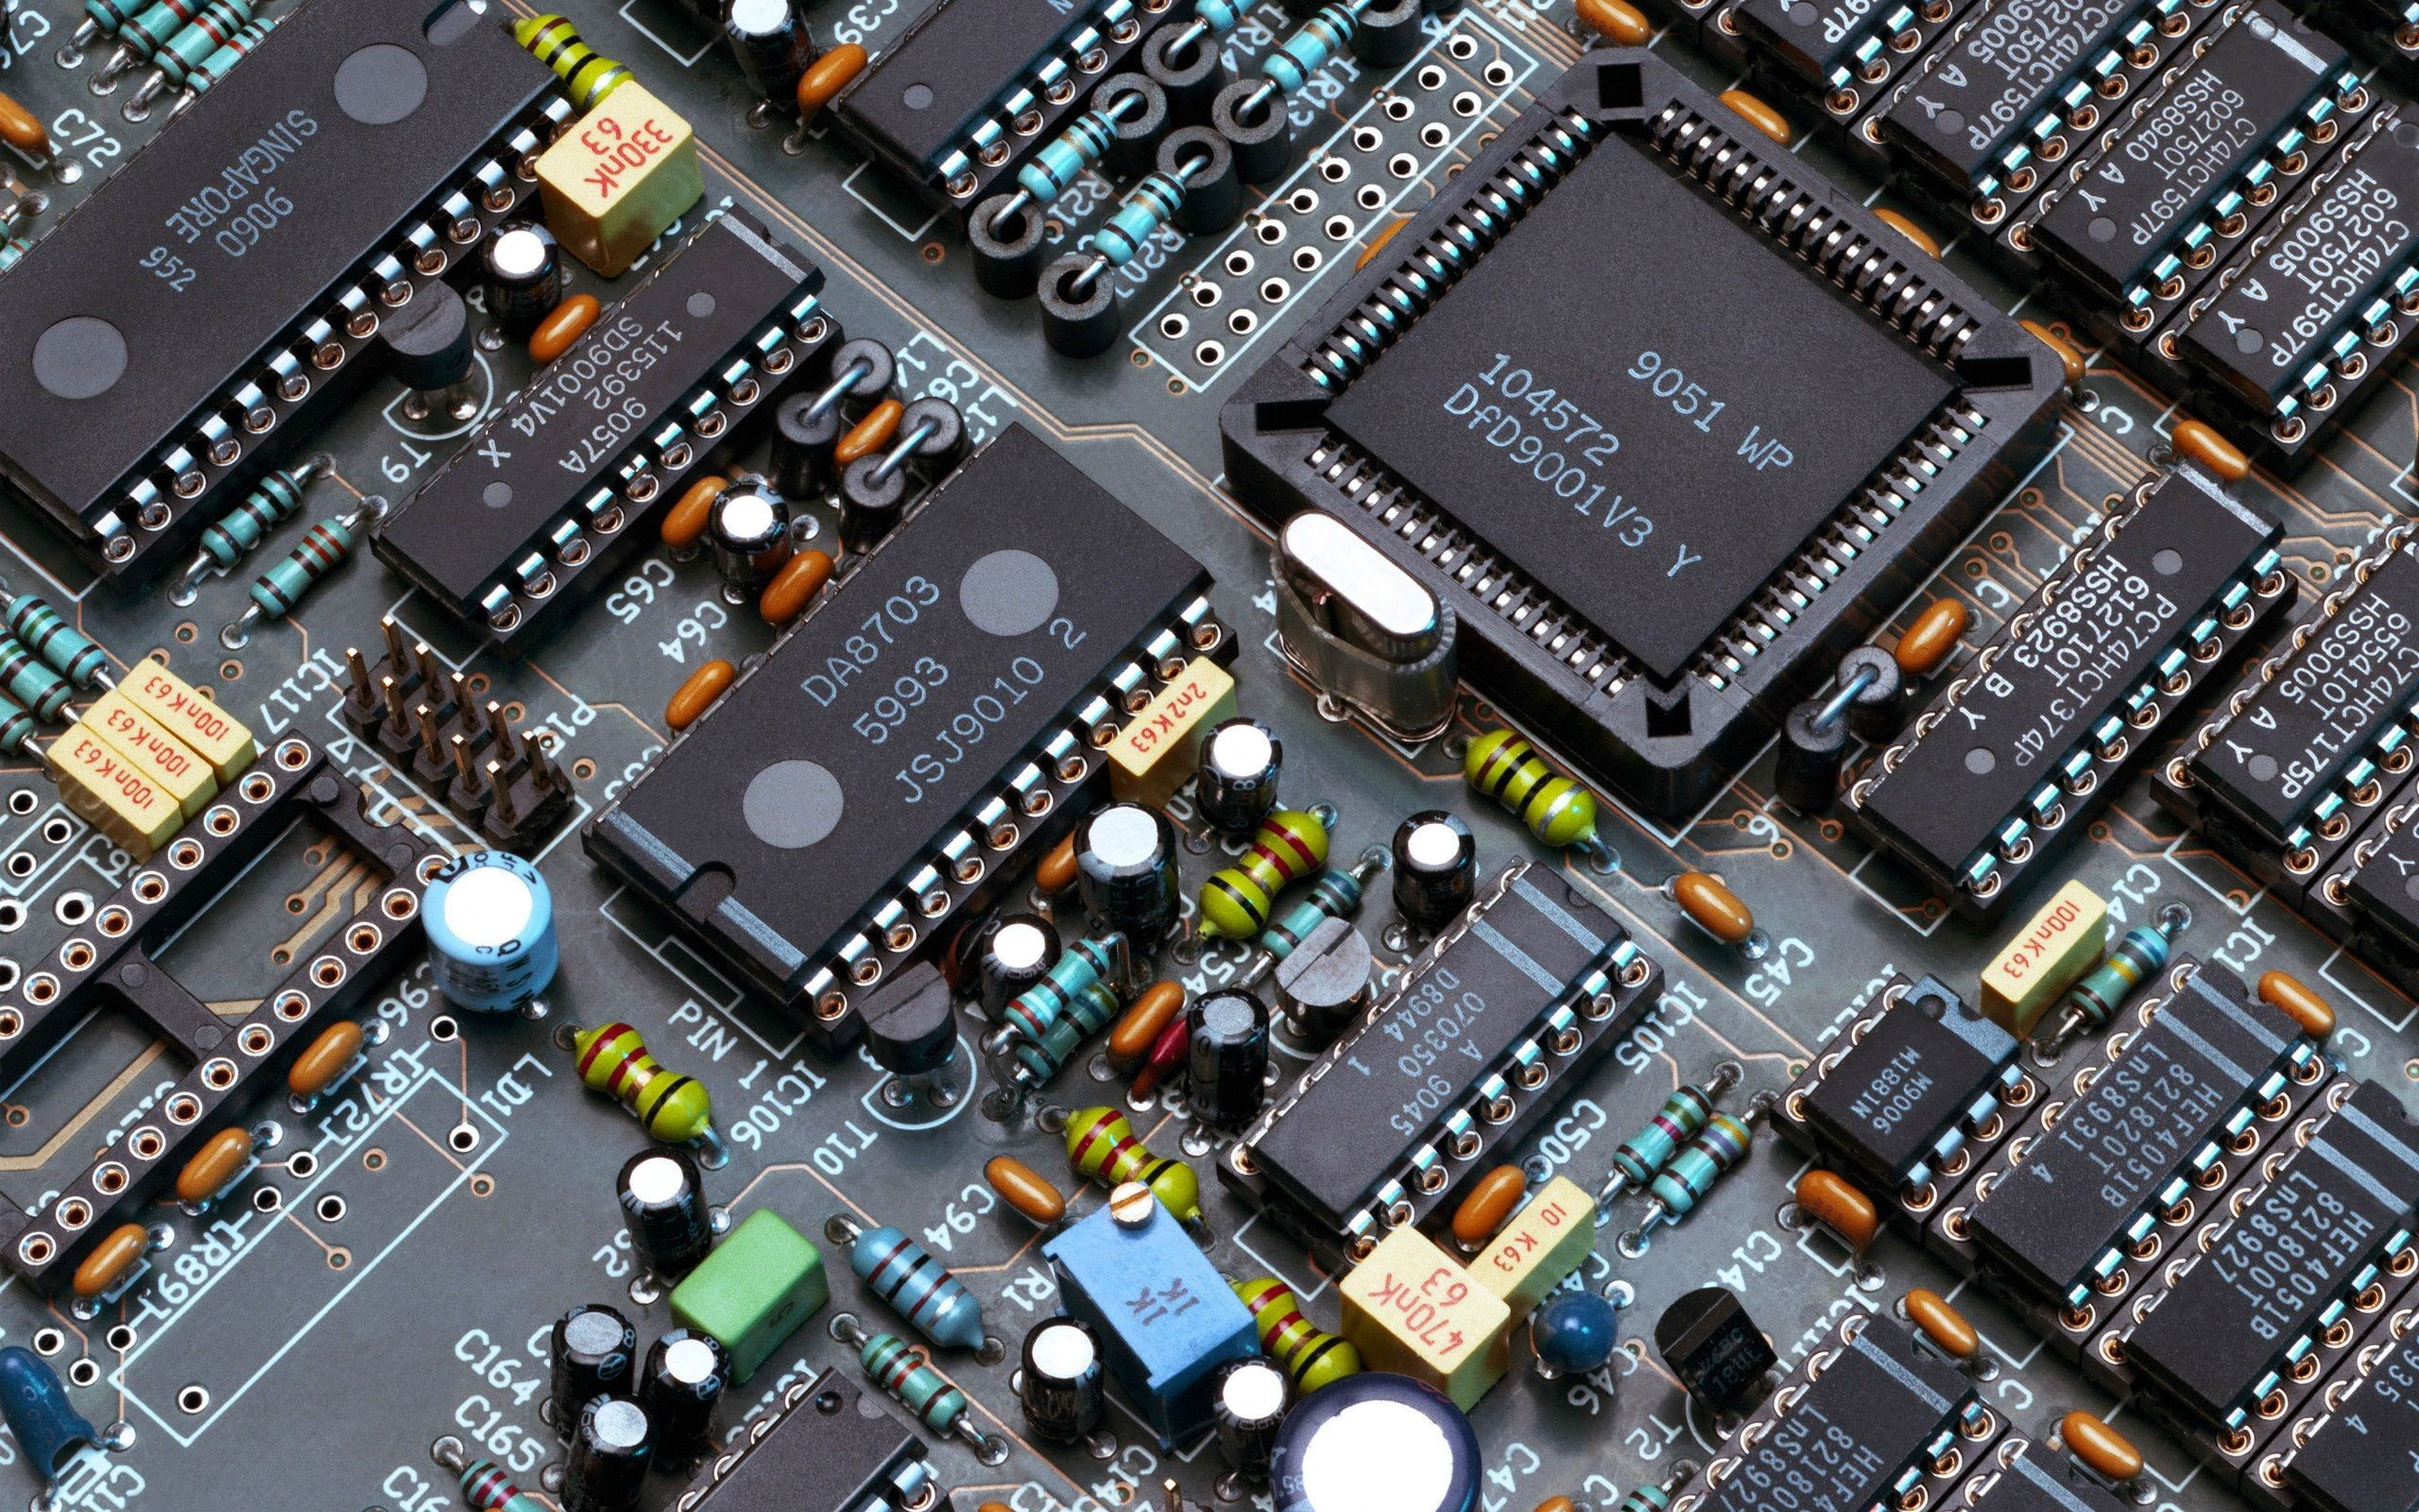
Life Cycle Analysis in Electronics
2025

Slide 2

Agenda
Course 2 – Life Cycle Analysis in electronics
LCA Process and environmental challenges

Slide 3





















Life cycle
Inputs/outputs
Inputs/outputs
Inputs/outputs
Inputs/outputs
Inputs/outputs
End-of-life
management
Natural resources
Material production
Product manufacture
Use
Company
A
Company
B
Gate to gate
Reuse
Cradle to gate
Combust
Landfill
Recycle
Ecological loop
Cradle to cradle
Cradle to grave

Slide 4
Life cycle
Inputs/outputs
Inputs/outputs
Inputs/outputs
Inputs/outputs
Inputs/outputs
End-of-life
management
Natural resources
Material production
Product manufacture
Use
Company
A
Company
B

Gate to gate
Reuse
Cradle to gate
Combust
Landfill
Recycle
Ecological loop
Cradle to cradle
Cradle to grave

Slide 5
Life cycle
Inputs/outputs
Inputs/outputs
Inputs/outputs
Inputs/outputs
Inputs/outputs
End-of-life
management
Natural resources
Material production
Product manufacture
Use
Company
A
Company
B
Gate to gate
Cradle to gate
Combust
Landfill
Cradle to grave

Slide 6
Electronics end-of-life
UN Global waste monitor
  In 2022 62 million tons of e-waste, including 2.5Mt from France (4 %)
Ecosystem (Responsabilité élargie du producteur (REP), in 2023
  Type (Collection rate (taux de collecte), recycling rate)
  Household WEEE 640 ktons (47%, 78%)
  Professional WEEE 89 ktons (42% 84%)
  Lamps 5,5 ktons (89%, 85%)
Ecologic, in 2023, 120 partners for recycling
  Household WEEE 215 ktons (57%, 77%)
  Professional WEEE 83 ktons (67%, 78%)
Video of a DEEE recycling process
Notes:
Le taux de collecte établit le rapport entre la quantité de déchets collectés auprès de producteurs identifiés et la quantité totale des déchets produits par ces mêmes producteurs.
Pour un matériau ou un type de produits donné, le taux de recyclage correspond à la quantité de déchets recyclés dans le courant d'une année civile par rapport au total des déchets produits.
=(640/0,47)+(89/0,42)+(5,5/0,89)+(215/0,57)+(83/0,67)
Exemple d’information Ecosystem
La collecte, le traitement et la dépollution des DEEE ne s'improvisent pas !
Supervisées et contrôlées par Ecologic pour le compte de ses producteurs adhérents, ces étapes sont assurées à ce jour par 120 opérateurs partenaires, qui doiventrépondre à des critères de qualité et de suivi très précis.
Paprec est l'un d'entre eux. Sur ces 40 usines installées en France, cinq sont chargées de la collecte, du démantèlement et de la dépollution de plus de 10 000 tonnes de DEEE par an.
« Depuis trois ans, explique Miguel Lauga, directeur délégué de Paprec, nous ne cessons de moderniser nos équipements pour répondre aux normes de traitement et améliorer le taux de dépollution des composants issus des DEEE. Et bien que notre activité principale porte sur le démantèlement des écrans, le groupe PAPREC s'intéresse aussi à d'autres produits tels le PAM (Petits Appareils en Mélange). »
Bien que leur taux de valorisation soit inférieur aux PAM, les écrans nécessitent des chaînes de traitements spécifiques, notamment pour extraire les poudres luminescentes.
« Notre site situé à Bordeaux, ajoute Miguel Lauga, vient d'être équipé d'un système confiné d'aspiration centrale qui permet aux équipes de travailler dans de meilleures conditions : un tapis de convoyage et un basculeur automatique acheminent les écrans sans que les opérateurs aient à se déplacer d'un poste de travail à un autre ; l'émission et la perte de poussières sont limitées ; la séparation des verres au plomb et des verres au baryum est optimisée au profit d'un meilleur taux de dépollution, etc. Ce type d'équipement nous permet de répondre aux exigences des audits conduits par Ecologic. Il nous offre aujourd'hui la possibilité de nous inscrire comme un acteur clé du traitement des écrans ».

Slide 7
2- Life Cycle Inventory
Life cycle assessment framework
Goal and scope definition
Interpretation
Direct applications:
Product development and improvement
Strategic planning
Public policy making
Marketing
Other
1
Inventory analysis
2
Impact assessment
3
4
ISO 14040

Slide 8
Life cycle
Inputs/outputs
Inputs/outputs
Inputs/outputs
Inputs/outputs
Inputs/outputs
End-of-life
management
Natural resources
Material production
Product manufacture
Use
Company
A
Company
B
Gate to gate
Reuse
Cradle to gate
Combust
Landfill
Recycle
Ecological loop
Cradle to cradle
Cradle to grave

Slide 9
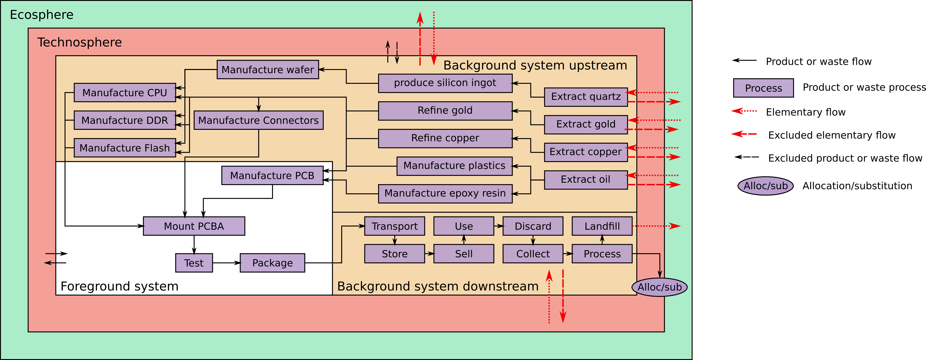
Ecosphere/Technosphere Foreground/Background
Example of a PCB producer and integrator
From ESOS, inspired from
JRC-IEA (2010) International Reference Life Cycle Data System (ILCD) Handbook—General guide for Life Cycle Assessment—Detailed guidance. First edition March 2010. Publications Office of the European Union, Luxembourg. Available at http://lct.jrc.ec.europa.eu/
Notes:
Foreground/background distinction
Specificity perspective: where specific data should be used versus where average or generic background data can typically be used by default
management perspective: identifying which processes can be underdirect control or decisive influence from the point of view of the decision-context of a study
Foreground: own operations and fixed suppliers - data for the specific e.g. technology, supplier etc. is most appropriate.
Background: purchased via a (theoretically fully homogenous) market - averaging effect across the suppliers

Slide 10
Ecosphere/Technosphere Foreground/Background
Example of a PCB producer and integrator
From ESOS, inspired from
JRC-IEA (2010) International Reference Life Cycle Data System (ILCD) Handbook—General guide for Life Cycle Assessment—Detailed guidance. First edition March 2010. Publications Office of the European Union, Luxembourg. Available at http://lct.jrc.ec.europa.eu/
Notes:
Foreground/background distinction
Specificity perspective: where specific data should be used versus where average or generic background data can typically be used by default
management perspective: identifying which processes can be underdirect control or decisive influence from the point of view of the decision-context of a study
Foreground: own operations and fixed suppliers - data for the specific e.g. technology, supplier etc. is most appropriate.
Background: purchased via a (theoretically fully homogenous) market - averaging effect across the suppliers

Slide 11
Inventory data retrieval
Foreground/background distinction
  Foreground: own operations and fixed suppliers
    data for the specific e.g. technology, supplier etc. is most appropriate.
    Primary data
  Background: purchased via a (theoretically fully homogenous) market
    Averaging effect across suppliers makes databases relevant
    Secondary data
  Two perspectives
    Specificity perspective: foreground = where specific data should be used versus background = where average or generic data can be used by default
    management perspective: foreground = processes under direct control or decisive influence from the point of view of the decision-context of a study

Slide 12





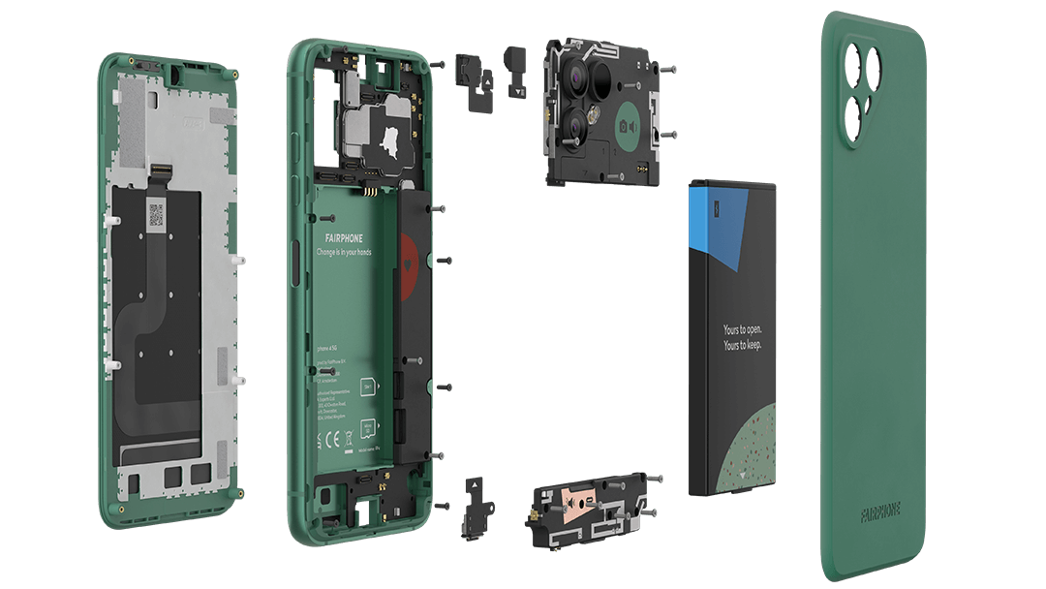





2 - Life Cycle Inventory
Inputs / outputs list
  Raw materials, chemicals
  Energy, water, air
  Packaging
  Transport
  Waste
  …
https://shop.fairphone.com/fr/fairphone-4

Slide 13
Mathematical methods for cost computation
The linear assumption dominates
  Producing N times more costs N times more
Several mathematical methods
  Linear sequential cost aggregation
  Linear matrix cost aggregation
  Non-linear cost aggregation

Slide 14









Cost computation
Reference flow
  Amount of product or service to reach functional unit.
Phone display
1
Phone battery
4
Ah
Phone case
1
Phone assembly
1
Smartphone
1
Electricity
1
kWh
Phone electronics
1
Phone camera
1
CO₂
1
kg
Notes:
A droite, le LCI. On étudie la génération d’électricité.

Slide 15


Sequential computation : an example
1
L
1
kWh
1
kWh
(
Oil
Electricity generation
Electricity
CO₂
1
kg
Notes:
Génération d’1 kWh d’électricité.

Slide 16

Sequential computation: an example
Electricity
0.2
kWh
Oil extraction
1
L
Oil
1
L
CO₂
1
kg
Notes:
Produire 1l de pétrole consomme de l’électricité => récursif

Slide 17














Sequential computation : an example
$$P$$
$$($$
$$)$$
$$=$$
$1$kWh
$1$L
$$=$$
$$P$$
$$($$
$$)$$
$1$L
$0,2$kWh
Notes:
Question : combien de chaque process (production d’électricité et production de prétrole) faut-il pour produite un flux de référence (par exemple 1kWh d’électricité)?

Slide 18








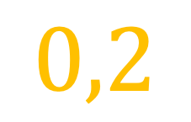




Sequential computation
$$P$$
$$∘$$
$$P$$
$$($$
$$)$$
$$=$$
$1$kWh
$0,2$kWh
$$P$$
$$∘$$
$$P$$
$$($$
$$)$$
$$0,2$$
kWh
Notes:
Suite récursive. Ligne 2, on remplace 0,2kWh par l’équivalent de la ligne 1.

Slide 19













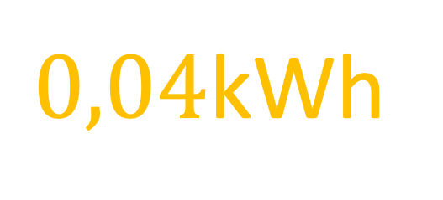


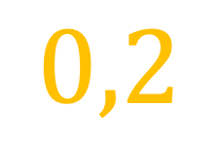

Sequential computation
$$P$$
$$∘$$
$$P$$
$$($$
$$)$$
$$=$$
$1$kWh
$0,2$kWh
$$P$$
$$∘$$
$$P$$
$$($$
$$P$$
$$∘$$
$$P$$
$$($$
$$)$$
$$)$$
$$0,2$$
$0,04$kWh
Notes:
Suite récursive 1+0,2+0,2^2+0,2^3+… pour produire 1kWh, suite qui tend vers 1,25,

Slide 20








Matrix computation
$$P$$
$$P$$
Processes
$$1$$
$$−$$
$$0,2$$
+ → produce
- → consume
Flows
$$−$$
$$1$$
$$1$$
$$A$$
Heijungs, R., & Suh, S. (2002). The computational structure of life cycle assessment (Vol. 11). Springer Science & Business Media.
Technosphere
Notes:
On pose le même problème au format matrice.
A = technosphère (échanges entre process et produits)
Se lit en colonne:
Pour produire 1kWh d’électricité, on consomme 1l de pétrole.
Produire 1l de pétrole consomme 0,2kWh d’électricité.

Slide 21














Matrix computation
$$1$$
$$1$$
$$−$$
$$0,2$$
$$s_{1}$$
$$=$$
$$0$$
$$−$$
$$1$$
$$1$$
$$s_{2}$$
$$f$$
$$A$$
$$s$$
Reference flow (1kWh)
Scaling factor
Notes:
f = reference flow, produire 1kWh d’électricité.
On cherche à résoudre S.
S: scaling factor : quantité de chaque process pour produire le reference flow

Slide 22
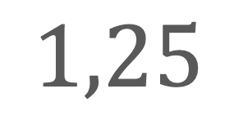







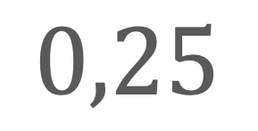

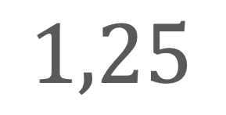
Matrix computation
$$s_{1}$$
$$1,25$$
$$0,25$$
$$1$$
$$=$$
$$s_{2}$$
$$1,25$$
$$1,25$$
$$0$$
$$s$$
$$A^{−1}$$
$$f$$
Notes:
S: scaling factor : quantité de chaque process pour produire le reference flow

Slide 23




Matrix computation
$$P$$
$$s_{1}$$
$$1,25$$
$$=$$
$$s_{2}$$
$$1,25$$
$$P$$
Notes:
S: scaling factor : quantité de chaque process pour produire le reference flow

Slide 24








Matrix computation
$$1,25$$
Cost
$$g$$
$$=$$
$$1$$
$$1$$
$$1,25$$
$$B$$
$$s$$
Ecosphere = Biosphere
Notes:
B = biosphère (ce qui est ajouté et extrait de l’environnement) 1kWh d’électricité et 1l de pétrole.
ce que coûte chaque process
g = quantité d’externalités (ecosphere)
Hypothèse ici: 1 kg CO2 emis par kWh d’électricité et par L de pétrole

Slide 25


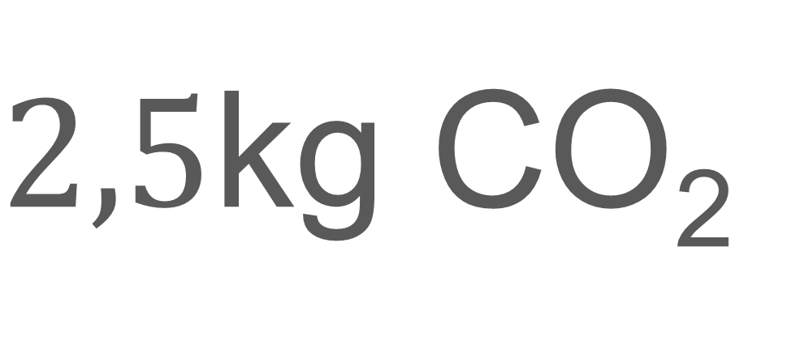
Matrix computation
$$g$$
$$=$$
$2,5$kg CO₂

Slide 26

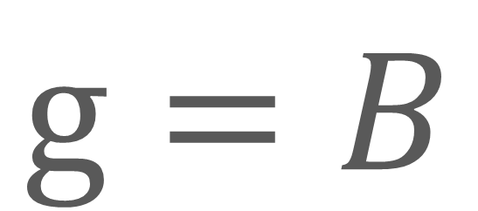




Model definition
$$f$$
$$=$$
$$A$$
$$s$$
Link process-flow (in columns)
Reference flow
$$g=B$$
$$s$$
Cost
Cost per process
Amount of each process to produce functional unit
R$esolve s$ and $g$
Notes:
Functional unit (reference flow)

Slide 27






Model definition
$$s$$
$$=$$
$$A$$
$$A$$
$$f$$
$$−1$$
$$f$$
$$−1$$
$$g=B$$
$$s$$
R$esolve s$ and $g$

Slide 28


Model definition
$$s$$
$$=$$
$$A$$
$$−1$$
$$f$$
$$g=B$$
$$A$$
$$−1$$
$$f$$
R$esolve s$ and $g$
Notes:
Using Ecoinvent/Brightway, we build f and complete A

Slide 29

Life-Cycle Inventory = produce f
$$s$$
$$=$$
$$A$$
$$−1$$
$$f$$
$$g=B$$
$$A$$
$$−1$$
$$f$$
Heijungs, R., & Suh, S. (2002). The computational structure of life cycle assessment (Vol. 11).
Springer Science & Business Media.
Notes:
Using Ecoinvent/Brightway, we build f (and complete A)

Slide 30





2 - Life Cycle Inventory
Data quality
Reliability
Exhaustiveness
Temporal correlation
Geographical correlation
Technological correlation

Slide 31
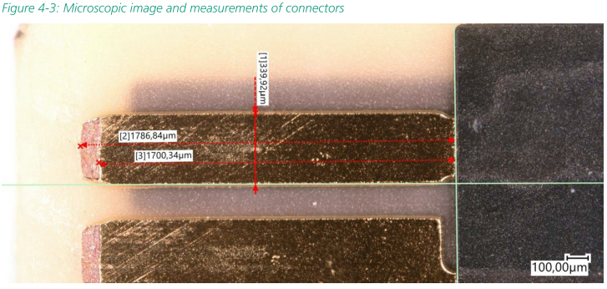
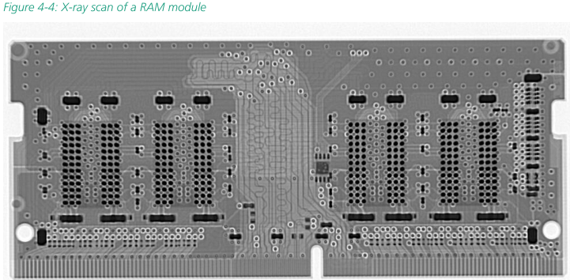
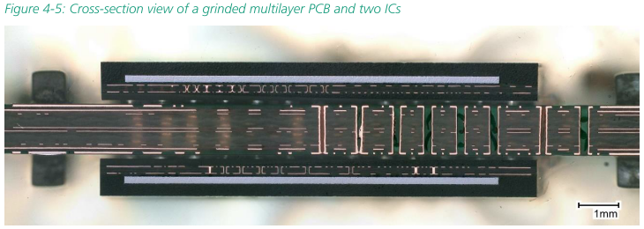
2 - Life Cycle Inventory
Primary data
  Real world data
  Manufacturer data
  Teardown
  Materials identification
  Size, weight measurements
  …
Baur, S-J.; Proske, M.; Poppe, E. LCA of the Framework Laptop 2022. Fraunhofer IZM, 2023,
https://downloads.frame.work/resources/Framework-Life-Cycle-Report.pdf

Slide 32
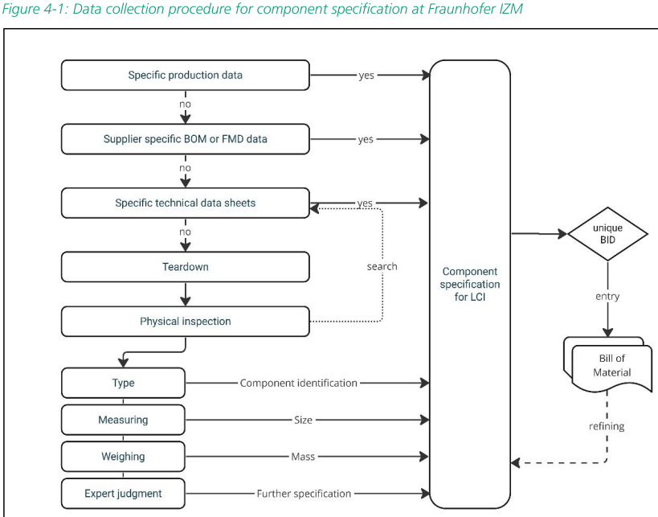
2 - Life Cycle Inventory
Secondary data
  Estimation, equivalent data
  Competitor datasheet
  Company reports
  Expert judgment
  …
Baur, S-J.; Proske, M.; Poppe, E. LCA of the Framework Laptop 2022. Fraunhofer IZM, 2023,
https://downloads.frame.work/resources/Framework-Life-Cycle-Report.pdf

Slide 33
2 - Life Cycle Inventory
Impact databases
  Ecoinvent
  Negaoctet
  Sphera LCA Database (GaBi)
  Bureau Veritas CODDE/EIME
  …
Tools
  Brightway
  OpenLCA
  Ecodesign Studio
  Bureau Veritas CODDE
  …
Baur, S-J.; Proske, M.; Poppe, E. LCA of the Framework Laptop 2022. Fraunhofer IZM, 2023,
https://downloads.frame.work/resources/Framework-Life-Cycle-Report.pdf

Slide 34
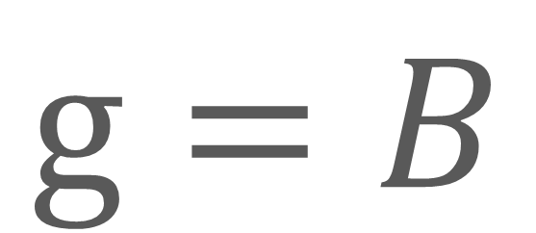



Data bases = Matrix A
$$s$$
$$=$$
$$A$$
$$f$$
$$−1$$
$$g=B$$
$$A$$
$$f$$
$$−1$$
Notes:
Using Ecoinvent/Brightway, we build f and complete A

Slide 35
2 - Life Cycle Inventory
Example
Phone battery

Slide 36
2 - Life Cycle Inventory
Example
Battery cell production, Li-ion, NCA
Phone battery
Date $⟶$ 2017
Localisation $⟶$ China
14.38 Wh
Capacity $⟶$ 224 Wh/kg
Unit $⟶$ kg
Technology
Lithium ion
Battery cell production, Li-ion, NMC811
Weight
Date $⟶$ 2017
64.2g
Localisation $⟶$ China
13.42 Wh
Capacity
3905 mAh / 15.03 Wh
Capacity $⟶$ 209 Wh/kg
Unit $⟶$ kg
Lifetime
1000 cycles
Battery cell production, Li-ion, LFP
Recharge
14.8 Wh/cycle
Date $⟶$ 2016
Localisation $⟶$ China
10.21 Wh
Localisation
China
Capacity $⟶$ 159 Wh/kg
Unit $⟶$ kg
Notes:
NMC, NCA, LFP: sous-catégories de batteries lithium ion
Question avant de répondre: laquelle choisir?

Slide 37

2 - Life Cycle Inventory
Example
Phone display

Slide 38
2 - Life Cycle Inventory
Example
Phone display
Technology
LCD
Liquid crystal display production, unmounted
Surface
97.4 cm²
Date $⟶$ 2007
Localisation $⟶$ Global
Resolution
1080 x 2340 pixels
Unit $⟶$ kg
Pixels density
410 ppp
Localisation
China

Slide 39

2 - Life Cycle Inventory
Example
Phone display
Technology
LCD
Surface
97.4 cm²
Resolution
1080 x 2340 pixels
Pixels density
410 ppp
Localisation
China

Slide 40

2 - Life Cycle Inventory
Example
Phone display
Localisation
Taiwan
Technology
LCD
Date
2022
Surface
97.4 cm²
Production
60 475 995 m²
Resolution
1080 x 2340 pixels
Scope 1
69.7 kt CO₂e
Pixels density
Scope 2
410 ppp
2 373.4 kt CO₂e
Localisation
China
Scope 3
1 004.5 kt CO₂e

Slide 41
Agenda
Impact assessment
Assigning numbers

Slide 42
3- Impact assessment
Life cycle assessment framework
Goal and scope definition
Interpretation
Direct applications:
Product development and improvement
Strategic planning
Public policy making
Marketing
Other
1
Inventory analysis
2
Impact assessment
3
4
ISO 14040

Slide 43
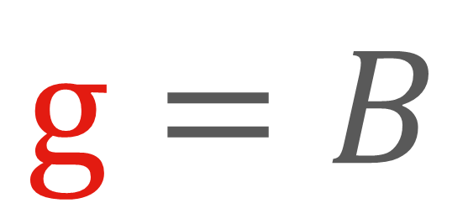
Impact assessment = produce g
$$s$$
$$=$$
$$A$$
$$−1$$
$$f$$
$$g=B$$
$$A$$
$$−1$$
$$f$$
Notes:
Using Ecoinvent/Brightway, we build f and complete A

Slide 44
Challenges of impact assessment
Environmental impacts of human activities are complex
  Global warming
  Destruction of forest
  Pollution of land, water and air
  Consumption of non-renewable resources
Impact assessment methods standardize evaluations
  Impact categories
  Units and aggregation methods
  Mid-point and end-point impacts

Slide 45


EU resources on impact assessment
EPLCA : European Platform on LCA (European Commission)
  DG ENV : responsible for the EU Commission's policies on the environment
  JRC (Joint Research Centre) : Scientific support to EF development
  ILCD 2010 (International Life Cycle Data system)
    Technical guidance
    LCI & LCIA phases
Notes:
EF: Environmental Footprint
PEF: Product Environmental Footprint

Slide 46

EU resources on impact assessment
EPLCA : European Platform on LCA (European Commission)
  DG ENV : responsible for the EU Commission's policies on the environment
  JRC (Joint Research Centre) : Scientific support to environmental footprint development
  EF (Environmental Footprint) 2013 : LCA methods
    Recommendation 2021/2279 of the EU Commission
    PEF : products
      Provides impacts for elementary flows
    OEF : organisations
    Data & tools development
  Standardizing environmental impacts and their assessment

Slide 47
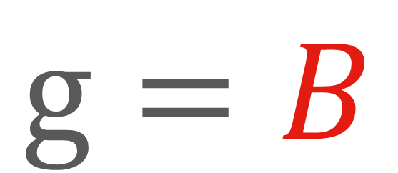
EU EF provides matrix B
$$s$$
$$=$$
$$A$$
$$−1$$
$$f$$
$$g=B$$
$$A$$
$$−1$$
$$f$$
Notes:
Using Ecoinvent/Brightway, we build f and complete A

Slide 48

EU resources on impact assessment
EPLCA : European Platform on LCA (European Commission)
  DG ENV : responsible for the EU Commission's policies on the environment
  JRC (Joint Research Centre) : Scientific support to environmental footprint development
  LCDN (Life Cycle Data Network)
    Nodes network
    Publish LCA data
    Search shared data
    Harmonized practices, quality

Slide 49














16 mid-point impacts, 5 very critical for electronics
Climate change
Particulate matter
Ozone depletion
Photochemical ozone formation, human health
Water use
Resource use, fossils
Land use
Resource use, minerals and metals
Acidification
Ionising radiation, human health
Eutrophication, freshwater
Eutrophication, marine
Human toxicity, cancer
Human toxicity, non-cancer
Eutrophication, terrestrial
Ecotoxicity, freshwater
Notes:
Ocean acidification -> jeopardizes animals and plants
Eutrophication -> (azote et de phosphore) nitrogen and phosphorus -> develop algae -> deplete oxygen

Slide 50
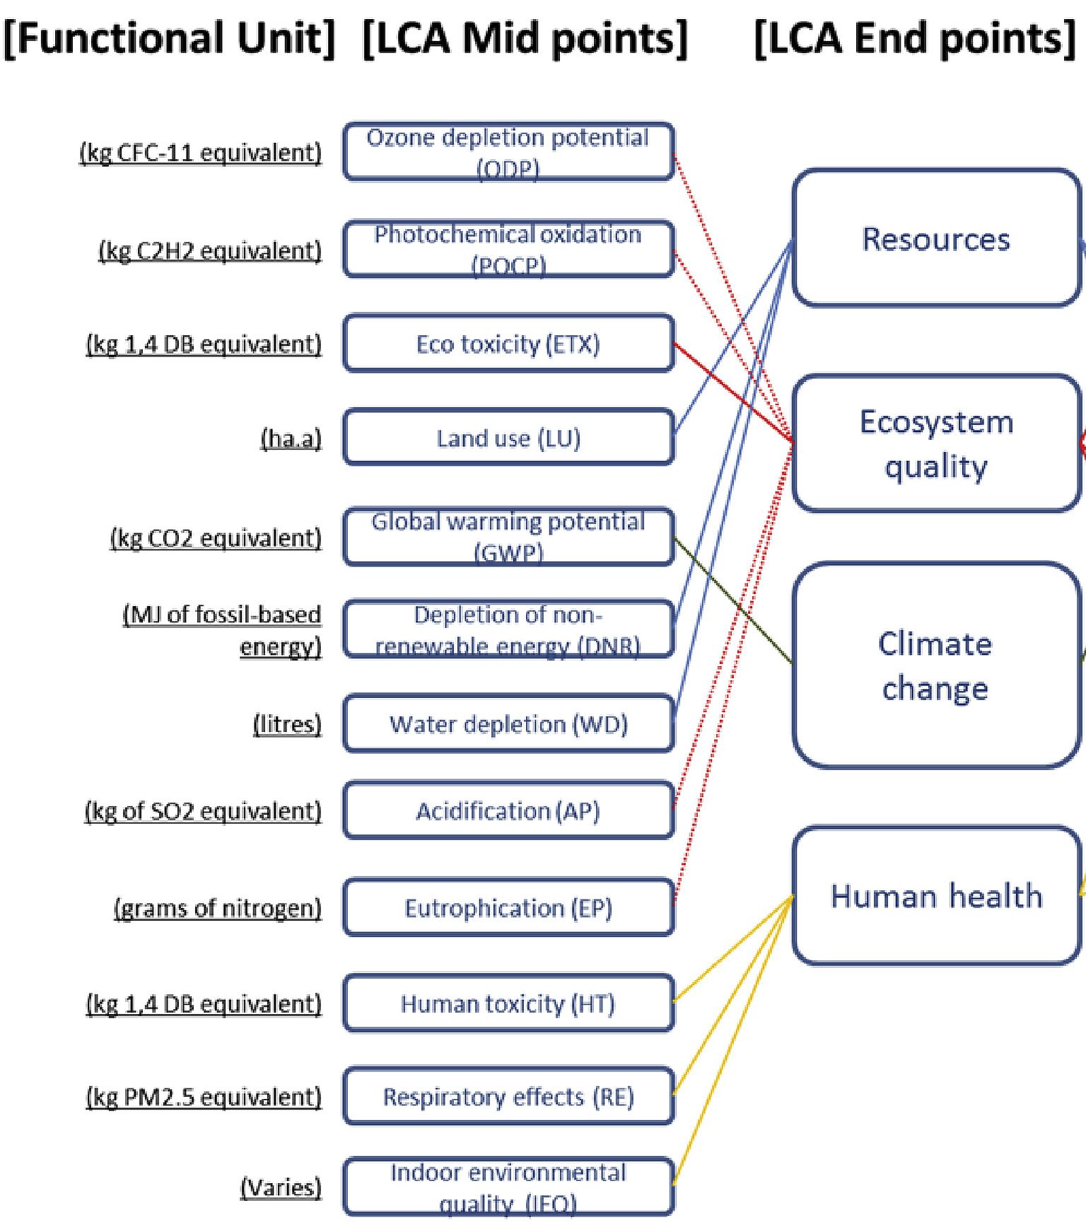
Mid-point to end-point impacts (example)
Ismaeel, W. S. (2018). Midpoint and endpoint impact categories in
Green building rating systems. Journal of Cleaner Production, 182, 783-793

Slide 51
16 impacts, 5 very critical for electronics
Climate change
Particulate matter
Ozone depletion
Photochemical ozone formation, human health
Water use
Resource use, fossils
Land use
Resource use, minerals and metals
Acidification
Ionising radiation, human health
Eutrophication, freshwater
Eutrophication, marine
Human toxicity, cancer
Human toxicity, non-cancer
Eutrophication, terrestrial
Ecotoxicity, freshwater
Notes:
Ocean acidification -> jeopardizes animals and plants
Eutrophication -> (azote et de phosphore) nitrogen and phosphorus -> develop algae -> deplete oxygen

Slide 52
16 impacts, 5 very critical for electronics
Climate change
Photochemical ozone formation, human health
Particulate matter
Unit : kg CO₂e
Resource use, fossils
Climate change
Ozone depletion
Water use
Localisation : Global
Consequences include extreme weather events, rising sea levels, melting glaciers, ecosystem degradation, threats to food security and increased risks to human health.
Land use
Resource use, minerals and metals
Acidification
Ionising radiation, human health
Eutrophication, freshwater
Eutrophication, marine
Human toxicity, cancer
Human toxicity, non-cancer
Eutrophication, terrestrial
Ecotoxicity, freshwater
Notes:
Ocean acidification -> jeopardizes animals and plants
Eutrophication -> (azote et de phosphore) nitrogen and phosphorus -> develop algae -> deplete oxygen
Land use index aggregates five midpoint indicators to assess the impact of land use on soil quality: 1) erosion resistance, 2) physicochemical filtration, 3) groundwater regeneration, 4) mechanical filtration and 5) biotic production.

Slide 53
Focus on global warming and greenhouse gases emissions
“The lifetime of fossil fuel CO₂ in the atmosphere is a few centuries, plus 25 percent that lasts essentially forever. The next time you fill your tank, reflect upon this”, D. Archer.
EF model = GWP100 (Global Warming Potentials over 100 years)
Semiconductor fabrication gas examples
  1kg Sulfur Hexafluoride (SF₆) = 23,900 kg CO₂e, remains 3,200 years in atmosphere
  1kg Trifluoromethane (HFC-23) (CHF₃) = 11,700 kg CO₂e , remains 264 years in atmosphere
  1kg Perfluoromethane (CF₄) = 6,500 kg CO₂e , remains 50,000 years in atmosphere
Archer, D. The Long Thaw: How Humans Are Changing the Next 100,000 Years of Earth's Climate (Princeton Univ. Press, 2008).
Bartos, S. C., & Burton, C. S. (2002). PFC, HFC, NF3, and SF6 emissions from semiconductor manufacturing. Good Practice Guidance and Uncertainty Management in National Greenhouse Gas Inventories, 1-13.

Slide 54
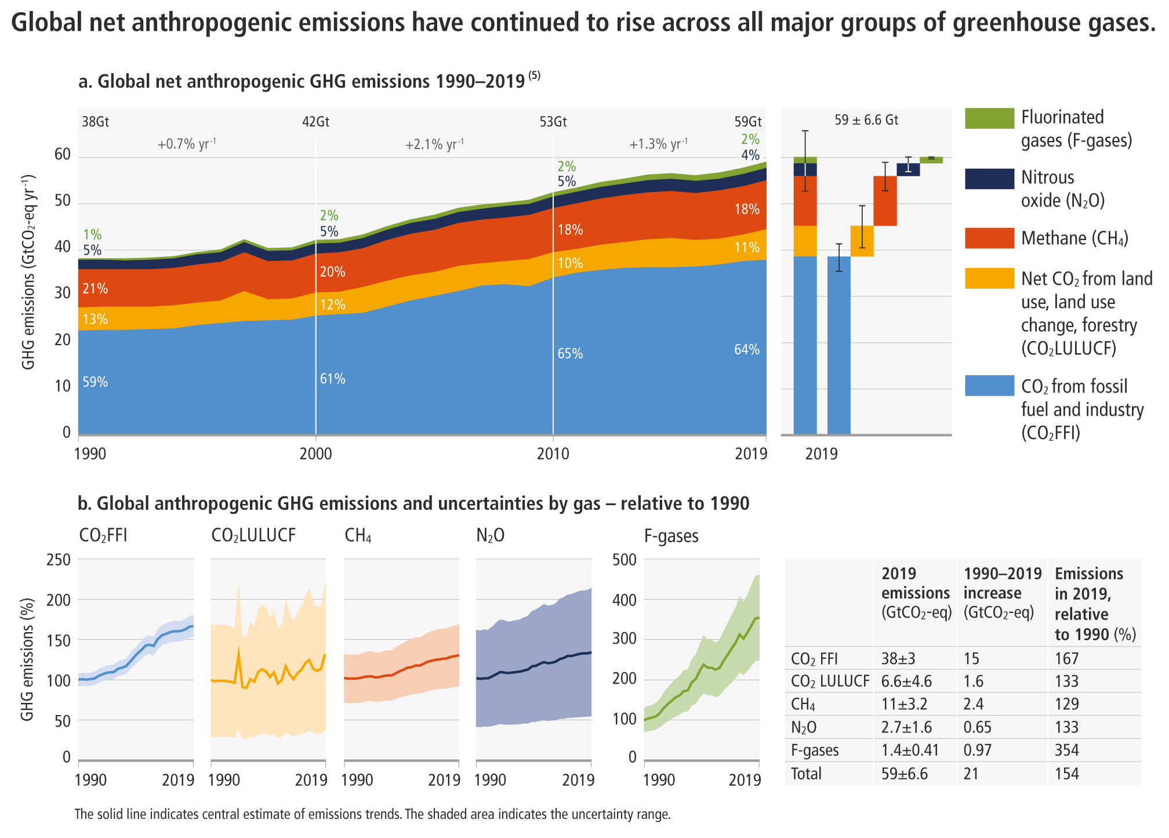
GHG Emissions objective
Human GHG emissions reach 60Gt/year
To respect the 1.5°C scenario of the Paris Agreement, emissions must reach 8Gt/year by 2050, i.e. a reduction of ~7× by 2050
The Closing Window: Climate crisis calls for rapid transformation of societies,
UN environment program 2022
8Gt

Slide 55
GHG Emissions objective
Human GHG emissions reach 60Gt/year
To respect the 1.5°C scenario of the Paris Agreement, emissions must reach 8Gt/year by 2050, i.e. a reduction of ~7× by 2050
-7%/year
8Gt

Slide 56
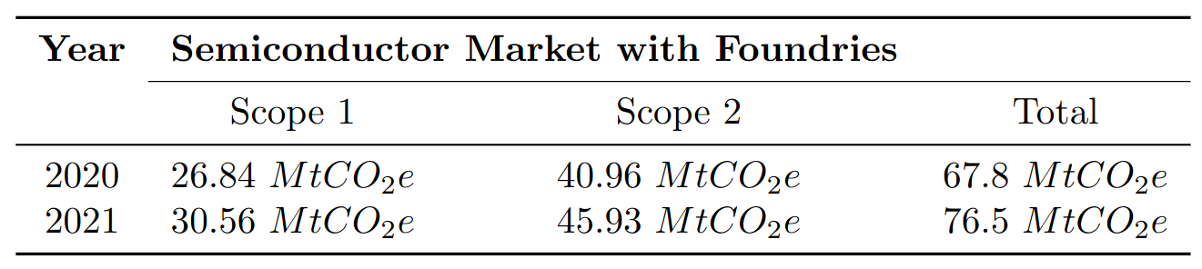
GHG Emissions objective
The manufacture of integrated circuits emitted 76Mt CO2eq in 2021, an increase of 13% compared to 2020.
For +28% revenue: efficiency has improved, sustainability has not.
The current study excludes Scope 3.
Maxime Pelcat. GHG emissions of semiconductor manufacturing in 2021. Research Report. 2023. ⟨hal-04112708⟩

Slide 57
16 impacts, 5 very critical for electronics
Water use
Unit : m³ water equivalent
Photochemical ozone formation, human health
Resource use, fossils
Climate change
Particulate matter
Ozone depletion
Water use
Localisation : Local
Consequences are lack of water for humans, plants or animals, and withdrawal of water from rivers, lakes and groundwater.
Land use
Resource use, minerals and metals
Acidification
Ionising radiation, human health
Eutrophication, freshwater
Eutrophication, marine
Human toxicity, cancer
Human toxicity, non-cancer
Eutrophication, terrestrial
Ecotoxicity, freshwater
Notes:
Ocean acidification -> jeopardizes animals and plants
Eutrophication -> (azote et de phosphore) nitrogen and phosphorus -> develop algae -> deplete oxygen

Slide 58
16 impacts, 5 very critical for electronics
Ressource use, fossils
Unit : MJ
Photochemical ozone formation, human health
Resource use, fossils
Climate change
Particulate matter
Ozone depletion
Water use
Localisation : Local
Consequences are depletion of oil, gas and coal, no more usable for other means.
Land use
Resource use, minerals and metals
Acidification
Ionising radiation, human health
Eutrophication, freshwater
Eutrophication, marine
Human toxicity, cancer
Human toxicity, non-cancer
Eutrophication, terrestrial
Ecotoxicity, freshwater
Notes:
Ocean acidification -> jeopardizes animals and plants
Eutrophication -> (azote et de phosphore) nitrogen and phosphorus -> develop algae -> deplete oxygen

Slide 59
16 impacts, 5 very critical for electronics
Land use
Climate change
Particulate matter
Ozone depletion
Photochemical ozone formation, human health
Water use
Resource use, fossils
Unit : Point
Localisation : Local
Land use index aggregates five midpoint indicators to assess the impact of land use on soil quality:
1) erosion resistance,
2) physicochemical filtration,
3) groundwater regeneration,
4) mechanical filtration and
5) biotic production.
Land use
Resource use, minerals and metals
Acidification
Ionising radiation, human health
Eutrophication, freshwater
Eutrophication, marine
Human toxicity, cancer
Human toxicity, non-cancer
Eutrophication, terrestrial
Ecotoxicity, freshwater
Notes:
Ocean acidification -> jeopardizes animals and plants
Eutrophication -> (azote et de phosphore) nitrogen and phosphorus -> develop algae -> deplete oxygen

Slide 60
16 impacts, 5 very critical for electronics
Ressource use, minerals and metals
Climate change
Particulate matter
Ozone depletion
Photochemical ozone formation, human health
Water use
Resource use, fossils
Unit : kg Sb equivalent
Localisation : Local
Resource use, minerals and metals
Consequences are depletion of metals and materials extracted from earth.
Eutrophication, marine
Land use
Acidification
Ionising radiation, human health
Eutrophication, freshwater
Human toxicity, cancer
Human toxicity, non-cancer
Eutrophication, terrestrial
Ecotoxicity, freshwater
Notes:
Ocean acidification -> jeopardizes animals and plants
Eutrophication -> (azote et de phosphore) nitrogen and phosphorus -> develop algae -> deplete oxygen
Sb: antimoine

Slide 61
16 impacts, 5 very critical for electronics
Climate change
Particulate matter
Ozone depletion
Photochemical ozone formation, human health
Water use
Resource use, fossils
Land use
Resource use, minerals and metals
Acidification
Ionising radiation, human health
Eutrophication, freshwater
Eutrophication, marine
Human toxicity, cancer
Human toxicity, non-cancer
Eutrophication, terrestrial
Ecotoxicity, freshwater
Notes:
Ocean acidification -> jeopardizes animals and plants
Eutrophication -> (azote et de phosphore) nitrogen and phosphorus -> develop algae -> deplete oxygen

Slide 62
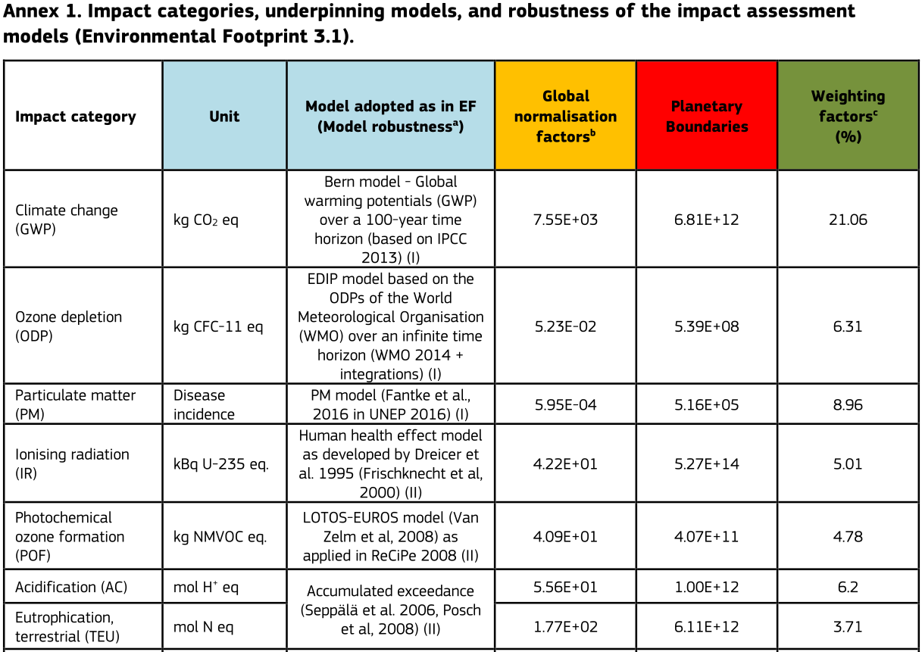
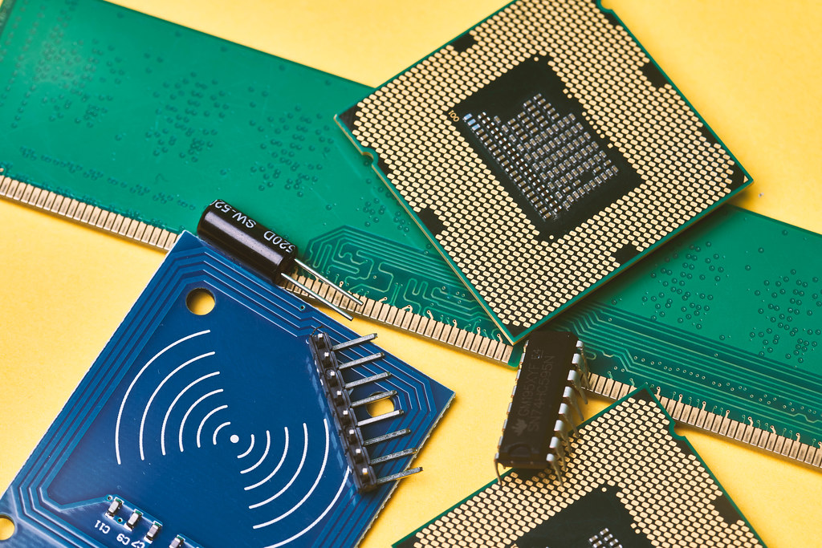
Impact categories
6.8Gt CO2e/y
CC BY European Union 2023
https://eplca.jrc.ec.europa.eu/uploads/JRC128571_S4P_ConsumptionFootprint.pdf
Notes:
Global normalisation factors = diviser le résultat de l’impact permet de les comparer entre eux avec une unité commune.
Weighting factors = importance de l’impact par rapport aux autres. Impact à traiter en priorité (considération subjective, selon les pays).
GWP planetary boundary 6,81 Gt CO2e (valeur absolue annuelle)

Slide 63
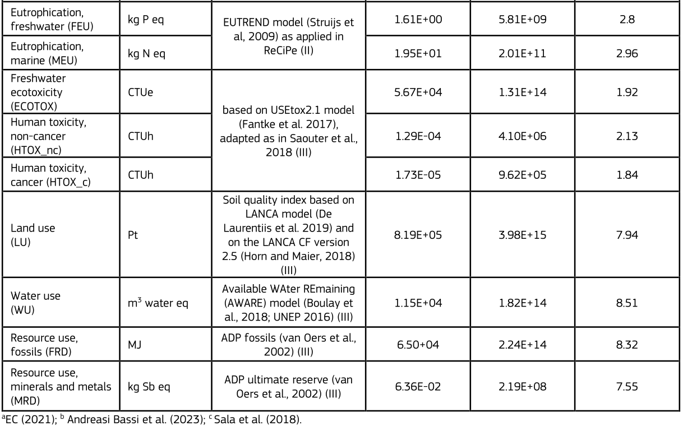
Impact categories
CC BY European Union 2023
https://eplca.jrc.ec.europa.eu/uploads/JRC128571_S4P_ConsumptionFootprint.pdf

Slide 64
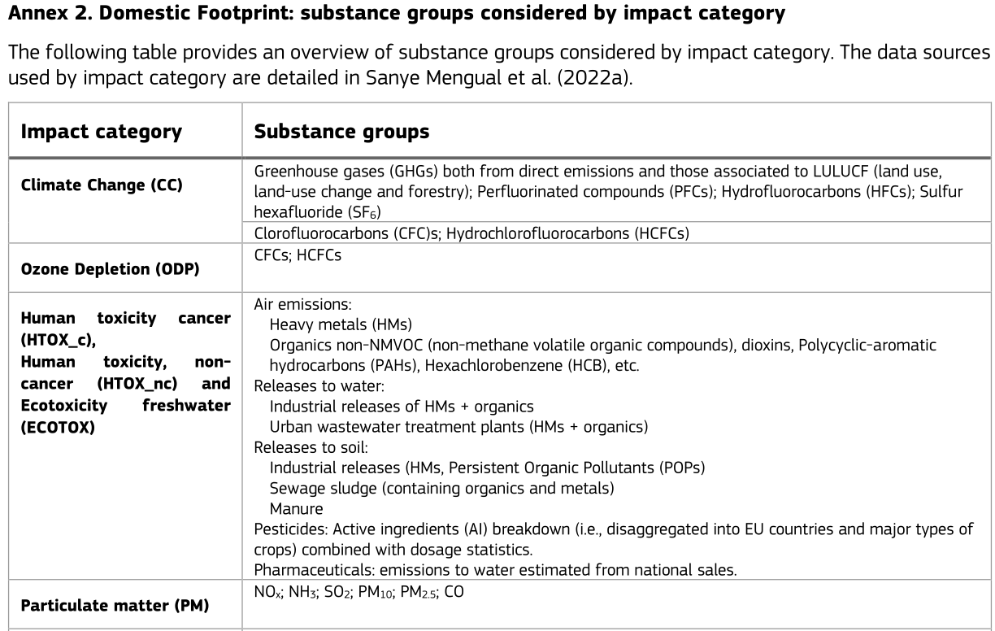
Impact categories
https://eplca.jrc.ec.europa.eu/uploads/JRC128571_S4P_ConsumptionFootprint.pdf

Slide 65
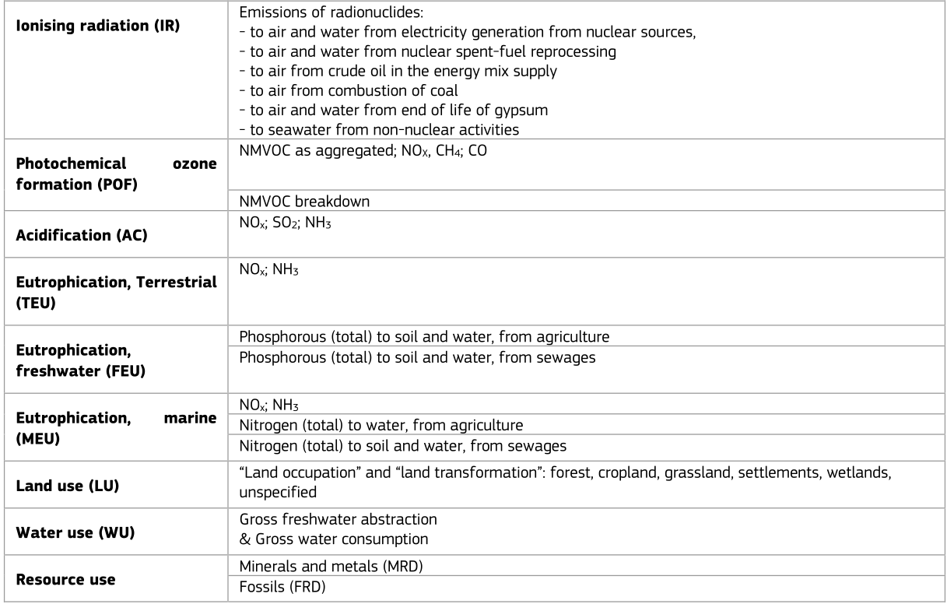
Impact categories
https://eplca.jrc.ec.europa.eu/uploads/JRC128571_S4P_ConsumptionFootprint.pdf

Slide 66
Interpretation
Life cycle assessment framework
Goal and scope definition
Interpretation
Direct applications:
Product development and improvement
Strategic planning
Public policy making
Marketing
Other
1
Inventory analysis
2
Impact assessment
3
4
ISO 14040

Slide 67
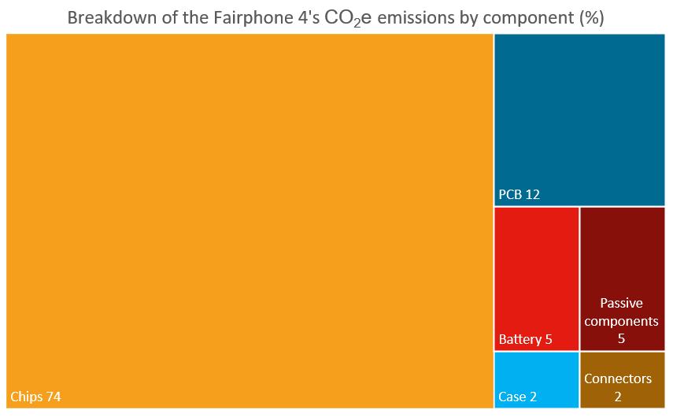
Interpretation : attributional LCA

Slide 68

Interpretation : consequential LCA
Smartphone
1
Phone
1
impacts
impacts
Water use
Water use
Climate change
Raw materials
Climate change
Raw materials

Slide 69
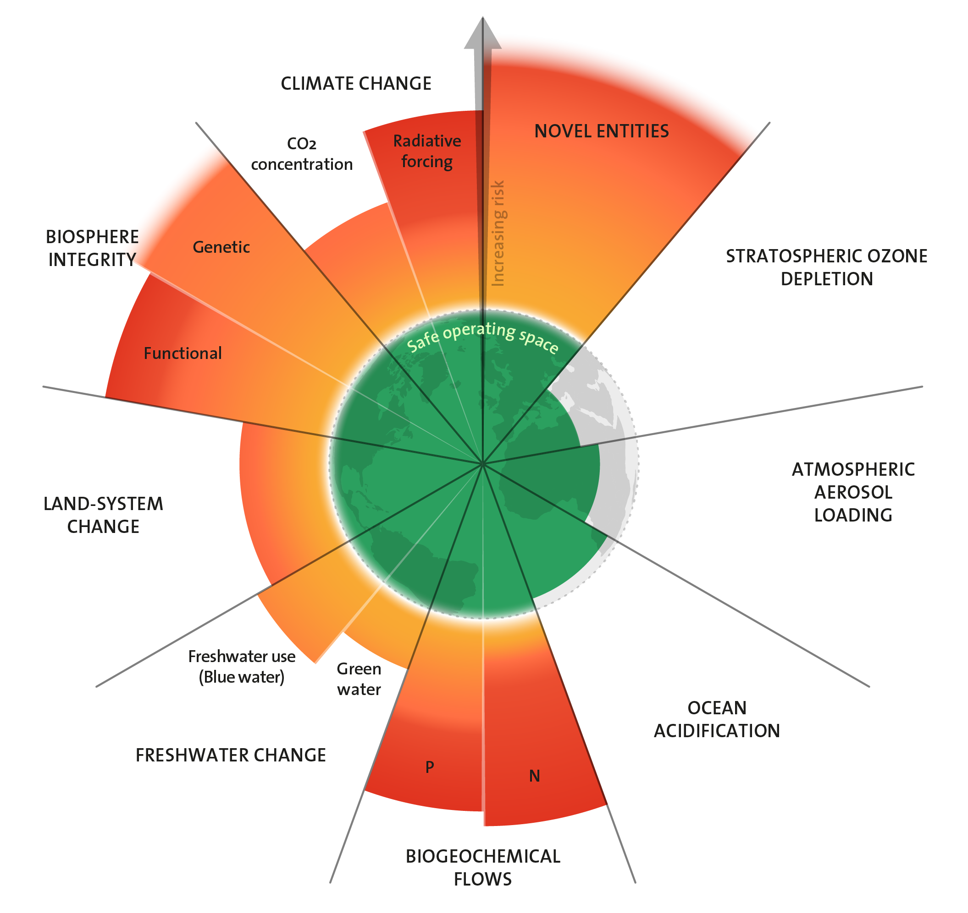
Nine planetary boundaries
Climate change (CO₂) concentration
  2015 Paris Agreement 1,5°C
High risk
450 ppm (~2°C)
CO₂ concentration (ppm)
Increasing risk
Current 417 ppm
350 ppm (~1°C)
Safe
280 ppm
Preindustrial
Richardson, K., Steffen, W., Lucht, W., Bendtsen, J., Cornell, S.E., Donges, J.F., Drüke, M., Fetzer, I., Bala, G., von Bloh, W., Feulner, G., Fiedler, S., Gerten, D., Gleeson, T., Hofmann, M., Huiskamp, W., Kummu, M., Mohan, C., Nogués-Bravo, D., Petri, S., Porkka, M., Rahmstorf, S., Schaphoff, S., Thonicke, K., Tobian, A., Virkki, V., Weber, L. & Rockström, J. 2023. Earth beyond six of nine planetary boundaries. Science Advances 9, 37. 10.1126/sciadv.adh2458
Notes:
Faire deviner les valeurs ppm aux étudiants.
Cycle azote et phosphore -> engrais
L’eau « bleue » est celle qui transite rapidement dans les cours d’eau, les lacs, les nappes phréatiques… vers la mer. Elle représente environ 40% de la masse totale des précipitations, souvent appelées « précipitations efficaces ». Par opposition à des précipitations non-efficaces ? Cette sémantique démontre de l’intérêt pour ce qu’on voit directement, au détriment de ce qui se révèle pourtant le plus important : les 60% du reste des précipitations, qui alimentent « l’eau verte ».
L’eau « verte » est cette eau qui est stockée dans le sol et la biomasse. Elle peut être évaporée par les sols, ou absorbée puis évapotranspirée par les plantes. En termes de flux d’eau douce, c’est l’eau la plus importante. On sait de fait que les plantes gèrent elles-mêmes le cycle de l’eau.

Slide 70
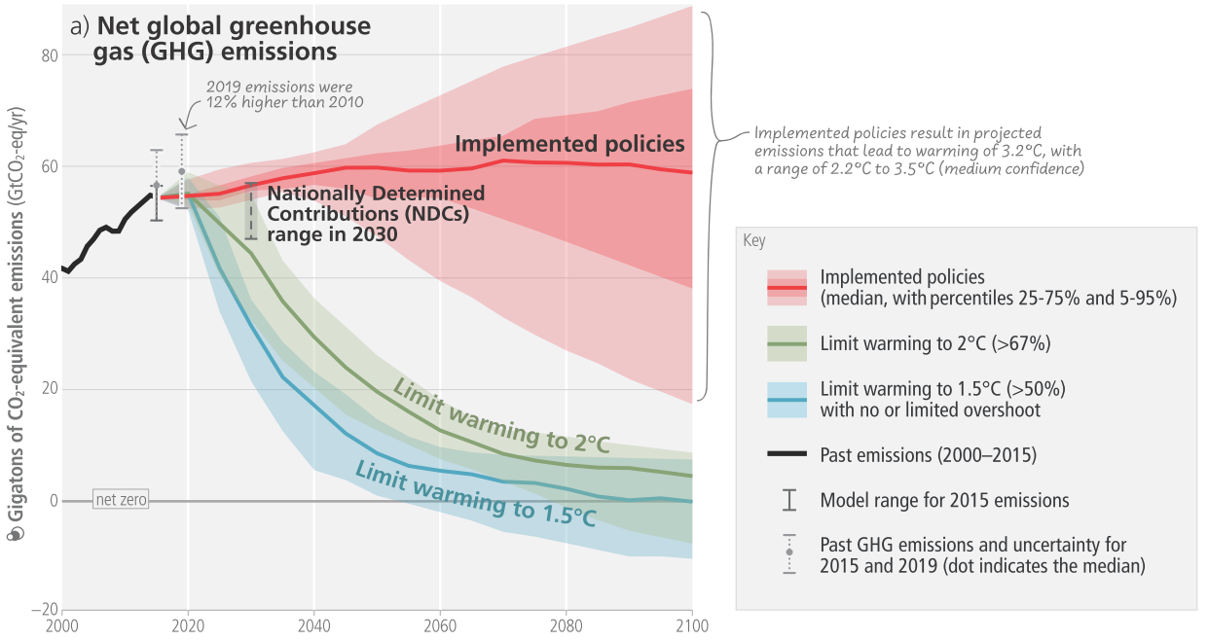
Global warming forecast
IPCC (en) = GIEC (fr)
IPCC, 2023: Summary for Policymakers. In: Climate Change 2023: Synthesis Report. Contribution of Working Groups I, II and III to
the Sixth Assessment Report of the Intergovernmental Panel on Climate Change [Core Writing Team, H. Lee and J. Romero (eds.)].
IPCC, Geneva, Switzerland, pp. 1-34, doi: 10.59327/IPCC/AR6-9789291691647.001

Slide 71
Agenda
LCA limits

Slide 72






LCA limits
H
Electric car
Gasoline car
Hydrogen car
Notes:
Suite à une LCA, on pourrait dire que l’hydrogène est une solution technique.

Slide 73


LCA limits
H
Electric car
Gasoline car
Hydrogen car
H
Kerosene plane
Hydrogen plane
Notes:
Seulement on ne peut pas l’appliquer à l’ensemble du parc, notamment en aviation.
LCA = mesure, pas une solution.

Slide 74
Rebound effect
impacts
impacts
Gasoline car
Electric car
Use
Use
Production
Production
Notes:
Paradoxe de Jevons, livre de 1865, sur la question du charbon.

Slide 75
Thanks

