Slide 1
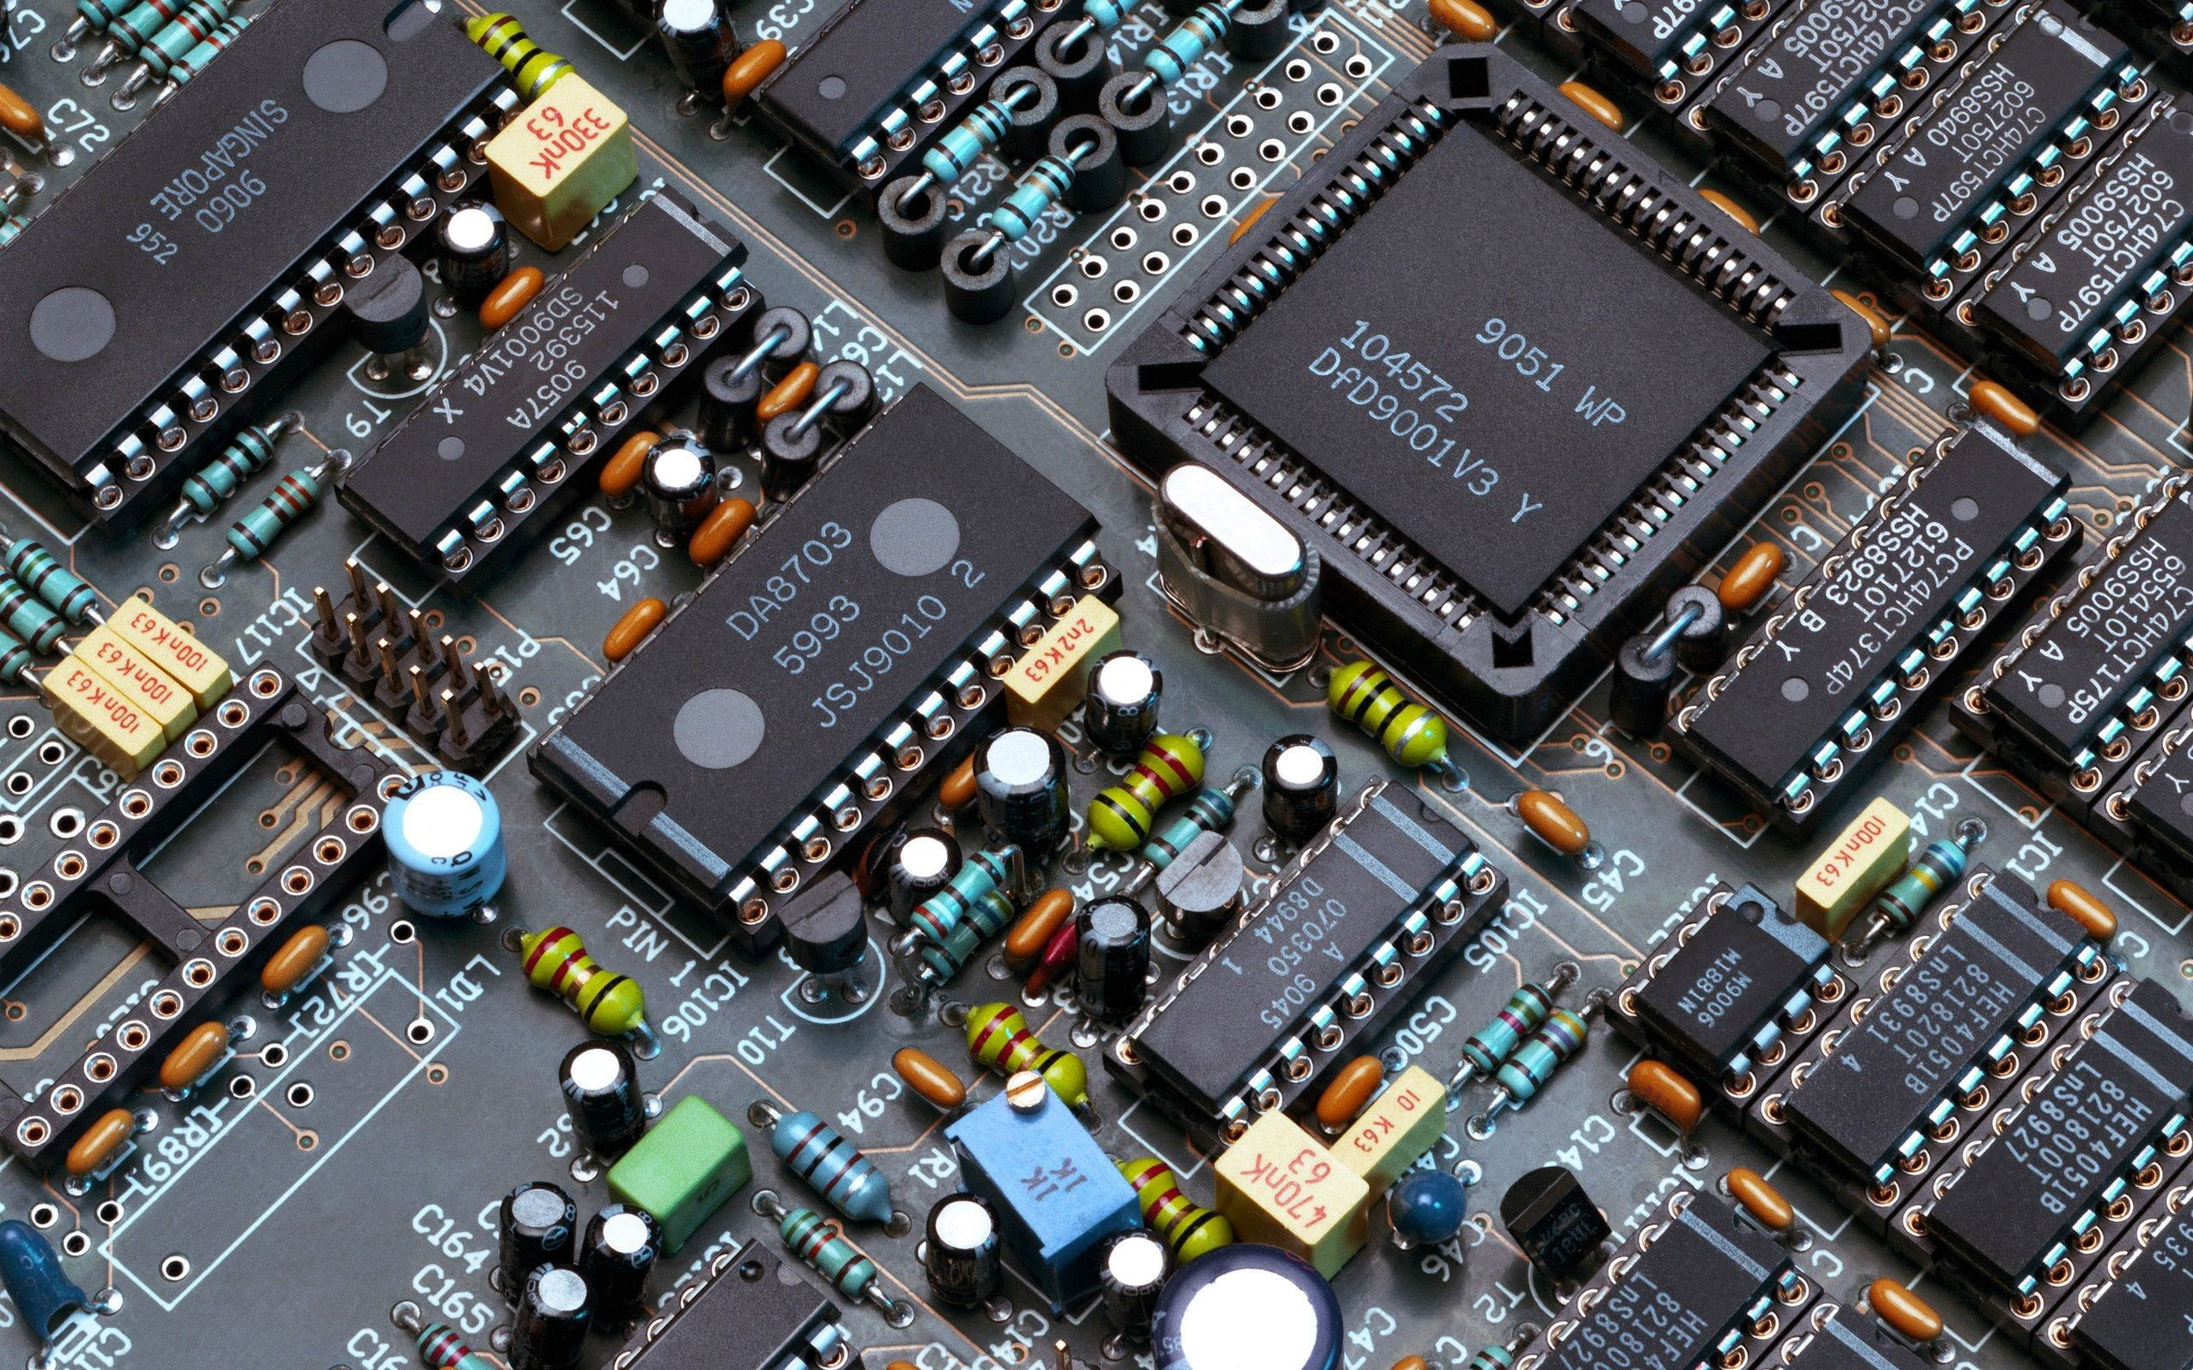
Life Cycle Analysis in Electronics
2025

Slide 2

Agenda
Course 3 – Life Cycle Analysis in electronics
Regulations and Challenges

Slide 3

Sustainability
A society may in many ways compromise its ability to meet the essential needs of its people in the future - by overexploiting resources, for example. The direction of technological developments may solve some immediate problems but lead to even greater ones.
Brundtland, G. H. (1987). Our common future—Call for action. Environmental conservation, 14(4), 291-294.

Slide 4
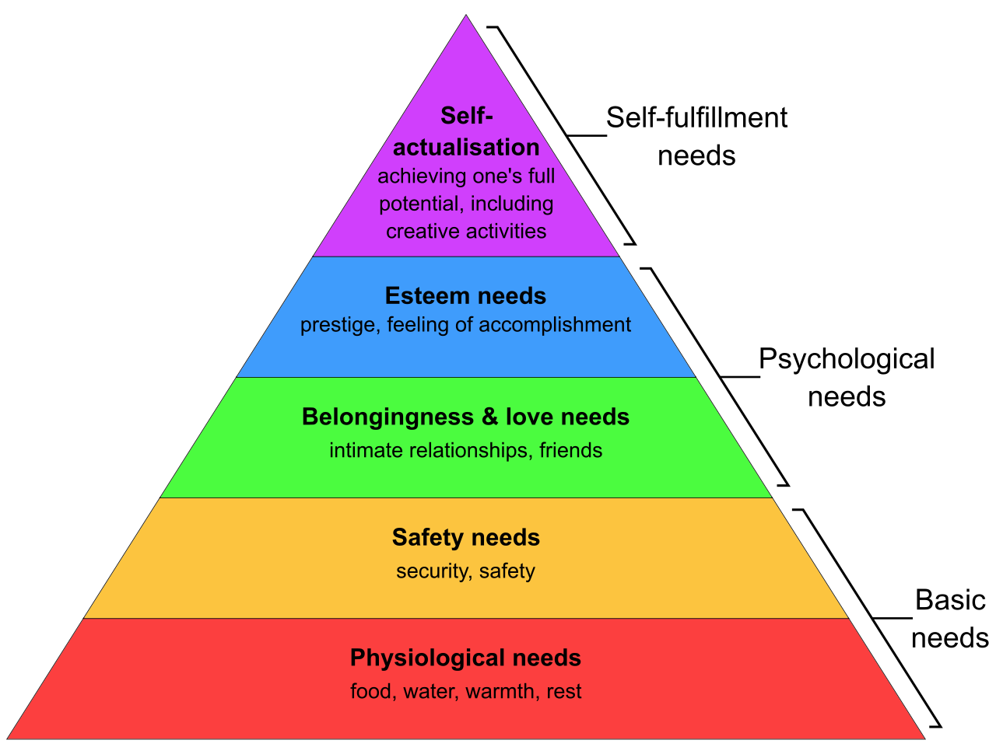
What is sustainable electronics?
Sustainable electronics is electronics that
  meets the needs of present generations without compromising the ability of future generations to meet their own needs.
  Brundtland report – “Our Common Future”, the United Nations, 1987
3 pilars
  Environmental
  Social
  Economic
Maslow’s pyramid
Notes:
What are the needs of current generation?
How do we compromise the needs of future generations?

Slide 5
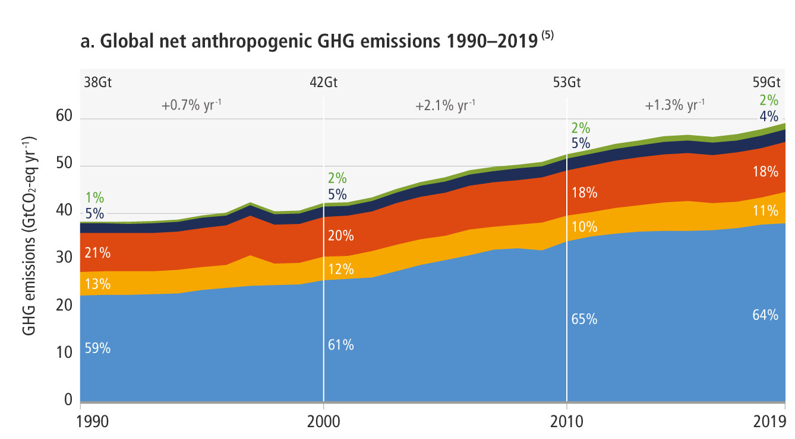
Human carbon impact
Human GHG emissions reach 60Gt/year
To respect the 1.5°C scenario of the Paris Agreement, emissions must reach 8Gt/year by 2050, i.e. a reduction of ~7× by 2050
-7%/year
8Gt

Slide 6
Human carbon impact per sector (in France)
Suivi de la Stratégie Nationale Bas-Carbone
Indicateurs de résultats
Ministère de la Transition Ecologique, 2021

Slide 7


Two strategies to distribute efforts
1
2

Slide 8
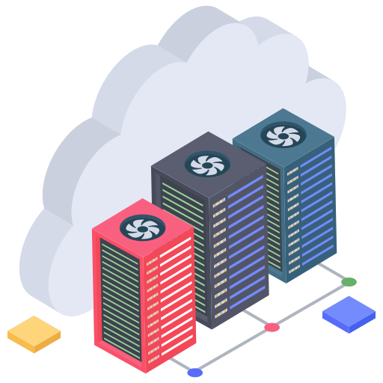






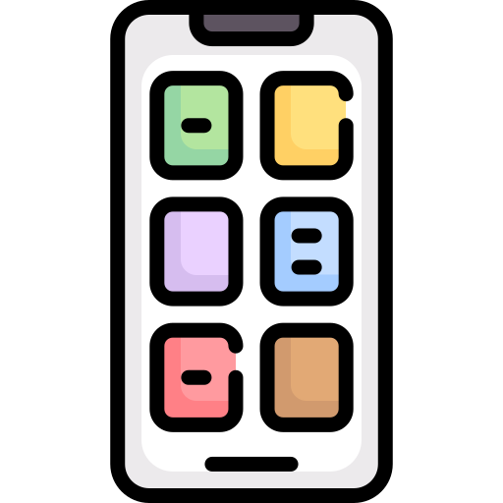









Cloud
Core cloud /
network
Fog resources /
edge network
Edge devices /
data sources
Services
Data storage
and backup
Data
manipulation
Social
Media
Mobility
Entertainment
E-commerce
Education
Management
Credits:
Iconjam, freepik, srip, monkik,
The Chohans Brand, vectorspoint, mynamepong
IconBandaar, Futuer, vectorsmarket15, Muhammad Atif,
Dendrogram

Slide 9
Cloud
Core cloud /
network
Fog resources /
edge network
Edge devices /
data sources
Services
Data storage
and backup
Data
manipulation
Social
Media
Mobility
Entertainment
E-commerce
Education
Management
Credits:
Iconjam, freepik, srip, monkik,
The Chohans Brand, vectorspoint, mynamepong
IconBandaar, Futuer, vectorsmarket15, Muhammad Atif,
Dendrogram

Slide 10
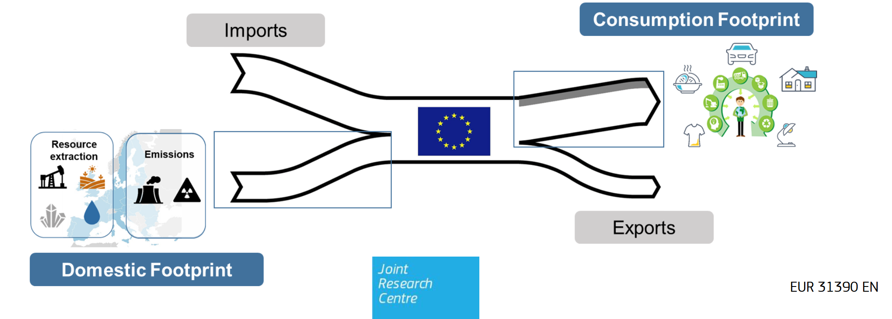
Human carbon impact (in France)
CO₂e is a global metric for global warming impact
  other greenhouse gases (GHG) are converted in equivalent CO₂
  One can distinguish (French numbers)
    inventaire national (domestic footprint): ~6.4t/person (in 2018) : quantities of greenhouse gases (GHG) produced on the French territory
    Carbon footprint (consumption footprint): 11.2t/ person (in 2018) : domestic consumption of goods and services, both domestically produced and imported

Slide 11
Carbon accounting
Greenhouse Gas Protocol and ISO 14064 (Organisation emissions)
  Employing an accounting method for carbon emission tracking (in tons of CO₂ equivalent) to avoid double counting
  Scope 1: GHG direct emissions from activity
  Scope 2: GHG emissions from energy consumption
    Location-based: reflects the average emissions intensity of grids on which energy consumption occurs
    Market-based: taking into account, derives emission factors from contractual instruments (e.g. REC)
      renewable energy certificates (RECs)
  Scope 3: Indirect emissions from value chain (up and downstream)

Slide 12








Semiconductors and GHG emissions
Scope 3 upstream emissions
  Mining materials
  Smelting
  Refining
    High temperature processes for wafer production: reducing silicon from SiO2, purifying silicon, building single crystal silicon ingots
Scope 3 downstream emissions
  Transporting products
  Using products
  End-of-life
Impacts of electronics are increasingly well understood
Client
Greenhouse Gas Protocol, World Resources Institute, Revised edition, 2015
Notes:
Ultrapure water, ultrapure silicium, coper, aluminum…

Slide 13



Supply chain (in general)
…
Industry employs a supply chain pyramid with Tiers
OEM: Original Equipment Manufacturer
TIER 1: Module or system supplier
TIER 2: Component supplier
TIER 3: Sub-component supplier
TIER N: Natural resource supplier
Flaticons: Mehwish, Freepik

Slide 14
The electronics industry supply chain
…
Industry employs a supply chain pyramid with Tiers
OEM: Original Equipment Manufacturer
TIER 1: PCBA supplier
TIER 2: Integrated circuit supplier
TIER 3: wafer supplier
TIER N: Minerals supplier
Flaticons: Surang, Kerismaker, Freepik, smashicons

Slide 15
Electronic devices
Electrical equipment
Electronic equipment
From another energy to electrical energy
Communication / Networking
Applications
Libraries
Sensors
Operating System
Computing
Actuators
Drivers
Hardware Interface
From electrical energy to another energy
Storage
Power Management

Slide 16
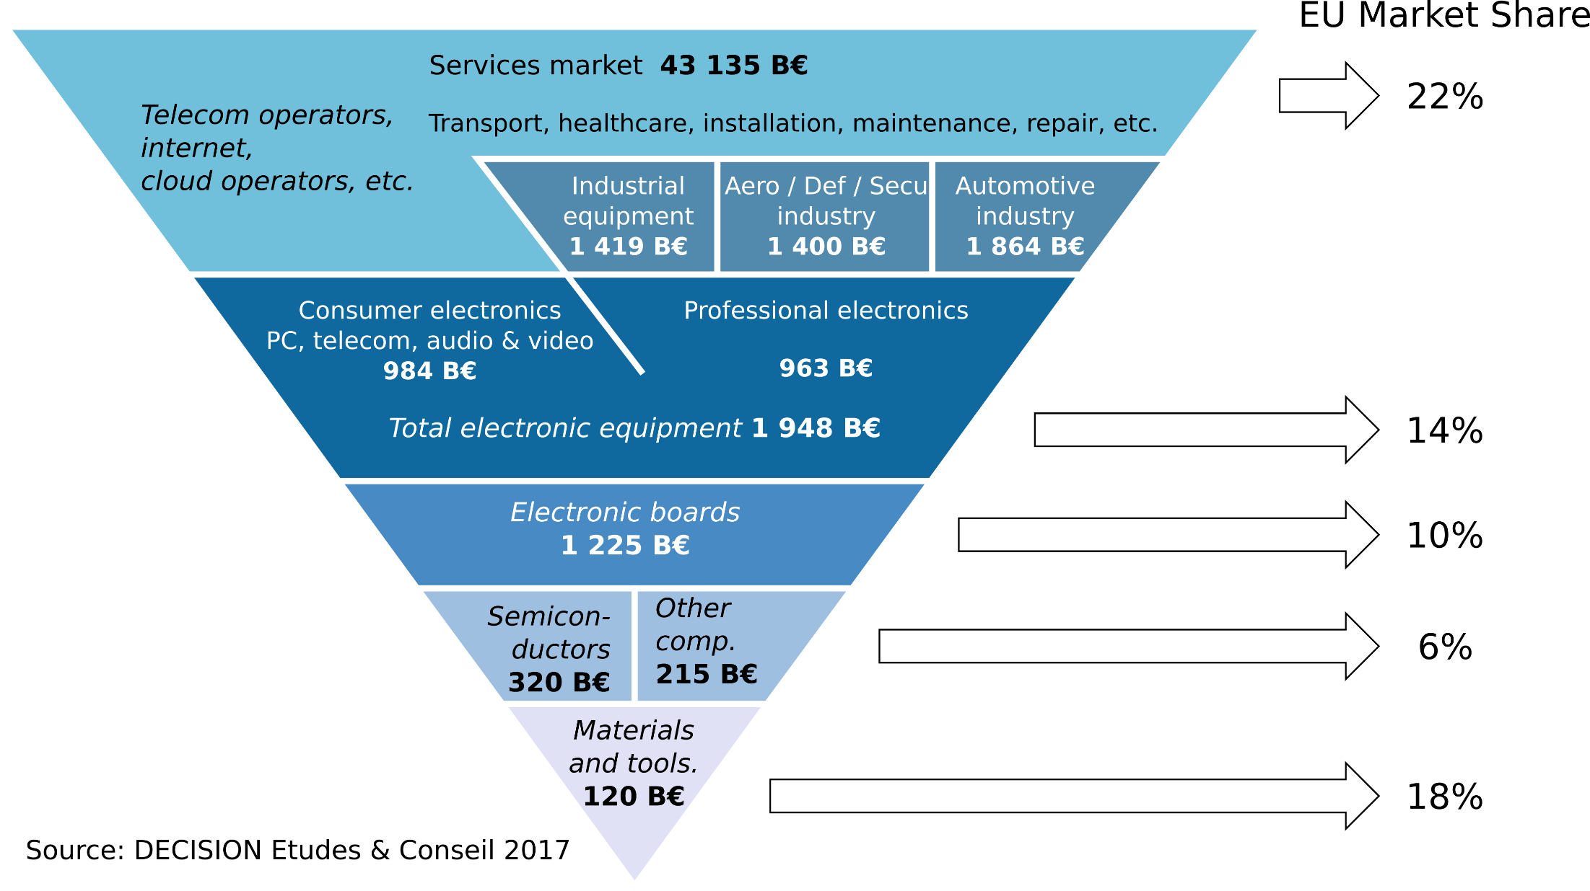
Electronics market and Europe (in 2017)
Now 600+ B€
Notes:
Semiconductor: 600B today, 1T in 2030

Slide 17
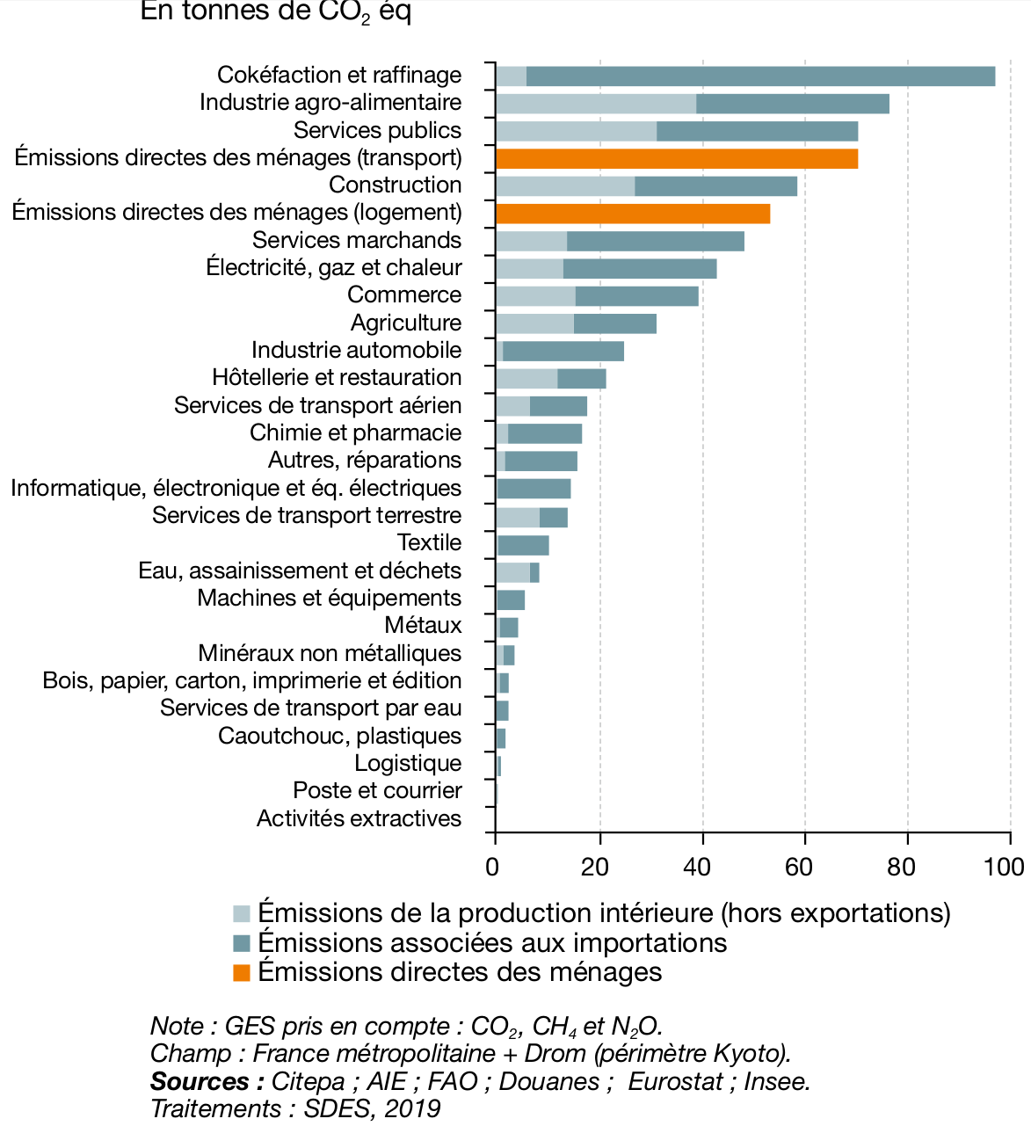
The case of global warming
All human activities produce CO2
Total: 749 Mt CO₂
in 2018
Mt CO₂ / year in France

Slide 18
The case of global warming
All human activities produce CO2
Total: 749 Mt CO₂
in 2018
Electronics is here
Mt CO₂ / year in France

Slide 19
The case of global warming
All human activities produce CO2
Total: 749 Mt CO₂
in 2018
Electronics is here
but not only
Mt CO₂ / year in France

Slide 20
Agenda
Laws and Labels

Slide 21
Goal & Disclaimer
Goal : overview of current Sustainable Products and Green IT legislations
Disclaimer: “IANAL” = I am not a lawyer

Slide 22
EU Terms
Regulation = legislative act directly applicable in EU member states
  Does not require national implementing measures
  Enhance uniformity of law across all member states
  Example: GDPR (General Data Protection Regulation)
Directive = legislative act that sets the objectives/results that members must achieve
  Not directly applicable
  Members must transpose it into their national legal system before a deadline
  More flexible, adaptable to national context
  Example: EU single-use plastics directive
https://european-union.europa.eu/institutions-law-budget/law/types-legislation_en

Slide 23
Product vs Product
Product in the sense of a new product line
  Life cycle: Development / Introduction / Maturity / Last order / Deprecation
Product in the sense of an object
  Life cycle: Manufacturing / Usage / Dispose
Current laws implements a object-based approach
Main limit: local optimization only

Slide 24
Overview of a product life cycle
Impact
1
Optimize manufacture
5
2
Increase energy efficiency
3
Increase reliability
4
2
4
Improve reparability
1
5
EOL management
Time
3
6
Delay obsolescence
6
Inspired by : Écoconception en électronique de puissance. Impacts du dimensionnement, de la modularité et de la diagnosticabilité, Briac Baudais, 2024

Slide 25
French laws

Slide 26
REEN law
REEN Law, 2022 (Réduction de l’Empreinte Environnementale du Numérique)
  Loi n°2021-1485 promulguée le 15 novembre 2021 ainsi que son décret d'application du 29 juillet 2022
    integration of sustainability in education (education code)
    Digital eco-design framework: e.g. extend lifespan of terminals, encourage reuse, limit the use of infinite scrolling, increase transparency
    Corporate Social Responsibility (CSR / RSE): encourages reporting
  Target: local authorities, large companies & public sector
Notes:
Framework: Arcep, Arcom, Ademe

Slide 27
WEEE
WEEE (Waste from Electrical and Electronic Equipment)
  = DEEE in France (déchets d'équipements électriques et électroniques)
  A waste management chain
In France
  Directive 2002/96/CE du 27 janvier 2003 relative aux déchets d’équipements électriques et électroniques.
  directive 2012/19/UE du 4 juillet 2012 (dite directive DEEE II).
  directive 2002/95/CE du 27 janvier 2003 relative aux substances dangereuses contenues dans ces équipements (dite directive RoHS)
  directive 2011/65/UE du 8 juin 2011 (dite directive RoHS II)
  Setting up a principle of producer responsibility (REP)
Video on e-waste management

Slide 28
Vigilance Law
Vigilance Law, 2017
  Loi n° 2017-399 relative au devoir de vigilance des sociétés mères et des entreprises donneuses d'ordre
    companies with more than 5,000 employees in France, or more than 10,000 employees worldwide must build, disclose, and implement a vigilance plan
    The vigilance plan must identify risks and prevent human rights violations and environmental damage
      resulting from the operations of the company
      resulting from the operations of its subcontractors.
Savourey, E., & Brabant, S. (2021). The French law on the duty of vigilance:
Theoretical and practical challenges since its adoption.
Business and Human Rights Journal, 6(1), 141-152.
Notes:
Effondrement d’un Immeuble Bangladesh qui a tué >1000 personnes travaillant pour des sous-traitants de marques de fringues occidentales
La France est le premier pays a faire une loi.

Slide 29
Loi AGEC
AGEC Law, 2020 (Loi anti-gaspillage pour une économie circulaire)
  Loi n° 2020-105 du 10 février 2020 / Anti-Waste Law for a Circular Economy
    move away from disposable plastic ;
    better inform consumers (reparability index);
    combat waste and promote solidarity-based re-use;
    act against programmed obsolescence;
    environmentally responsible production
  This regulatory framework is supplemented by decrees concerning:
    the procedure for registering and declaring EEEs in the national register
    the methods for processing WEEE
    the distinction between household and professional EEEs
    the contract between waste management operators and eco-organizations or the producer who has set up an individual system

Slide 30
European Union laws

Slide 31
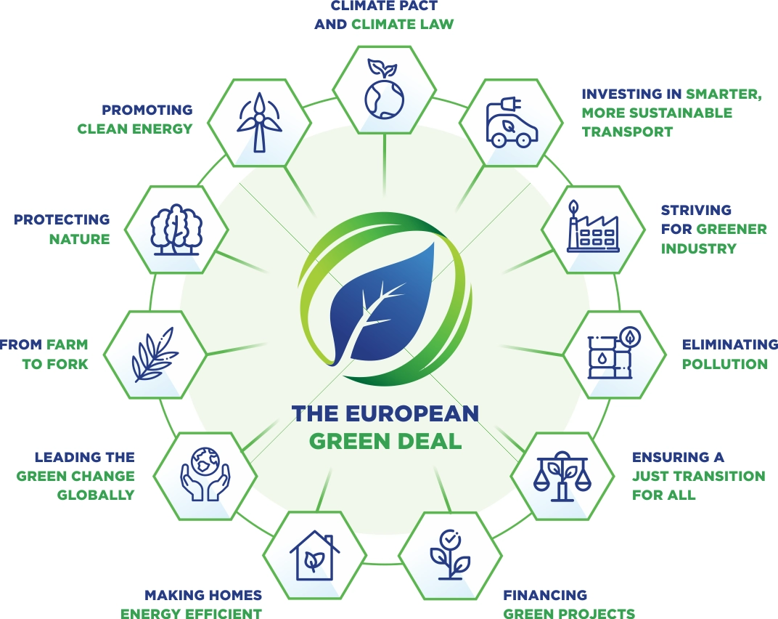
European Green Deal
European Green Deal, 2019
Strategy to achieve a climate-neutral, sustainable, and competitive economy by 2050
> 175 directives & regulations

Slide 32
ROHS directive
Restriction of Hazardous Substances in EEEs
  Purpose: prevent hazardous substances, ensure safer disposal of WEEE
  2002/95/CE: 6 materials
    Lead (Pb)
    Mercury (Hg)
    Cadmium (Cd)
    Hexavalent chromium (Cr6+)
    Polybrominated biphenyls (PBB)
    Polybrominated diphenyl ether (PBDE)
  2011/65/UE: + 4 materials
    Bis(2-ethylhexyl) phthalate (DEHP)
    Butyl benzyl phthalate (BBP)
    Dibutyl phthalate (DBP)
    Diisobutyl phthalate (DIBP)
  2017/2102/UE: extending application, address second market operations

Slide 33
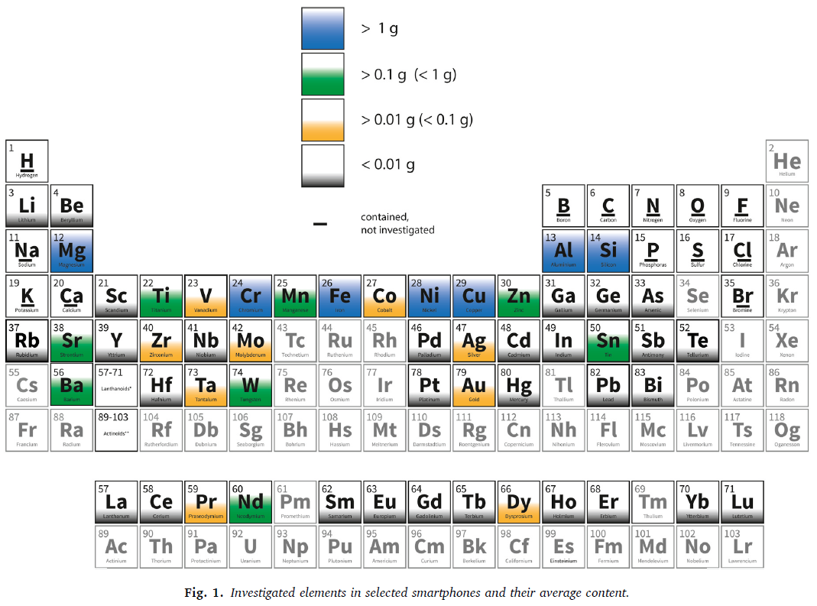
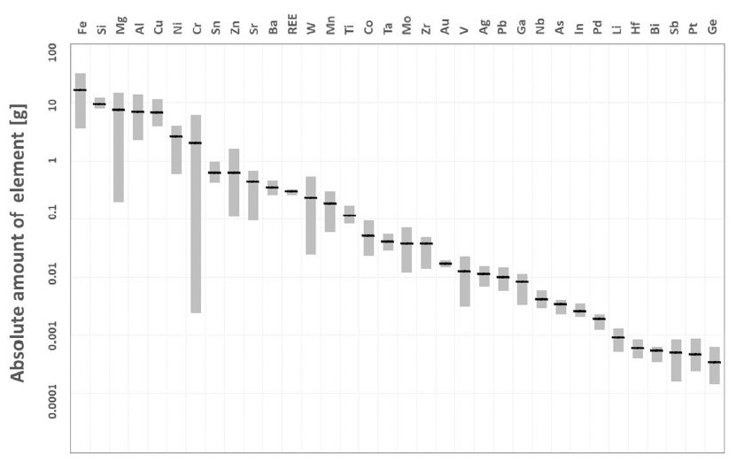
Electronics and Toxicity
Bookhagen, B., Bastian, D., Buchholz, P., Faulstich, M., Opper, C., Irrgeher, J., ... & Koeberl, C. (2020). Metallic resources in smartphones. Resources Policy, 68, 101750.
A smartphone contains 53 metals.
with Au, Pd, Pt, and Cu, 82% of the metal value is recycled (6% of device weight), if the device is collected.
Recycling from smartphones at EOL is not economically feasible for e.g Co (disregarding batteries), Ga, Ge, In, Ta, and the rare earth elements.
Notes:
What is not recycled ends up in combustion ashes or wastewater sludge.

Slide 34
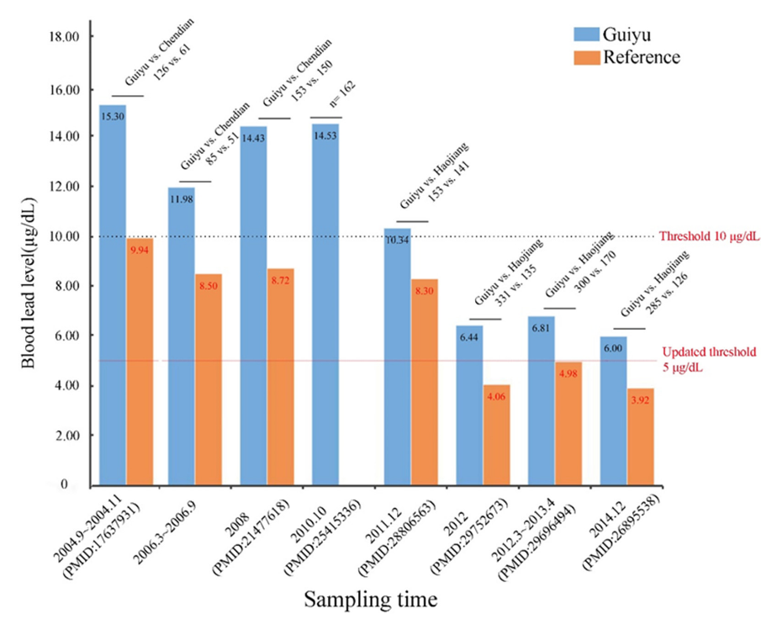
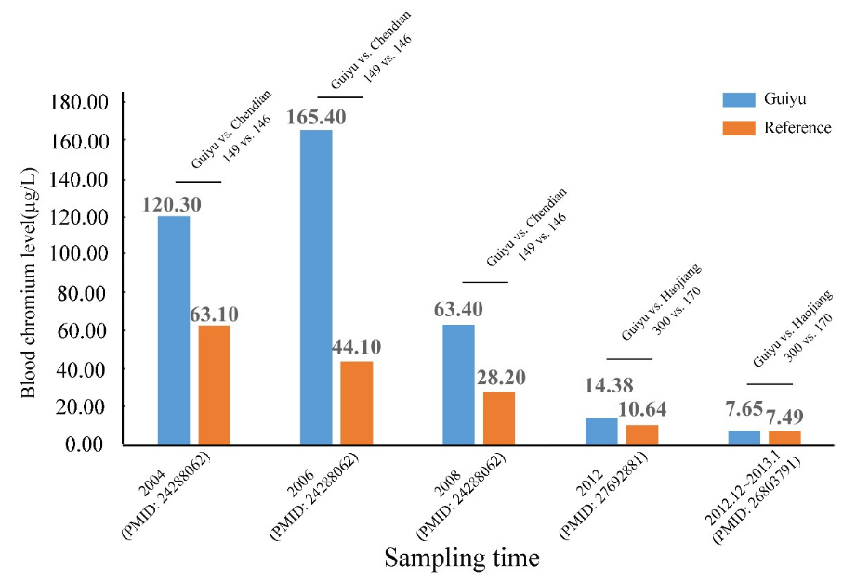
The Example of Guiyu City
E-waste Recycling Town
Huang, Wenlong, Xiaoling Shi, and Kusheng Wu. "Human body burden of heavy metals and health consequences of Pb exposure in Guiyu, an E-waste recycling town in China." International Journal of Environmental Research and Public Health 18.23 (2021): 12428.
The level of chromium and lead in people’s blood is higher than in a reference Chinese population

Slide 35
CSRD
European Corporate Sustainability Reporting Directive (CSRD)
  EU directive, 1er Janvier 2024
  Target: companies of all sizes, with phased implementations
  Expands and strengthens requirements for sustainability reporting + standardize
  Double materiality: how sustainability affect their business and vice-versa
  Mandatory auditing: information must be independently audited
  Integration with Financial Reporting

Slide 36
REACH
Regulation (EC) 1907/2006 of the Registration, Evaluation, Authorisation and Restriction of Chemicals
  Objective: ensure protection for human health & environment from chemicals
  Shifts the responsibility from chemical safety from authorities to the industry
  Electronic manufacturers must register chemicals they produce/import/use.
  Ensure chemicals are used safely and identify substances that may require further scrutiny
  Substances of very high concern (carcinogenic, toxic) require autorisation
  Some substances may be restricted
https://echa.europa.eu

Slide 37
WEEE directive
WEEE Directive 2012/19/EU
  Goal: protect the environment and human health by reducing WEEE sent to landfill
  Producer are responsible for financing collection, treatment, recycling & disposal.
  Collection: achieve >65% of average weight
  Recovery: increase to 75-86% of collected WEEE
  Control of transboundary movements
  Treatment: minimum requirements for removal of substances and components

Slide 38
Ecodesign directive
Ecodesign Directive 2009/125/EC
  Framework for setting mandatory ecodesign requirements for energy-related products
  Goal: improve environmental performance throughout their entire life cycle
Replaced by Regulation (EU) 2024/1781 - Ecodesign for Sustainable Products Regulation (ESPR)
  Framework to improve circularity, energy performance & sustainability of products
  No limited to energy-related products: textile, furniture, tyres, paint, electronics, etc.
  Alignment with European Green Deal
  Introduce Digital Product Passport (DPP)
  Producers bear the full cost of waste management

Slide 39
Digital Product Passport (DPP)
Digital Product Passport (DPP)
  Digital record providing structured information about a product & its entire value chain
  From material extraction to end-of-life management
  Increase transparency, sustainability and circularity by making data accessible
  Include information on composition, environmental impact, how to repair, recycle, dispose

Slide 40
Regulation (EU) 2023/1670
Regulation (EU) 2023/1670
  Applies from 20 juin 2025!
  Mandatory ecodesign requirements for smartphones (and dumb phones) & tablets
  Pursuant to Ecodesign Directive 2009/125/EC
  Software update for at least 5 years after end of sale
  Battery: 800 cycles before reaching 80% of initial capacity
  Spare parts available 7 years after end of sales
  Increase resistance, no performance manipulation, etc.
  Simplify repair
Notes:
Pursuant = conformément

Slide 41
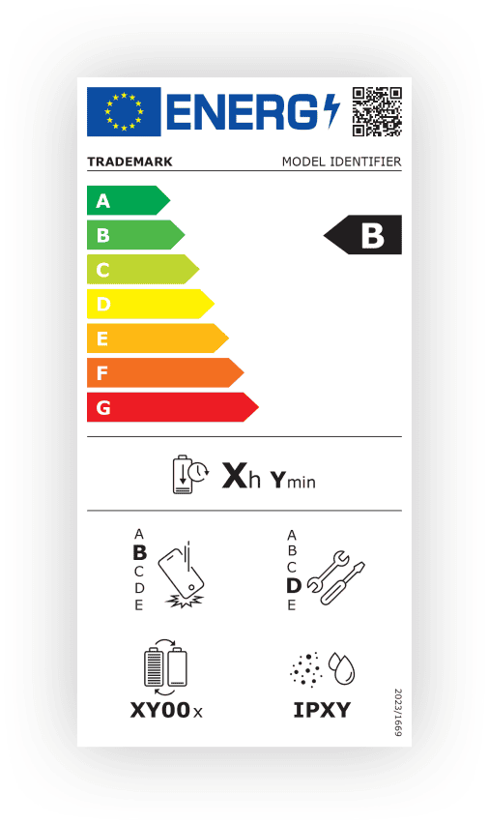
Regulation (EU) 2023/1669
Regulation (EU) 2023/1669
  Energy labelling of phones & tablets
  Energy efficiency is not enough!
  + battery endurance
  + repairability
  + drop resistance
  + IP rating
Expected savings: 20B€ by 2030
  3%: electricity
  97%: longer lifespan
Notes:
Pursuant = conformément

Slide 42
Ecolabels
Ecolabels
EnergyStar : very strong energy constraints on EEEs
Electronic Product Environmental Assessment Tool (EPEAT)
  reduction/elimination of hazardous substances
  choice of environmentally-friendly components
  taking into account the end-of-life of equipment right from the design stage
  equipment durability
  energy saving
  recycling
  packaging...

Slide 43
Agenda
Best Practices & State-of-the-Art – Electronics Eco-design

Slide 44
Research and engineering needed
Life cycle analysis of products and services
Circular Economy - 3R: Repair, Reuse, Recycle
  and Reduce, Refurbish…
Better energy management and reliability
New technologies, processes and materials with low footprint
  PCB, IC, other components
Delayed obsolescence of hardware and software stack

Slide 45
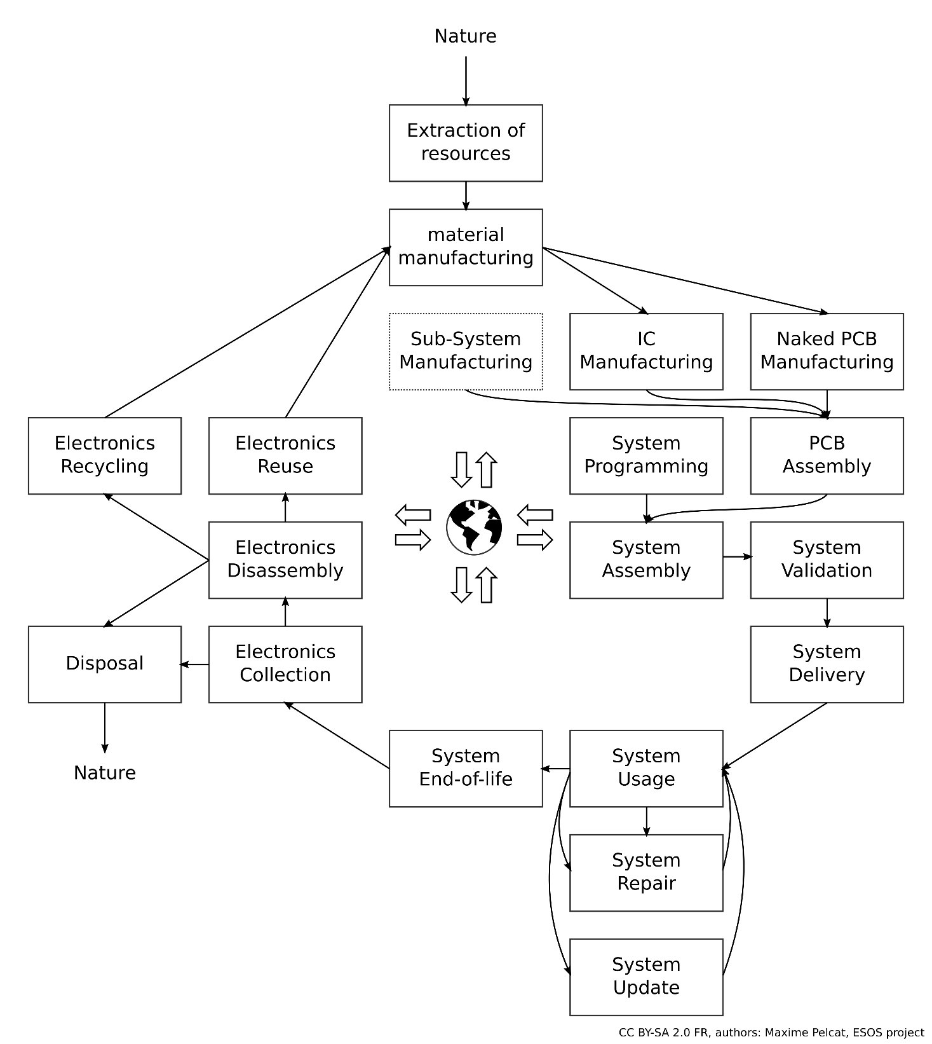
Repair, reuse, recycle

Slide 46
3R
Making a system more reparable may require more connectors
  That themselves require abiotic resources
Recycling will increase the impact of end-of-life (!)
  And sustainability improvements need to be evaluated reliably
Shorter cycles have lower cost
But they do have a cost

Slide 47
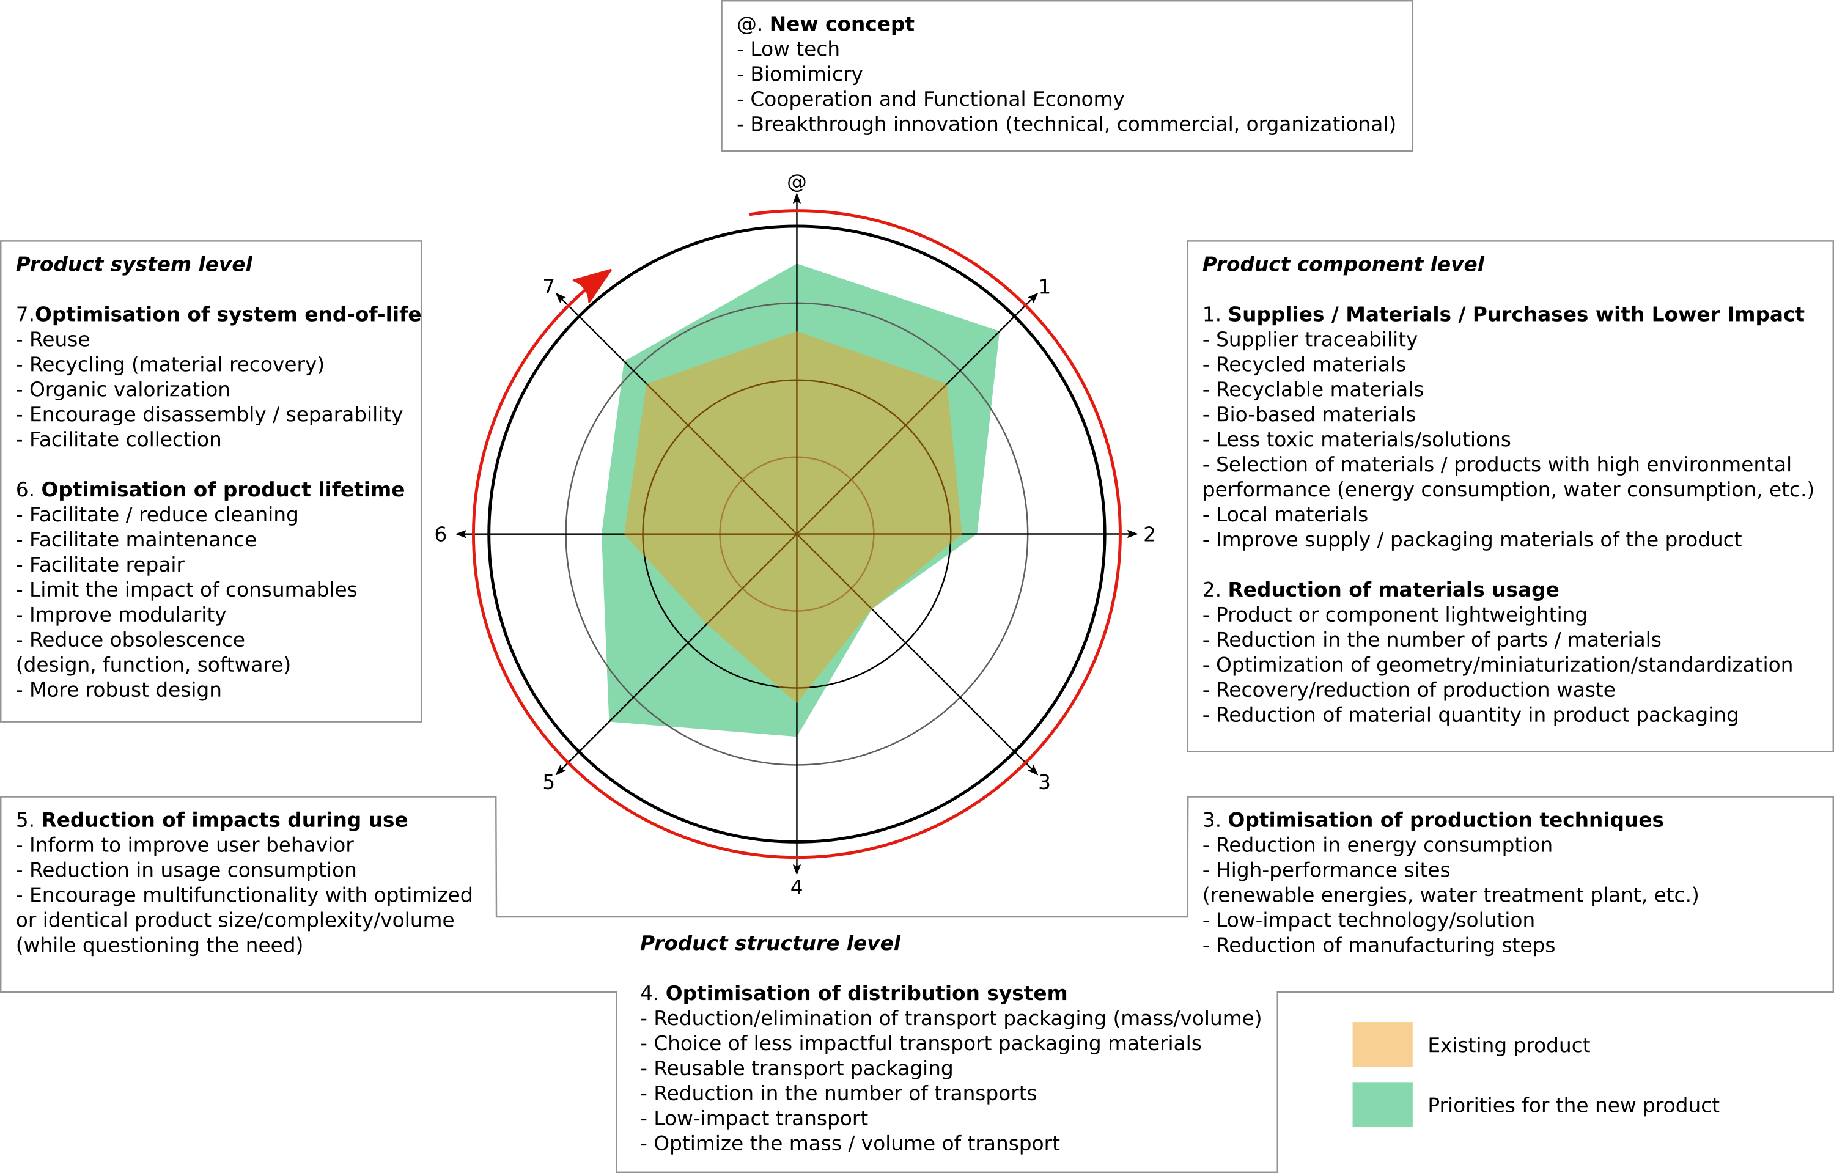
Ecodesign Brezet-van Hemel Wheel
(ADEME version)
@ New Concepts
Low tech, biomimicry
Cooperation and functional economy
Breathrough innovation (technical, commercial, organizational)
Product system level
7.Optimisation of system end-of-life
Reuse, Recycling (material recovery),
Organic valorization
Encourage disassembly / separability,
Facilitate collection
6. Optimisation of product lifetime
Facilitate / reduce cleaning,
Facilitate maintenance,
Facilitate repair, Limit the impact of consumables,
Improve modularity, Reduce obsolescence
(design, function, software), More robust design
Product component level
1. Supplies / Materials / Purchases with Lower Impact*
Supplier traceability, Recycled materials,
Recyclable materials, Bio-based materials,
Less toxic materials/solutions, Selection of materials,
High environmental performance (energy, water, etc.),
Local materials, Improve supply / packaging materials
2. Reduction of materials usage
Lightweighting, Reduction in the number of parts / materials,
Optimization of geometry/miniaturization/standardization,
Recovery/reduction of production waste,
Reduction of material quantity in product packaging
5. Reduction of impacts during use
Inform to improve user behavior,
Reduction in usage consumption,
Encourage multifunctionality with
optimized or identical product
size/complexity/volume
(while questioning the need)
3. Optimisation of production techniques
Reduction in energy consumption, High-performance sites
(renewable energies, water treatment plant, etc.),
Lower-impact technology/solution,
Reduction of manufacturing steps
Product structure level
4. Optimisation of distribution system
Reduction/elimination of transport packaging (mass/volume),
Choice of less impactful transport packaging materials, Reusable transport packaging,
Reduction in the number of transports, Low-impact transport, Optimize the mass / volume of transport
Notes:
Risk : impact migration

Slide 48
Ecodesign Brezet-van Hemel Wheel
(ADEME version)
@ New Concepts
Low tech, biomimicry
Cooperation and functional economy
Breathrough innovation (technical, commercial, organizational)
Product system level
7.Optimisation of system end-of-life
Reuse, Recycling (material recovery),
Organic valorization
Encourage disassembly / separability,
Facilitate collection
6. Optimisation of product lifetime
Facilitate / reduce cleaning,
Facilitate maintenance,
Facilitate repair, Limit the impact of consumables,
Improve modularity, Reduce obsolescence
(design, function, software), More robust design
Product component level
1. Supplies / Materials / Purchases with Lower Impact*
Supplier traceability, Recycled materials,
Recyclable materials, Bio-based materials,
Less toxic materials/solutions, Selection of materials,
High environmental performance (energy, water, etc.),
Local materials, Improve supply / packaging materials
2. Reduction of materials usage
Lightweighting, Reduction in the number of parts / materials,
Optimization of geometry/miniaturization/standardization,
Recovery/reduction of production waste,
Reduction of material quantity in product packaging
Circular economy
System lifetime extension
5. Reduction of impacts during use
Inform to improve user behavior,
Reduction in usage consumption,
Encourage multifunctionality with
optimized or identical product
size/complexity/volume
(while questioning the need)
3. Optimisation of production techniques
Reduction in energy consumption, High-performance sites
(renewable energies, water treatment plant, etc.),
Low-impact technology/solution,
Reduction of manufacturing steps
Product structure level
4. Optimisation of distribution system
Reduction/elimination of transport packaging (mass/volume),
Choice of less impactful transport packaging materials, Reusable transport packaging,
Reduction in the number of transports, Low-impact transport, Optimize the mass / volume of transport

Slide 49
The ESOS project
Electronics: Sustainable, Open and Sovereign
INSA Rennes, Université de Rennes, ENS Rennes
2023-2028, 6.3M€ funding, 15M€ total cost, funded by France2030
  Sustainable: meeting the needs of the present generation without compromising the ability of future generations to meet their own needs.
  Open: a decentralized development model that publicly distributes the source code for open collaboration and peer production, known as "the open-source method."
  Sovereign: the quality of a state being free and independent, determined solely by its own will within the limits of the higher principle of law, and in accordance with the collective purpose it is called to achieve.

Slide 50
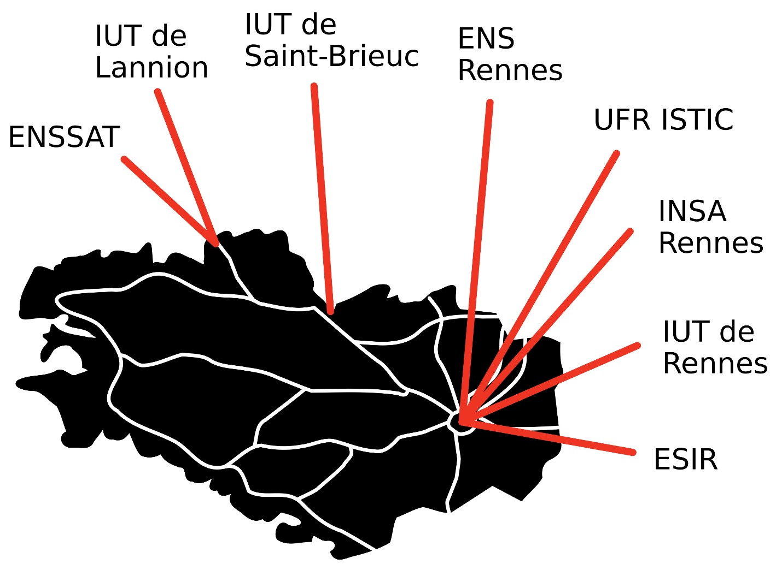
ESOS – 7 actions
Attract pupils to electronics
Train students to ESOS
  Licence, master, doctorate
Train teachers to ESOS
Train professionals to ESOS
  Trainings on eco-design : stay tuned!
Create open teaching material
https://esos.insa-rennes.fr
30+ industrial partners
14 PhD theses
Looking for synergies!

Slide 51


ESOS – 14 PhDs
Low impact sensors and antennas
Systems LCA
@New concepts
Biosourced electronics
1 Novel materials
7 Better end-of-life
Longer lifetime digital systems
6 Better lifetime
Brezet-van Hemel
Wheel
2 Less materials
3 Better production techniques
5 Better use
Energy harvesting
Digital systems ecodesign
4 Better distribution
Low energy electronics

Slide 52
Conclusion: LCA of electronics
Methods and tools for LCA are mature
  Databases for background, and tools for entering inputs flows and computing costs
The main challenges are
  Access to impact data
    Supply chain and industrial secrecy
  Unknowns at the time of LCA
    Location, Materials
LCA must be handled with care
  Never disclose data without assumptions
The state-of-the-art of LCA will evolve fast, with regulations
Notes:
M. Ashby, Cambridge

Slide 53
State-of-the-Art of Electronics Eco-design
Books to go further on LCA
  Mickaël Ashby
  Reinout Heijungs, et. al
  Michael Z. Hauschild, et. al
Conferences to go further on LCA of electronics
  Electronics goes Green, Fraunhofer IZM
  IEEE Sustainable Technologies
  Sustainability sessions in
    Design Automation and Test in Europe Conference 2023-25
    With proceedings : Digital System Design Conference 2024 (DSD 2024)
    With proceedings : Computing Frontiers 2025
    With proceedings : Design Automation and Test in Europe Conference 2026 (DATE 26)
More to be created!

Slide 54
Thanks

