Slide 1
Strategies, Tools and Perspectives for Sustainable Electronics
RAPIDO 2024
Maxime Pelcat, INSA Rennes, Univ Rennes, IETR - UMR CNRS 6164

Slide 2
Scope
What is the electronics market?
What are the sustainability challenges? (focus on environment)
How does electronics affect environment? (focus on climate)
How can we act towards sustainable electronics?

Slide 3
Electronic devices
Electronic devices
Collins dictionary: Electronics is the technology of using transistors and silicon chips, especially in devices such as radios, televisions, and computers.
Electrical devices
Electrical devices functionally rely on electric energy (AC or DC) to drive their core parts (electric motors, transformers, rechargeable batteries…).
Both: EEE: Electrical and Electronic Equipments
Notes:
Semiconductor: 600B today, 1T in 2030

Slide 4
Electrical and Electronic Equipments (EEE)
Air purifier
Air conditioner
Alarm clock
Backup charger
Bread maker
Banknote counter
Blender
Bluetooth speaker
Bulb
Calculator
Car toy
Ceiling fan
Chandelier
Clock
Clothes dryer
Coffee maker
Computer
Copier
Curling iron
Digital camera
Dishwasher
Doorbell camera
Drill
Dvd player
Earphones
Electric frying pan
Electric grill
Electric guitar
Electric pencil sharpener
Electric razor
Exhaust fan
External hard drive
Fan
Facial cleansing machine
Fax
Fish tank
Floor lamp
Game controller
Garage
Grandfather clock
Hair dryer
Headset
Inkjet printer
iPod
Iron
Juicer
Kettle
Kitchen scale
Hair straightening machine
Laser printer
Lawn mower
Lift
Meat grinder
Microphone
Microwave
Mixer
Monitor
Mosquito racket
Mouse
Mp3 player
Oil-free fryer
Piano
Oven
Plotter
Pressure cooker
Printer
Projector
Radiator
Radio
Reading lamp
Refrigerator
Remote control
Rice cooker
Safe
Robotic vacuum cleaner
Sandwich maker
Scale
Scanner
Sewing machine
Smart television
Smartphone
Speakers
Tablet
Television
Timer
Toaster
Torch
USB drive
Vacuum cleaner
Walkie-talkie
Washing machine
Watch
Water pumps
Water purifier
Wall fan
Water heater
Webcam
Wifi modem
Main Computing
Continuum devices
List from 7esl.com

Slide 5
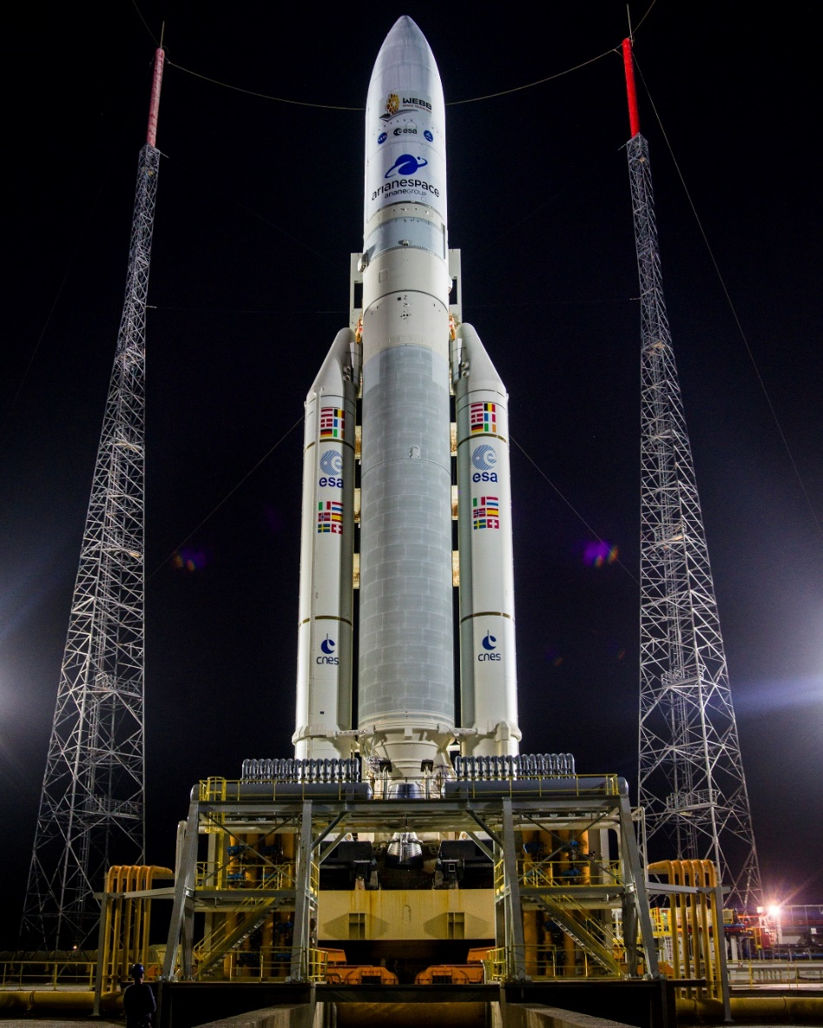
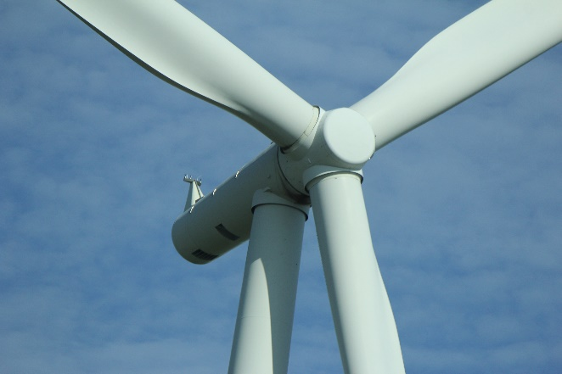
Electrical and Electronic Equipments (EEE)
And
xG Base stations
Cars
Boats
Planes
Trains
Tramways
Busses
Windmills
Power plants
Satellites
Rockets
Supercomputers
Data centers
…
CC-BY-SA Aynamankajan
CC-BY NASA's James Webb Space Telescope from Greenbelt, MD, USA

Slide 6
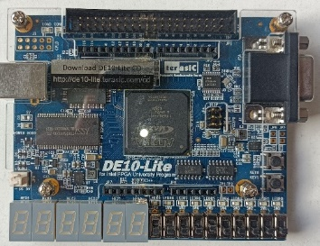
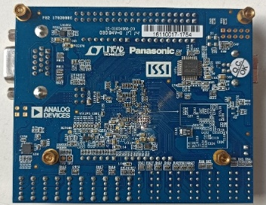
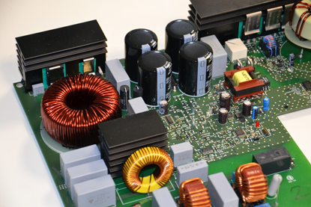
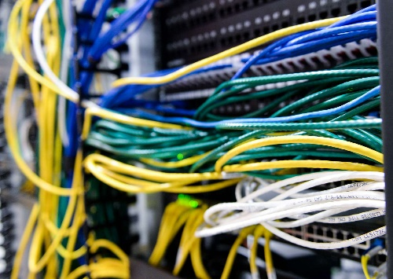
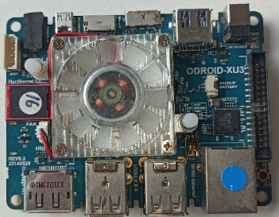
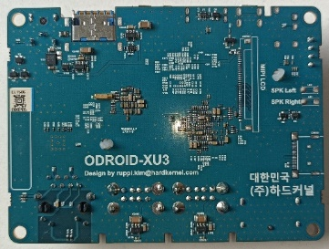
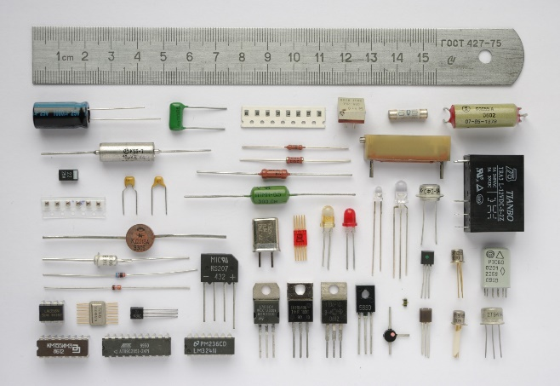
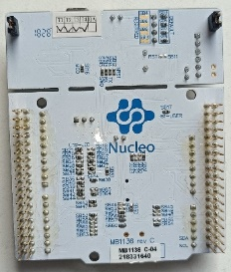
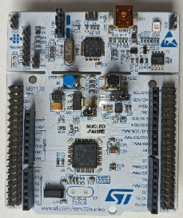
Electronic devices
CC SA Angels Pinyol
CC-SA Project Kei
Notes:
Composants Chimiques, électromécaniques, électroniques

Slide 7
Electronic devices
Electrical equipment
Electronic equipment
From another energy to electrical energy
Communication / Networking
Applications
Libraries
Sensors
Operating System
Computing
Actuators
Drivers
Hardware Interface
From electrical energy to another energy
Storage
Power Management

Slide 8
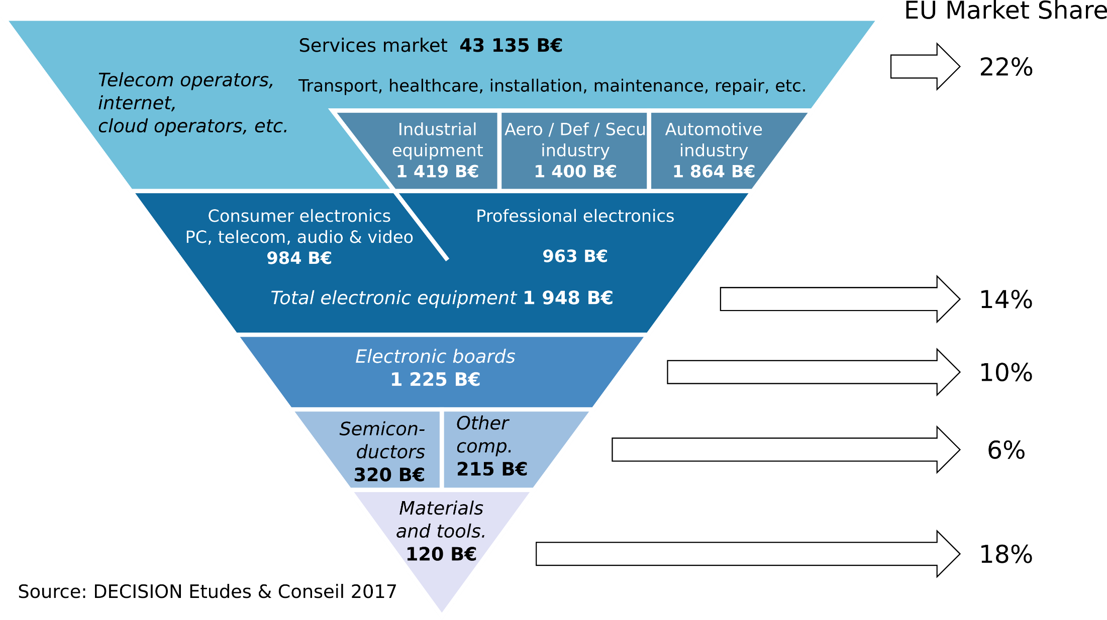
Electronics market and Europe (in 2017)
Notes:
Semiconductor: 600B today, 1T in 2030

Slide 9
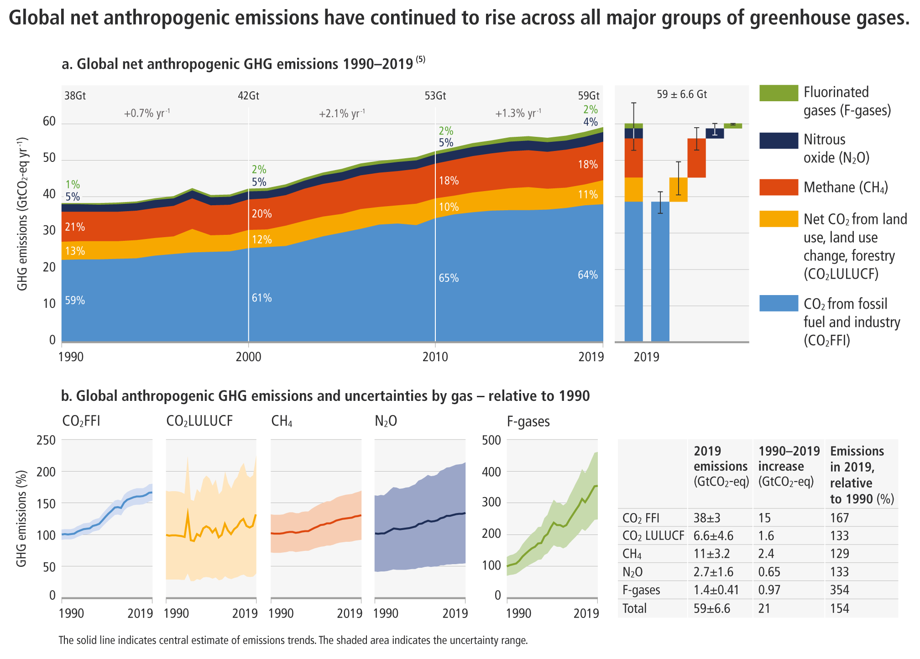
Human carbon impact
Human GHG emissions reach 60Gt/year
To respect the 1.5°C scenario of the Paris Agreement, emissions must reach 8Gt/year by 2050, i.e. a reduction of ~7× by 2050
The Closing Window: Climate crisis calls for rapid transformation of societies,
UN environment program 2022
8Gt

Slide 10
Human carbon impact
Human GHG emissions reach 60Gt/year
To respect the 1.5°C scenario of the Paris Agreement, emissions must reach 8Gt/year by 2050, i.e. a reduction of ~7× by 2050
-7%/year
8Gt

Slide 11
Human carbon impact per sector (in France)
Suivi de la Stratégie Nationale Bas-Carbone
Indicateurs de résultats
Ministère de la Transition Ecologique, 2021

Slide 12
Two strategies to distribute efforts
1
2

Slide 13
How does electronics affect environment?

Slide 14
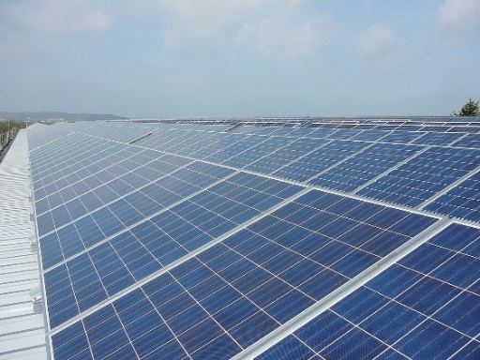
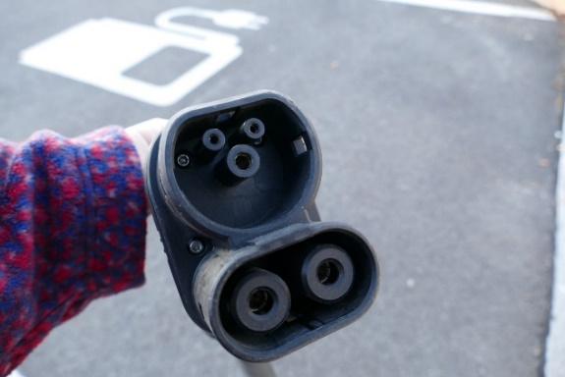
How do EEE help sustainability?
All energy transitions/shifts heavily employ electronics and electrical equipments (EEE)
Electric cars, renewable energies from windmills, solar panel, heat pumps…
Energy optimization heavily relies on EEEs
Smart grids, smart buildings, smart cities…
+
CC 3.0 ChristofferRiemer
CC SA Kritzolina

Slide 15
How do EEE hinder sustainability?
-
(focusing on environmental impacts)
Production of EEEs
Requires rare material (abiotic resource depletion)
Emits greenhouse gases
Requires much water
Usage of EEEs
Requires energy
End-of-life of EEEs
Emits about no greenhouse gases
Emits e-wastes that pollute water and soils
Author: Laconicon

Slide 16
Semiconductors and GHG emissions
85% of a cell phone's GHG emissions come from manufacturing
Gupta, U., Kim, Y. G., Lee, S., Tse, J., Lee, H. H. S., Wei, G. Y., ... & Wu, C. J. (2022).
Chasing carbon: The elusive environmental footprint of computing. IEEE Micro.

Slide 17
Absolute carbon emissions of devices
Gupta, U., Kim, Y. G., Lee, S., Tse, J., Lee, H. H. S., Wei, G. Y., ... & Wu, C. J. (2022).
Chasing carbon: The elusive environmental footprint of computing. IEEE Micro.

Slide 18
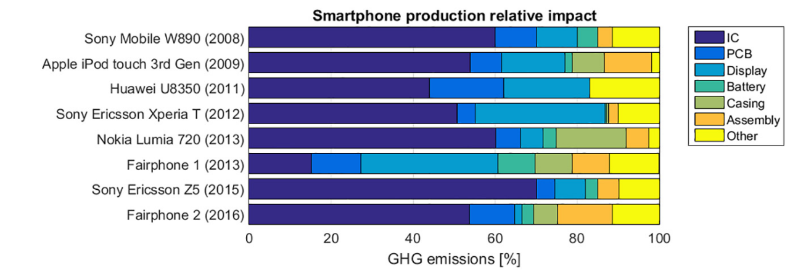
Semiconductors and GHG emissions
The manufacture of integrated circuits is the primary cause of cell phone emissions
Louis-Philippe, P. V. C., Jacquemotte, Q. E., & Hilty, L. M. (2020). Sources of variation in life cycle assessments of smartphones and tablet computers. Environmental Impact Assessment Review, 84

Slide 19
Semiconductors and GHG emissions
Scope 1 emissions: F-gases
F-gases are used for cleaning and etching, as well as for heat pumps and refrigerants
1kg of SF₆ ⬄ 23 tons of CO₂, and lasts 3200 years in the atmosphere
Scope 2 emissions: electricity
From 60g CO₂e/kWh to 1kg CO₂e/kWh
Bartos, S. C., & Burton, C. S. (2002). PFC, HFC, NF3, and SF6 emissions from semiconductor manufacturing. Good Practice Guidance and Uncertainty Management in National Greenhouse Gas Inventories, 1-13.
Notes:
F-gases have replaced ozone-depleting gases

Slide 20
Semiconductors and GHG emissions
Scope 3 upstream emissions
Mining materials
Smelting
Refining
High temperature processes for wafer production: reducing silicon from SiO2, purifying silicon, building single crystal silicon ingots
Scope 3 downstream emissions
Transporting products
Using products
End-of-life
Impacts of electronics are increasingly well understood
Client
Greenhouse Gas Protocol, World Resources Institute, Revised edition, 2015
Notes:
Ultrapure water, ultrapure silicium, coper, aluminum…

Slide 21
Semiconductors and GHG emissions
The manufacture of integrated circuits emitted 76Mt CO2eq in 2021, an increase of 13% compared to 2020.
The current study excludes Scope 3.
Maxime Pelcat. GHG emissions of semiconductor manufacturing in 2021. Research Report. 2023. ⟨hal-04112708⟩

Slide 22
Semiconductor industry revenue
1 trillion $
2030
Numbers: Statista

Slide 23
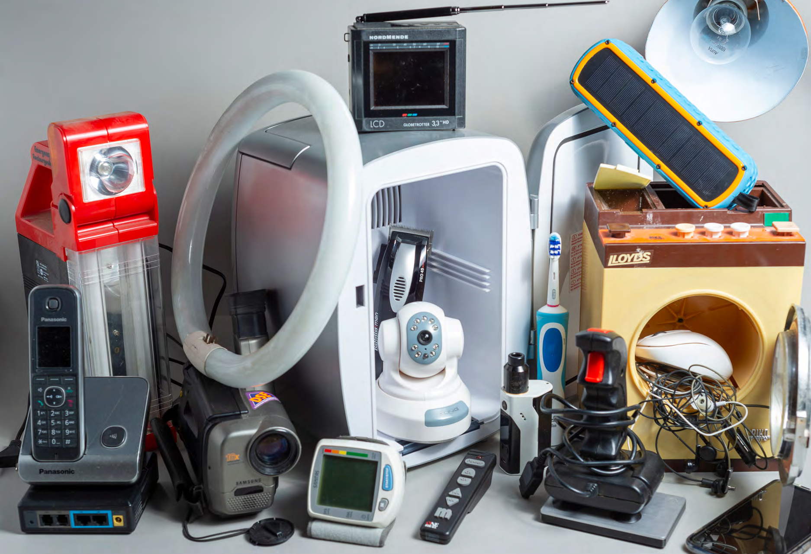
EEE-generated waste
E-waste
One of the fastest-growing waste categories, growing at a rate of 3–5% per year → includes product housing
In 2016, 44.7 million tons of e-waste were generated in the world , 6.1 kg per person; in 2019: 53.6 million tons
“Only 17.4 per cent of 2019’s e-waste was collected and recycled.” Global E-waste Monitor 2020
CC BY-NC 3.0 IGO - © UNU/UNITAR and ITU, 2020
Ilankoon, I. M. S. K., Ghorbani, Y., Chong, M. N., Herath, G., Moyo, T., & Petersen, J. (2018).
E-waste in the international context – A review of trade flows, regulations, hazards,
waste management strategies and technologies for value recovery. Waste Management, 82, 258-275.

Slide 24
How can we act?

Slide 25
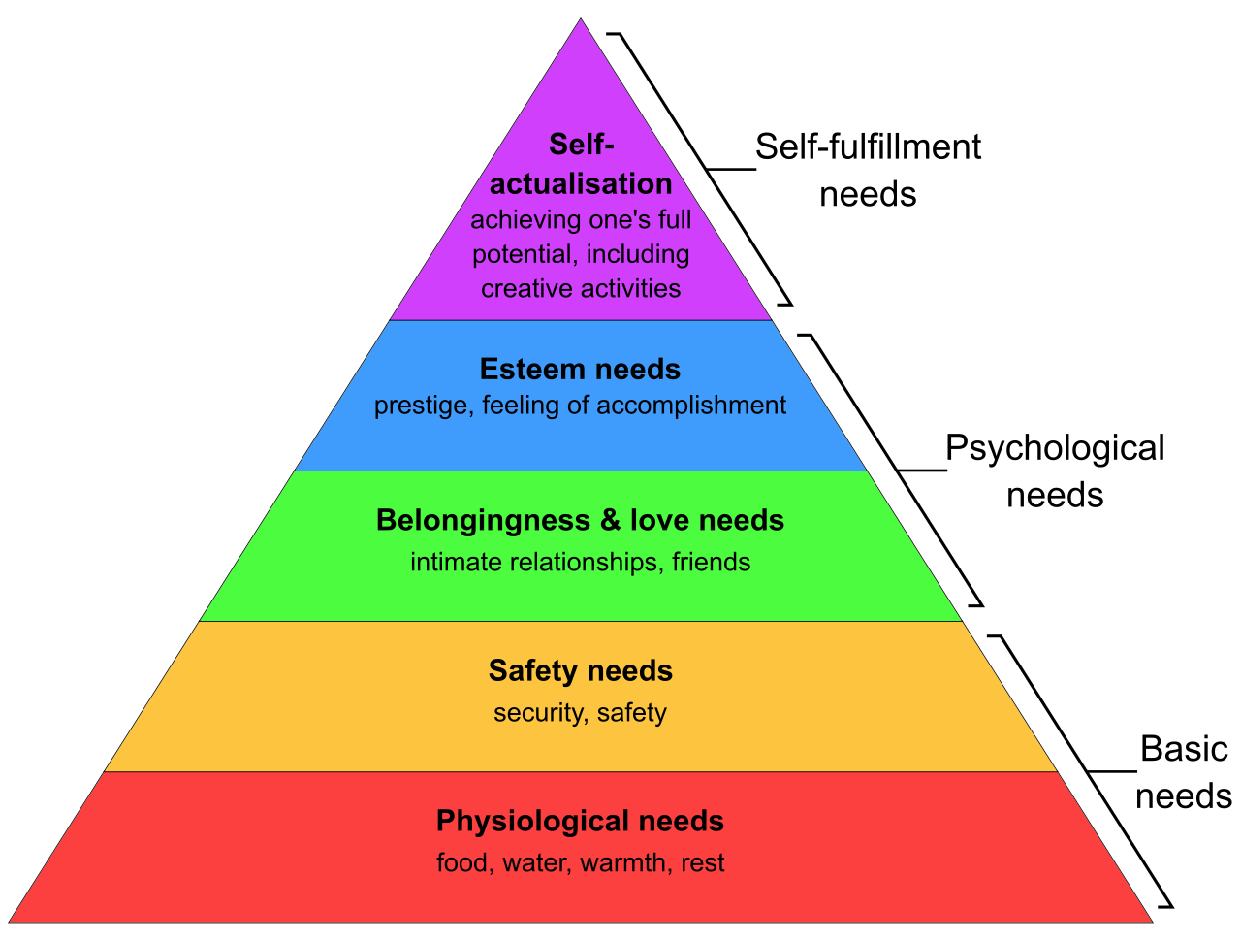
What is sustainable electronics?
Sustainable electronics is electronics that
meets the needs of present generations without compromising the ability of future generations to meet their own needs.
Brundtland report – “Our Common Future”, the United Nations, 1987
3 pilars
Environmental
Social
Economic
Maslow’s pyramid

Slide 26
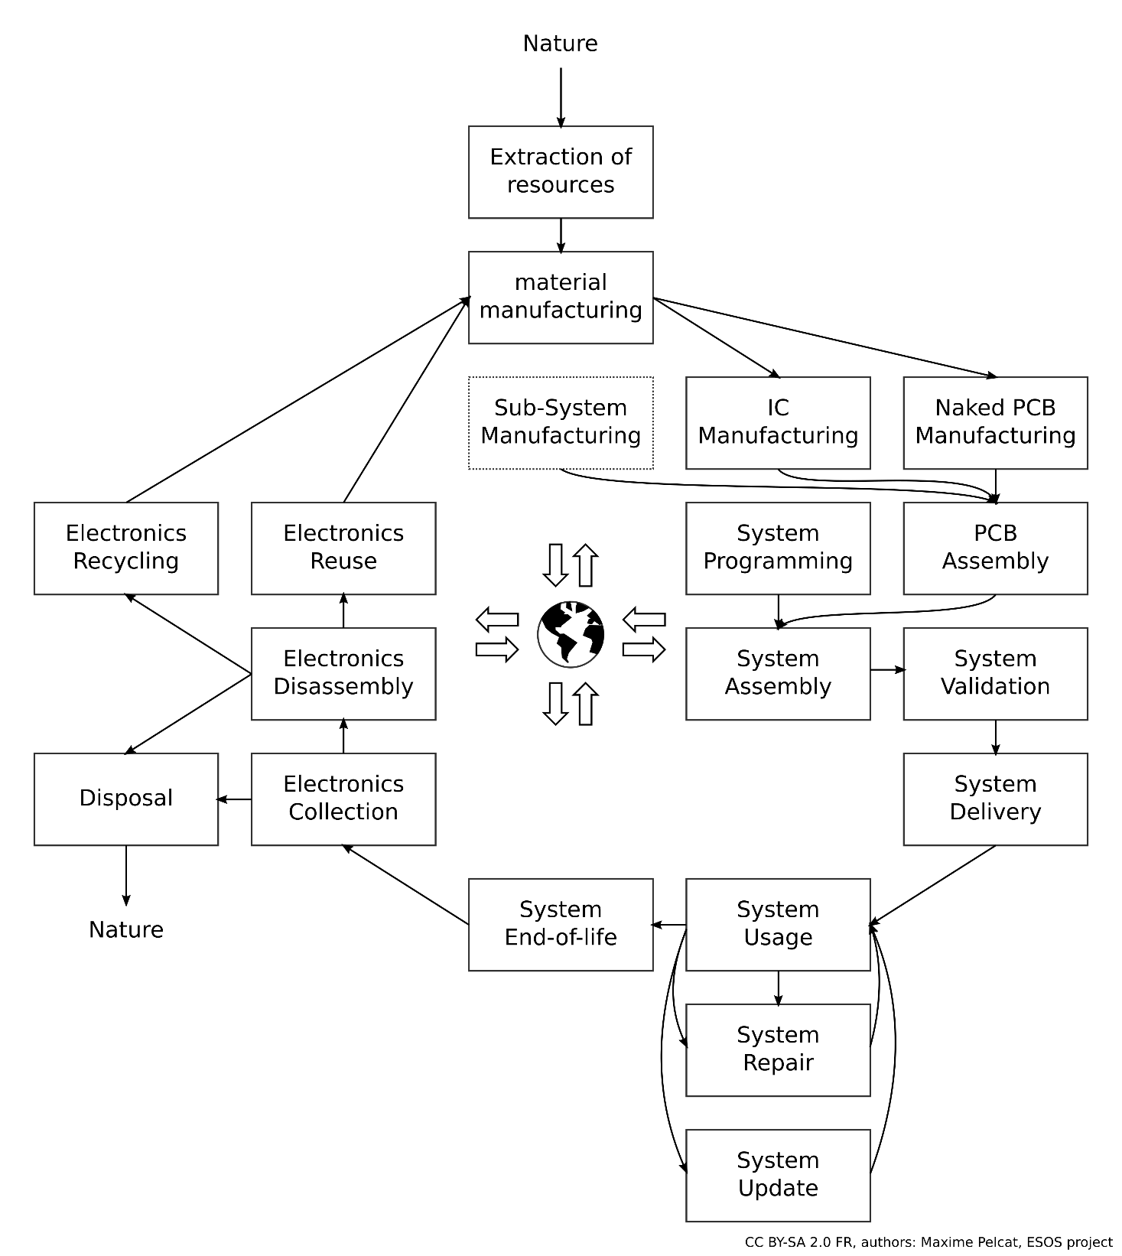
Research needed!
Life cycle analysis of products and services
3R: Repair, Reuse, Recycle
and Reduce, Refurbish…
Better energy management and reliability
New technologies, processes and materials with low footprint
PCB, IC, other components
Delayed obsolescence of hardware and software stack
and all these at scale, with a valid business model

Slide 27
Research needed!
Life cycle analysis of products and services
3R: Repair, Reuse, Recycle
and Reduce, Refurbish…
Better energy management and reliability
New technologies, processes and materials with low footprint
PCB, IC, other components
Delayed obsolescence of hardware and software stack

Slide 28
From Local Decisions to Global Impacts
Global Warming
Causality established and quantified by IPCC
Human greenhouse gas emissions
Communication
Transport
Healthcare
Defense
Industry
Energy
Agriculture
…

Slide 29
From Local Decisions to Global Impacts
Global Warming
Causality established and quantified by IPCC
Human greenhouse gas emissions
Causality to be established and quantified by domain experts
Communication
Transport
Healthcare
Defense
Industry
Energy
Agriculture
…

Slide 30
LCA Method: ISO 14044 Standard
1- Goal and scope definition
4- Interpretation / discussion
ISO 14040:2006, Environmental management — Life cycle assessment — Principles and framework
2- Inventory analysis
3- Impact assessment

Slide 31
Different forms of LCAs for different objectives
Gather reliable, scientific numbers on electronics impacts, and evaluate their reliability
Attributional LCA: aims to describe the environmentally relevant physical flows to and from a life cycle
Consequential LCA: LCA aiming to describe how environmentally relevant flows will change in response to possible decisions
Finnveden, G., Hauschild, M. Z., Ekvall, T., Guinée, J., Heijungs, R., Hellweg, S., ... & Suh, S. (2009). Recent developments in life cycle assessment. Journal of environmental management, 91(1), 1-21.

Slide 32
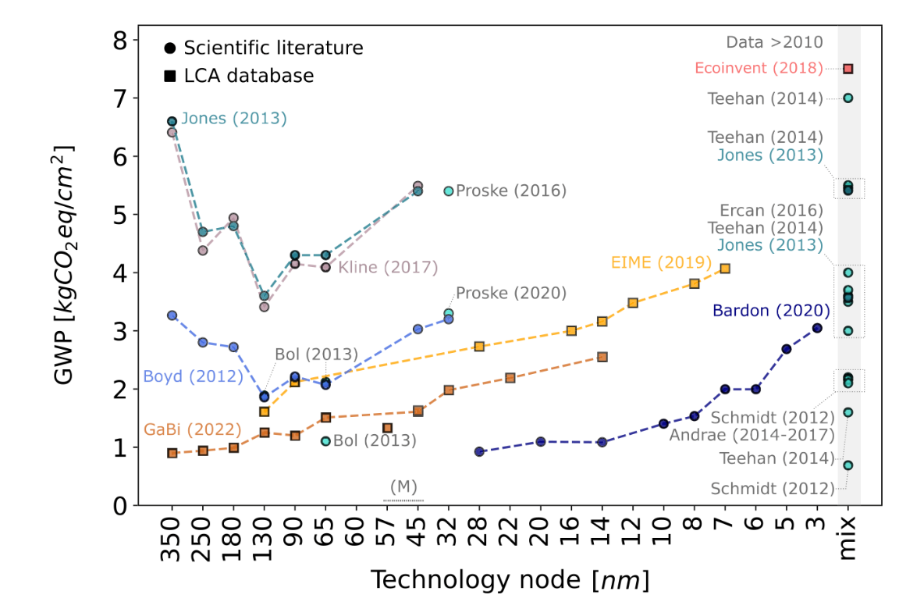
Variations in semiconductor LCAs
Product lifecycle analysis is a complex science, requiring a detailed understanding of the scope and assumptions involved
Pirson, T., Delhaye, T. P., Pip, A., Le Brun, G., Raskin, J. P., & Bol, D. (2022). The environmental footprint of IC production: Review, analysis and lessons from historical trends. IEEE Transactions on Semiconductor Manufacturing.

Slide 33
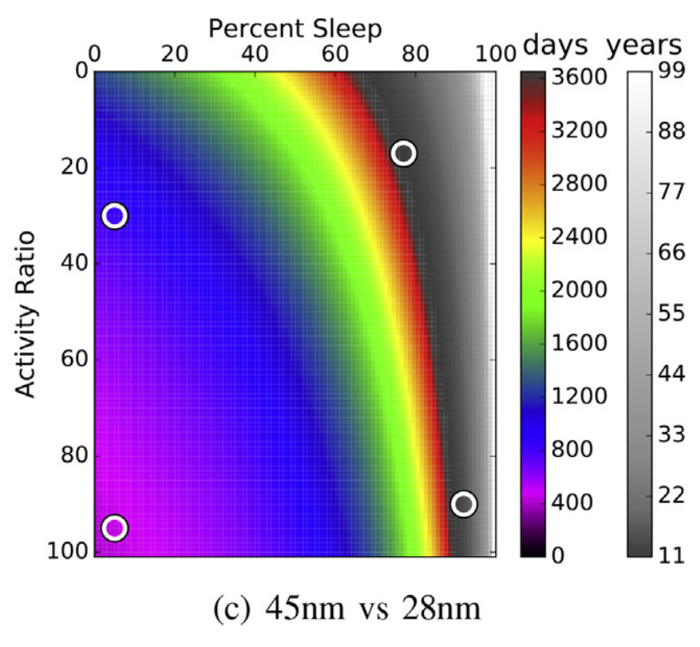
Evaluating when to replace systems by LCA
impact of upgrading to a new technology node
analysis of 2017 processor trends indicated that upgrading may require upwards of 10 years of service time to break even on energy
Kline Jr, D., Parshook, N., Ge, X., Brunvand, E., Melhem, R., Chrysanthis, P. K., & Jones, A. K. (2019). GreenChip: A tool for evaluating holistic sustainability of modern computing systems. Sustainable Computing: Informatics and Systems, 22, 322-332.
Notes:
Team at uni Pittsburg and Uni Utah
To determine the overall energy cost of a system during its lifetime, a usage scenario must be considered consisting of the time the system is awake versus asleep (sleep ratio), when awake, how much it is active versus idle (activity ratio), and the time period it will be in service.
The break even time indicates the point
when a new system will reach the same energy consumption of
the system it will replace. This comparison assumes the manufac-
turing cost has already been invested for the original system. Thus,
it identiﬁes the upgrade time, when the energy for the new system
will be less than leaving the original system in service.

Slide 34
Tools and challenges of electronics LCA
Open source tools exist for LCA: OpenLCA, Brightway…
Some challenges
Scope and functional unit definition (step 1)
E.g. how to attribute impacts shared with other products?
Access to reliable data (life cycle inventory step 2)
Computation of materials, processes and energy required to build and operate a product
Measured, calculated, estimated, interpolated, extrapolated…
Comparison of different LCAs and decision making (step 4)
“Comparing the results of different LCA or LCI studies is only possible if the assumptions and context of each study are equivalent.” ISO 14044
Multidisciplinary discipline: materials, architecture, business…
LCAs are costly

Slide 35
Research needed!
Life cycle analysis of products and services
3R: Repair, Reuse, Recycle
and Reduce, Refurbish…
Better energy management and reliability
New technologies, processes and materials with low footprint
PCB, IC, other components
Delayed obsolescence of hardware and software stack

Slide 36
Repair, reuse, recycle
Mobile phones have a lifetime of 2.5 years, high-end processors 4.5 years
To be a leader in future chips, EU shall invest in novel lengthened lifetime chips and systems
tools: upgradeable, reparable, reconfigurable, and repurposable chip and board technologies
Build technologies for validating and providing warranty for reused components
Eco-design and eco-innovation

Slide 37
Repair, reuse, recycle
Making a system more reparable may require more connectors
That themselves require abiotic resources
Recycling will increase the impact of end-of-life (!)
And sustainability improvements need to be evaluated reliably
Shorter cycles have lower cost
But they do have a cost

Slide 38
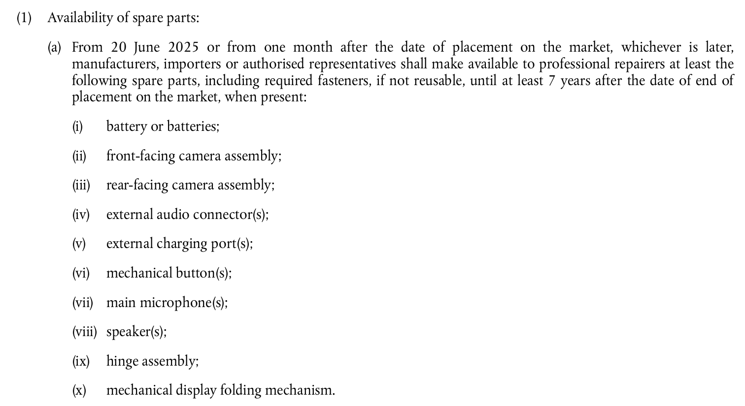
Repair, reuse, recycle
Europe acts already through new requirements

Slide 39
LCAs: 16 evaluated impacts
Climate change
Ozone depletion
Human toxicity, cancer
Human toxicity, non-cancer
Particulate matter
Ionizing radiation, human health
Photochemical ozone formation, human health
Acidification
Eutrophication, terrestrial
Eutrophication, freshwater
Eutrophication, marine
Ecotoxicity, freshwater
Land use
Water use
Resource use, minerals and metals
Resource use, fossils

Slide 40
Research needed!
Life cycle analysis of products and services
3R: Repair, Reuse, Recycle
and Reduce, Refurbish…
Better energy management and reliability
New technologies, processes and materials with low footprint
PCB, IC, other components
Delayed obsolescence of hardware and software stack

Slide 41
Research needed!
Life cycle analysis of products and services
3R: Repair, Reuse, Recycle
and Reduce, Refurbish…
Better energy management and reliability
New technologies, processes and materials with low footprint
PCB, IC, other components
Delayed obsolescence of hardware and software stack

Slide 42
New technologies, processes and materials
Organic electronics, bio-sourced PCBs…
Beware the rebound effect (!)
Requires an evaluation of the large-scale impact of products

Slide 43
Research needed!
Life cycle analysis of products and services
3R: Repair, Reuse, Recycle
and Reduce, Refurbish…
Better energy management and reliability
New technologies, processes and materials with low footprint
PCB, IC, other components
Delayed obsolescence of hardware and software stack

Slide 44
The role of open source hardware
Code, application and library obsolescence is to be delayed
Open source hardware can stabilise interfaces and delay obsolescence :
Instruction Set Architecture
Application Binary Interface
Device Tree Support
Carbon footprint reduction requires properties of open source communities
Transparency
Sharing information

Slide 45
The ESOS project
Electronics: Sustainable, Open and Sovereign
2023-2028, 6.3M€ funding, 15M€ total cost, funded by France2030
Sustainable: meeting the needs of the present generation without compromising the ability of future generations to meet their own needs.
Open: a decentralized development model that publicly distributes the source code for open collaboration and peer production, known as "the open-source method."
Sovereign: the quality of a state being free and independent, determined solely by its own will within the limits of the higher principle of law, and in accordance with the collective purpose it is called to achieve.

Slide 46
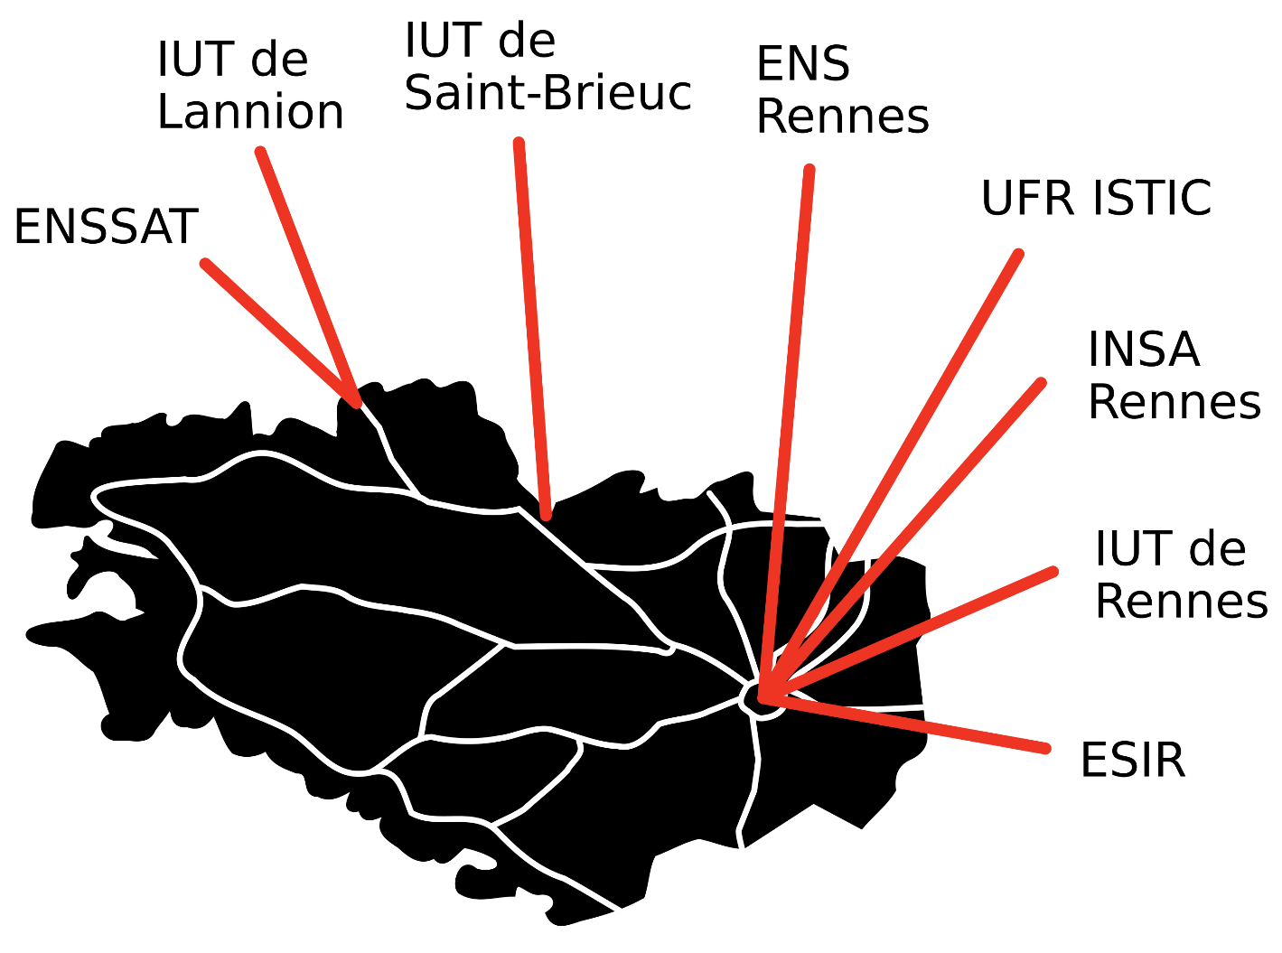
ESOS – 7 actions
Attract pupils to electronics
Train students to ESOS
Licence, master, doctorate
Train teachers to ESOS
Train professionals to ESOS
Create open teaching material
https://esos.insa-rennes.fr
30 industrial partners
14 PhD theses
Looking for synergies!

Slide 47
Wrapping up: how can we act?
Propose new technologies for lower impact, repairable, reusable, reconfigurable, repurposable systems
Assess the real impact of these new technologies in the field with Life Cycle Analysis
Help and foster the setup of novel regulations (incentives, taxes and quotas)
Train students and professionals
Ashby, M. F. (2022). Materials and sustainable development. Butterworth-Heinemann.
Notes:
M. Ashby, Cambridge

Slide 48
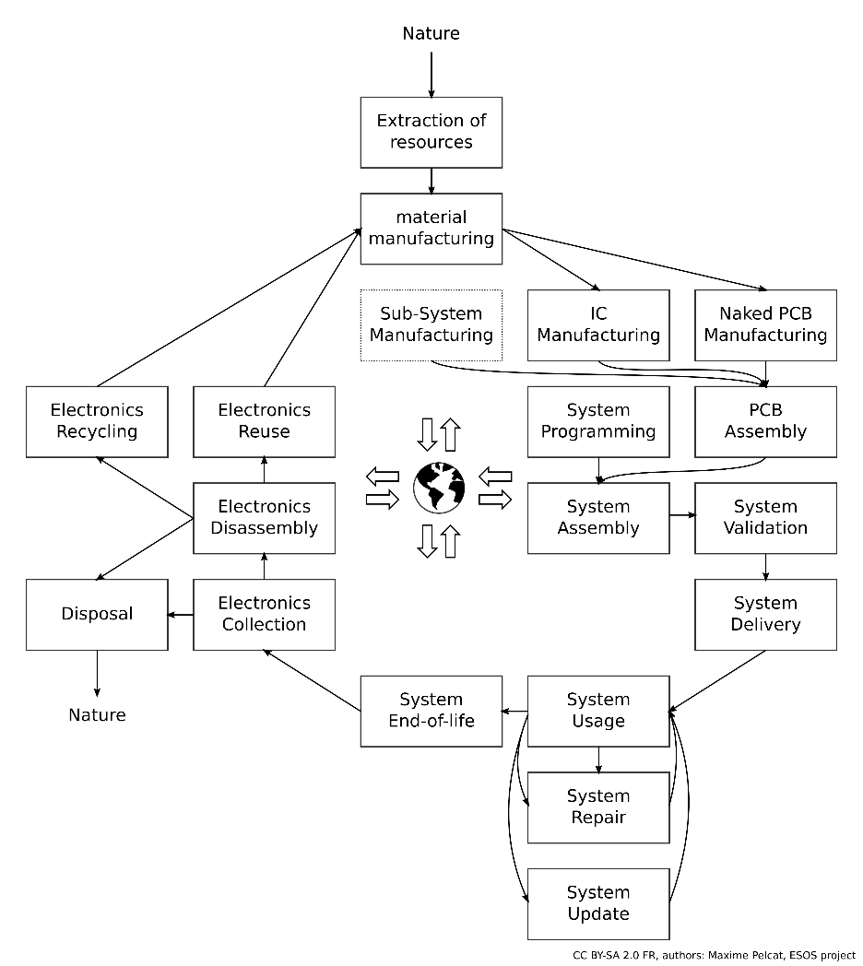
Thanks!
CC SA Angels Pinyol
CC-SA Project Kei

Slide 49
Additional Slides

Slide 50
Electronics, ethics and human rights
Sustainability challenges in terms of social responsibility and human rights include:
Social standards for employees
Impacts on local communities
Impact on society
Downstream
Upstream
Client

Slide 51
LCAs: 16 evaluated impacts
Climate change
Ozone depletion
Human toxicity, cancer
Human toxicity, non-cancer
Particulate matter
Ionizing radiation, human health
Photochemical ozone formation, human health
Acidification
Eutrophication, terrestrial
Eutrophication, freshwater
Eutrophication, marine
Ecotoxicity, freshwater
Land use
Water use
Resource use, minerals and metals
Resource use, fossils

