Slide 1
Sustainable Electronics: Open Challenges and Opportunities
Maxime PELCAT,
IETR, INSA Rennes
2023
shared under the
CC BY-SA 2.0 FR licence
authors: Maxime Pelcat,
ESOS project
Credit: James Mathews - CC BY-SA 4.0

Slide 2
Introduction: What is Sustainable Electronics?

Slide 3
What is electronics?
Electronic devices
Collins dictionary: Electronics is the technology of using transistors and silicon chips, especially in devices such as radios, televisions, and computers.
Electrical device
Electrical devices functionally rely on electric energy (AC or DC) to drive their core parts (electric motors, transformers, lighting, rechargeable batteries…).
Both: EEE: Electrical and Electronic Equipment

Slide 4
Electrical and Electronic Equipments
Air purifier
Air conditioner
Alarm clock
Backup charger
Bread maker
Banknote counter
Blender
Bluetooth speaker
Bulb
Calculator
Car toy
Ceiling fan
Chandelier
Clock
Clothes dryer
Coffee maker
Computer
Copier
Curling iron
Digital camera
Dishwasher
Doorbell camera
Drill
Dvd player
Earphones
Electric frying pan
Electric grill
Electric guitar
Electric pencil sharpener
Electric razor
Exhaust fan
External hard drive
Fan
Facial cleansing machine
Fax
Fish tank
Floor lamp
Game controller
Garage
Grandfather clock
Hair dryer
Headset
Inkjet printer
iPod
Iron
Juicer
Kettle
Kitchen scale
Hair straightening machine
Laser printer
Lawn mower
Lift
Meat grinder
Microphone
Microwave
Mixer
Monitor
Mosquito racket
Mouse
Mp3 player
Oil-free fryer
Piano
Oven
Plotter
Pressure cooker
Printer
Projector
Radiator
Radio
Reading lamp
Refrigerator
Remote control
Rice cooker
Safe
Robotic vacuum cleaner
Sandwich maker
Scale
Scanner
Sewing machine
Smart television
Smartphone
Speakers
Tablet
Television
Timer
Toaster
Torch
USB drive
Vacuum cleaner
Walkie-talkie
Washing machine
Watch
Water pumps
Water purifier
Wall fan
Water heater
Webcam
Wifi modem
List from 7esl.com
Notes:
Air purifier
Air conditioner
Alarm clock
Backup charger
Bread maker
Banknote counter
Blender
Bluetooth speaker
Bulb
Calculator
Car toy
Ceiling fan
Chandelier
Clock
Clothes dryer
Coffee maker
Computer
Copier
Curling iron
Digital camera
Dishwasher
Doorbell camera
Drill
Dvd player
Earphones
Electric frying pan
Electric grill
Electric guitar
Electric pencil sharpener
Electric razor
Electric stove
Exhaust fan
External hard drive
Fan
Facial cleansing machine
Fax
Fish tank
Floor lamp
Game controller
Garage
Grandfather clock
Hair dryer
Headset
Inkjet printer
iPod
Iron
Juicer
Kettle
Kitchen scale
Hair straightening machine
Laser printer
Lawn mower
Lift
Meat grinder
Microphone
Microwave
Mixer
Monitor
Mosquito racket
Mouse
Mp3 player
Oil-free fryer
Piano
Oven
Plotter
Pressure cooker
Printer
Projector
Radiator
Radio
Reading lamp
Refrigerator
Remote control
Rice cooker
Safe
Robotic vacuum cleaner
Sandwich maker
Scale
Scanner
Sewing machine
Smart television
Smartphone
Speakers
Tablet
Television
Timer
Toaster
Torch
USB drive
Vacuum cleaner
Walkie-talkie
Washing machine
Watch
Water pumps
Water purifier
Wall fan
Water heater
Webcam
Wifi modem

Slide 5
Electrical and Electronic Equipments
Air purifier
Air conditioner
Alarm clock
Backup charger
Bread maker
Banknote counter
Blender
Bluetooth speaker
Bulb
Calculator
Car toy
Ceiling fan
Chandelier
Clock
Clothes dryer
Coffee maker
Computer
Copier
Curling iron
Digital camera
Dishwasher
Doorbell camera
Drill
Dvd player
Earphones
Electric frying pan
Electric grill
Electric guitar
Electric pencil sharpener
Electric razor
Exhaust fan
External hard drive
Fan
Facial cleansing machine
Fax
Fish tank
Floor lamp
Game controller
Garage
Grandfather clock
Hair dryer
Headset
Inkjet printer
iPod
Iron
Juicer
Kettle
Kitchen scale
Hair straightening machine
Laser printer
Lawn mower
Lift
Meat grinder
Microphone
Microwave
Mixer
Monitor
Mosquito racket
Mouse
Mp3 player
Oil-free fryer
Piano
Oven
Plotter
Pressure cooker
Printer
Projector
Radiator
Radio
Reading lamp
Refrigerator
Remote control
Rice cooker
Safe
Robotic vacuum cleaner
Sandwich maker
Scale
Scanner
Sewing machine
Smart television
Smartphone
Speakers
Tablet
Television
Timer
Toaster
Torch
USB drive
Vacuum cleaner
Walkie-talkie
Washing machine
Watch
Water pumps
Water purifier
Wall fan
Water heater
Webcam
Wifi modem
Main EEE devices
of digital society
List from 7esl.com
Notes:
Air purifier
Air conditioner
Alarm clock
Backup charger
Bread maker
Banknote counter
Blender
Bluetooth speaker
Bulb
Calculator
Car toy
Ceiling fan
Chandelier
Clock
Clothes dryer
Coffee maker
Computer
Copier
Curling iron
Digital camera
Dishwasher
Doorbell camera
Drill
Dvd player
Earphones
Electric frying pan
Electric grill
Electric guitar
Electric pencil sharpener
Electric razor
Electric stove
Exhaust fan
External hard drive
Fan
Facial cleansing machine
Fax
Fish tank
Floor lamp
Game controller
Garage
Grandfather clock
Hair dryer
Headset
Inkjet printer
iPod
Iron
Juicer
Kettle
Kitchen scale
Hair straightening machine
Laser printer
Lawn mower
Lift
Meat grinder
Microphone
Microwave
Mixer
Monitor
Mosquito racket
Mouse
Mp3 player
Oil-free fryer
Piano
Oven
Plotter
Pressure cooker
Printer
Projector
Radiator
Radio
Reading lamp
Refrigerator
Remote control
Rice cooker
Safe
Robotic vacuum cleaner
Sandwich maker
Scale
Scanner
Sewing machine
Smart television
Smartphone
Speakers
Tablet
Television
Timer
Toaster
Torch
USB drive
Vacuum cleaner
Walkie-talkie
Washing machine
Watch
Water pumps
Water purifier
Wall fan
Water heater
Webcam
Wifi modem

Slide 6
And Other Electrical and Electronic Equipments
And
xG Base stations
Cars
Boats
Planes
Trains
Tramways
Busses
Windmills
Power plants
Satellites
Rockets
Supercomputers
Data centers
…
Notes:
Air purifier
Air conditioner
Alarm clock
Backup charger
Bread maker
Banknote counter
Blender
Bluetooth speaker
Bulb
Calculator
Car toy
Ceiling fan
Chandelier
Clock
Clothes dryer
Coffee maker
Computer
Copier
Curling iron
Digital camera
Dishwasher
Doorbell camera
Drill
Dvd player
Earphones
Electric frying pan
Electric grill
Electric guitar
Electric pencil sharpener
Electric razor
Electric stove
Exhaust fan
External hard drive
Fan
Facial cleansing machine
Fax
Fish tank
Floor lamp
Game controller
Garage
Grandfather clock
Hair dryer
Headset
Inkjet printer
iPod
Iron
Juicer
Kettle
Kitchen scale
Hair straightening machine
Laser printer
Lawn mower
Lift
Meat grinder
Microphone
Microwave
Mixer
Monitor
Mosquito racket
Mouse
Mp3 player
Oil-free fryer
Piano
Oven
Plotter
Pressure cooker
Printer
Projector
Radiator
Radio
Reading lamp
Refrigerator
Remote control
Rice cooker
Safe
Robotic vacuum cleaner
Sandwich maker
Scale
Scanner
Sewing machine
Smart television
Smartphone
Speakers
Tablet
Television
Timer
Toaster
Torch
USB drive
Vacuum cleaner
Walkie-talkie
Washing machine
Watch
Water pumps
Water purifier
Wall fan
Water heater
Webcam
Wifi modem

Slide 7
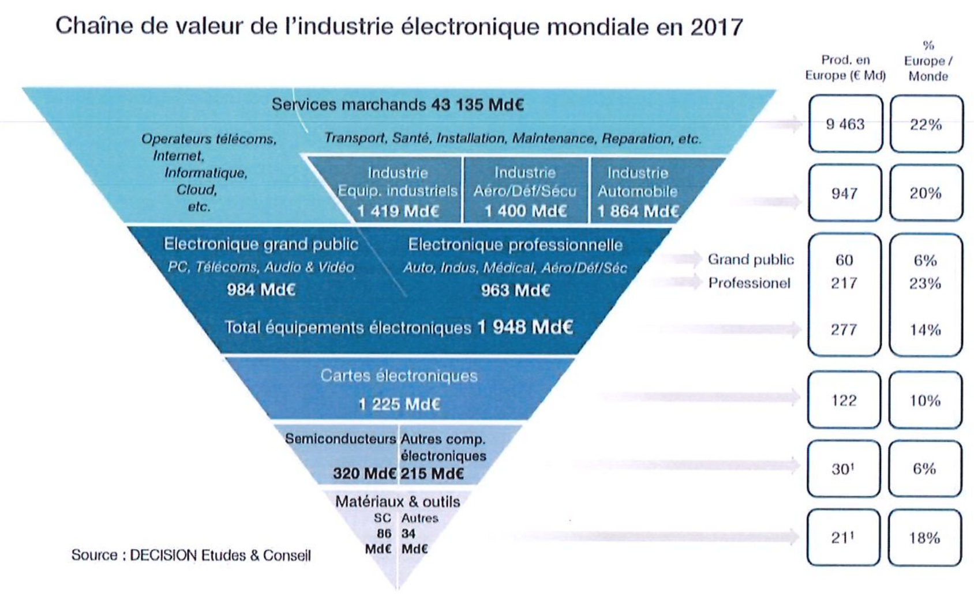
Concentrating on Electronics

Slide 8
What is sustainable electronics?
Sustainable electronics is electronics that
meets the needs of present generations without compromising the ability of future generations to meet their own needs.
Brundtland report – “Our Common Future”, the United Nations, 1987
What are the needs of current generation?
How do we compromise the needs of future generations?

Slide 9
Brundtland Report
Chapter 2: Towards Sustainable Development
81. the pursuit of sustainable development requires:
a political system that secures effective citizen participation in decision making,
an economic system that is able to generate surpluses and technical knowledge on a self-reliant and sustained basis,
a social system that provides for solutions for the tensions arising from disharmonious development,
a production system that respects the obligation to preserve the ecological base for development,
a technological system that can search continuously for new solutions,
an international system that fosters sustainable patterns of trade and finance, and an administrative system that is flexible and has the capacity for self-correction.
82. These requirements are more in the nature of goals that should underlie national and international action on development. What matters is the sincerity with which these goals are pursued and the effectiveness with which departures from them are corrected.
Notes:
Gro Harlem Brundtland
Ancienne Première ministre de Norvège

Slide 10
Claims on sustainable electronics
Researchers and teacher are key players to reach sustainable electronics
To progress towards sustainability, we shall
Employ verified, scientific information
Go beyond extreme positions
Pinpoint the problems and the potential solutions
Incorporate engineering and social sciences
Pursue the goal with sincerity
Share information and question the method
Open source hardware has a major role to play

Slide 11
Outline
Electronics and Sustainability Challenges
How is electronics designed and built?
Focus on global warming
How to act on electronics sustainability?
Low energy, life cycle analysis, product extended lifetimes and the role of open source hardware
Focus on the ESOS project

Slide 12
Electronics and Sustainability Challenges

Slide 13
Electronics and Innovation
Electronics support most innovations in
Communication, Mobility, Health, Energy, Industry, Farming
In particular, digital technologies help:
Improved social connectivity
Improved communication speeds
Enhanced learning opportunities
Improved versatile working
Automation of tasks
Information storage
Information editing

Slide 14
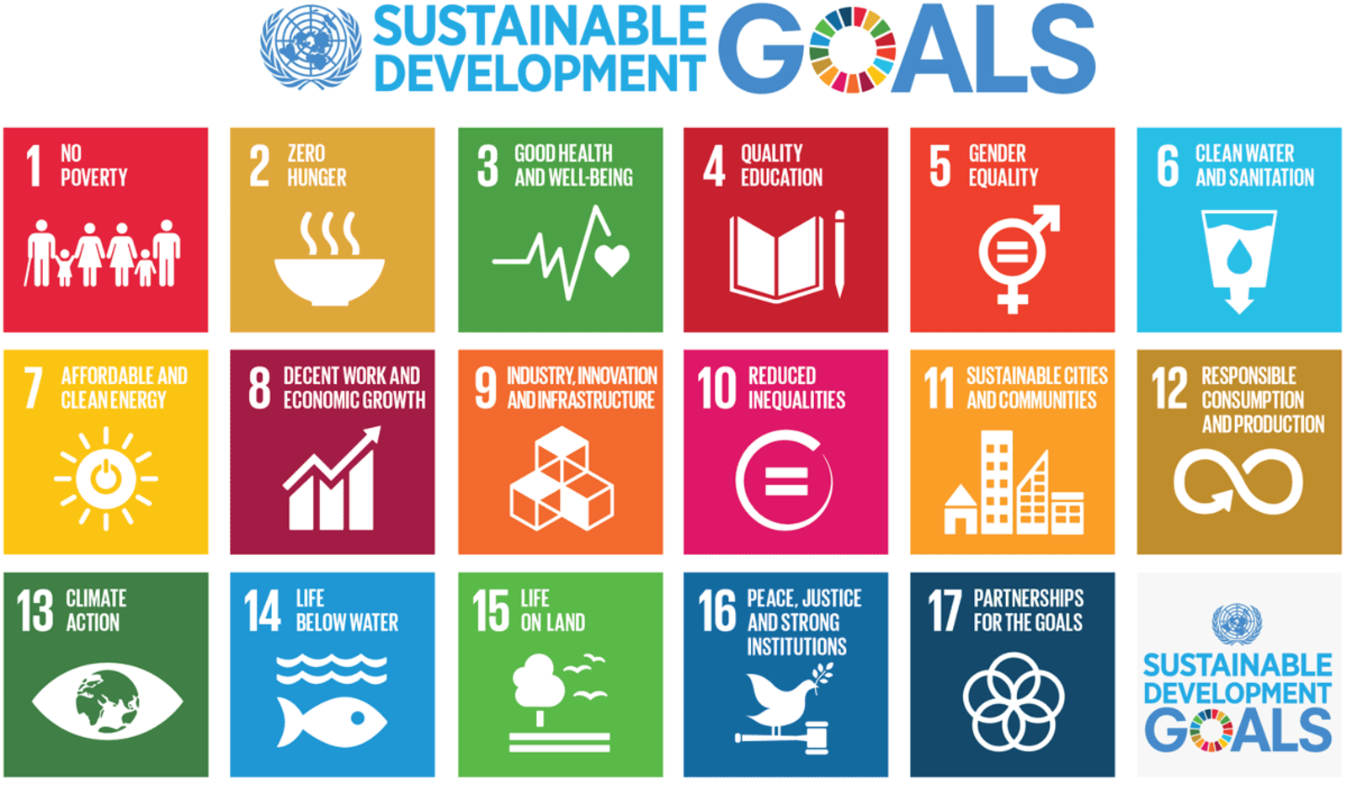
Understanding sustainability
UN 17 sustainable development goals for 2030

Slide 15
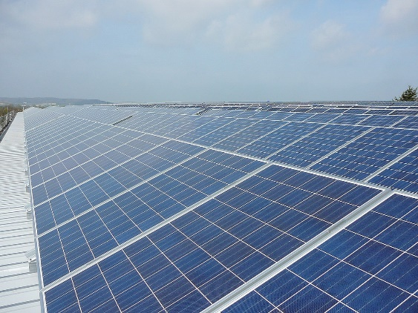
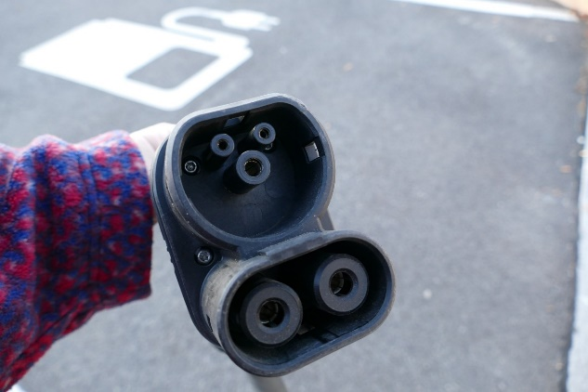
How do EEE help sustainability?
All energy transitions/shifts heavily employ EEEs
Electric cars, renewable energies from windmills, solar panel, heat pumps…
Energy reduction heavily relies on EEEs
Smart grids, smart buildings, smart cities…
More largely, production optimization and earth observation heavily rely on EEEs
Precision farming, earth observation satellites…
+
CC 3.0 ChristofferRiemer
CC SA Kritzolina

Slide 16
How do EEE hinder sustainability?
(Apart from social and economical impacts)
Production of EEEs
Requires rare material which mining emits greenhouse gases and wastes
Emits greenhouse gases
Requires much water
Usage of EEEs
Produces heat
Requires energy
End-of-life of EEEs
Emits e-wastes that pollute water and soils
-

Slide 17
How is electronics Designed and Built?

Slide 18
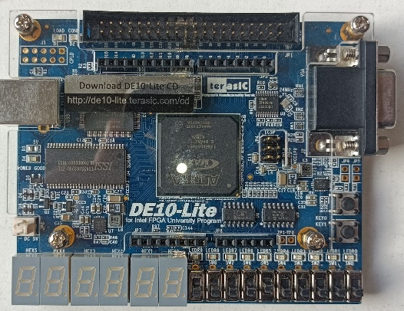
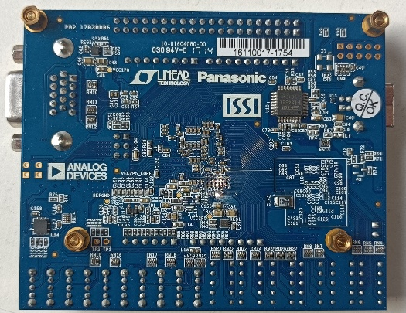
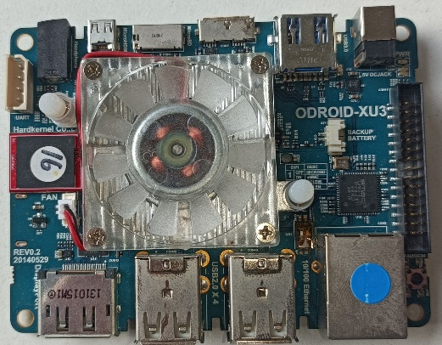
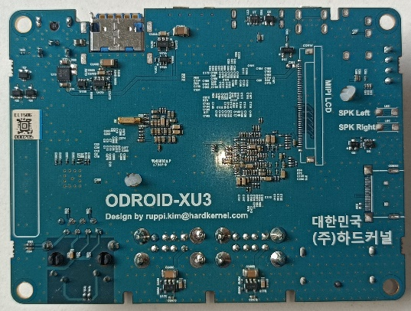
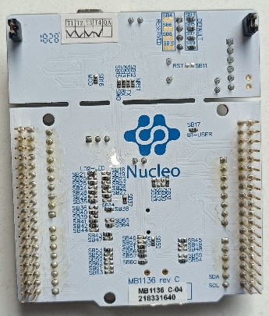
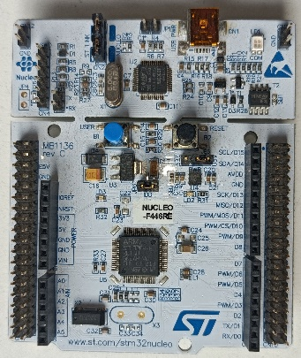
Examples: Printed Circuit Boards
CC BY-SA Maxime Pelcat
Notes:
Les stratifiés sont fabriqués en durcissant sous pression et température des couches fibreuses (fibre de verre, papier, etc.) avec une matrice, le plus souvent de la résine époxyde thermodurcie. Cela forme une pièce finale d'épaisseur uniforme dont les plaques carrées peuvent mesurer jusqu'à 2,5 m de côté. L'épaisseur et les caractéristiques diélectriques du circuit sont données par différents tissages, concentration et épaisseur de fibres, et par le pourcentage résine/fibre.
thermoset epoxy resin + copper wires

Slide 19
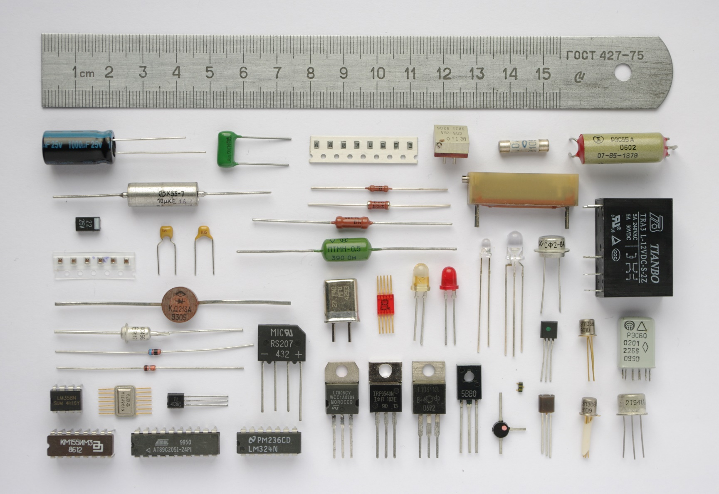
Examples: Electronics Components
Notes:
Chemical, semiconductor, mechanical, mixed (e.g. MEMs)

Slide 20
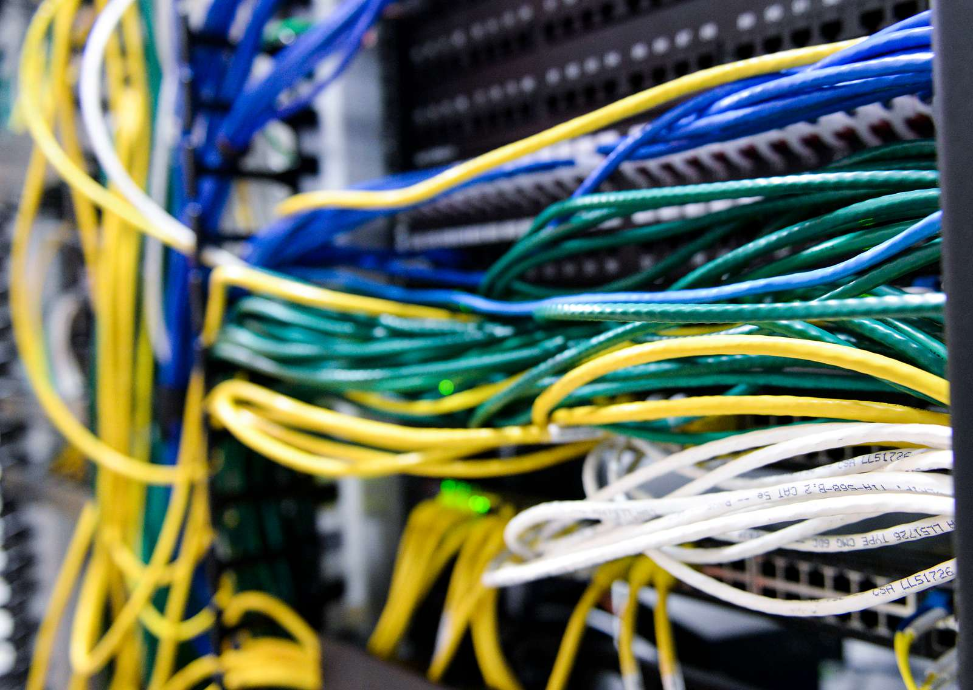
Examples: Communications and storage

Slide 21
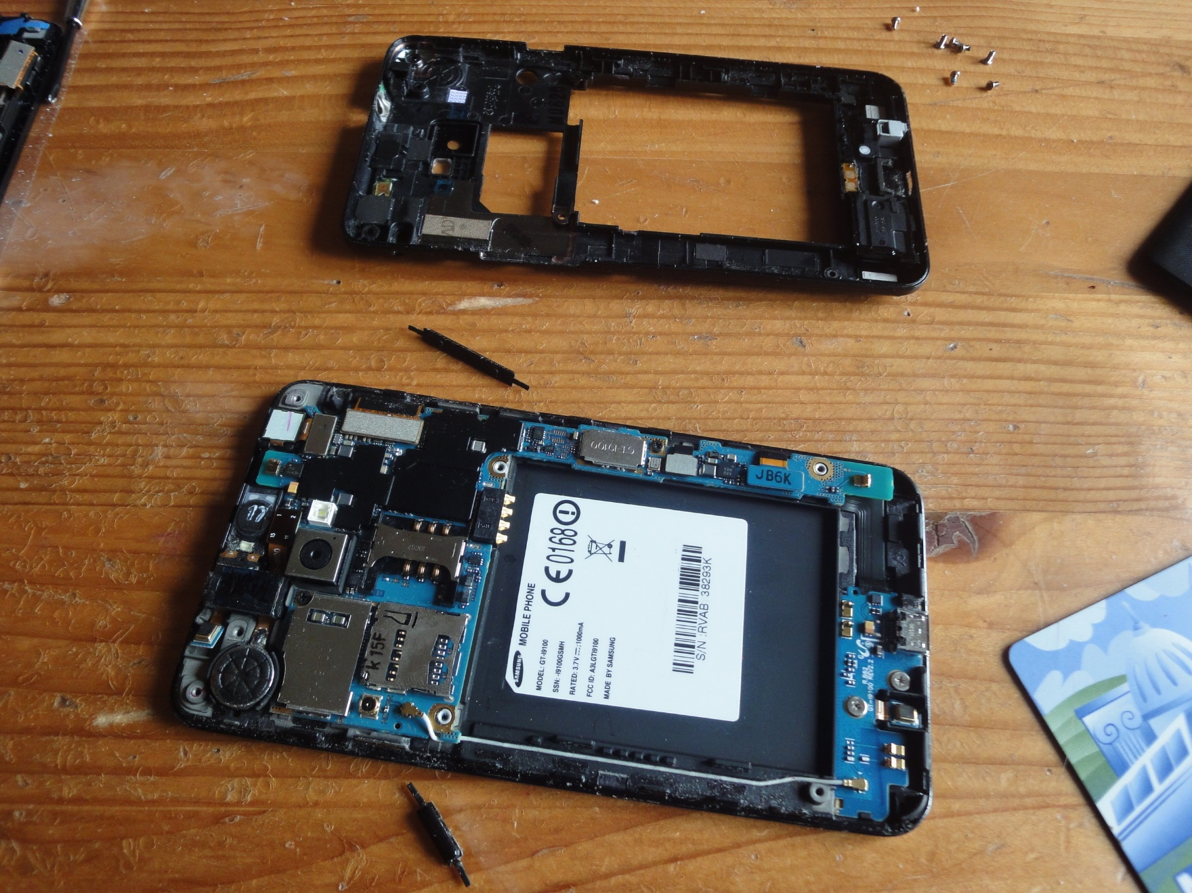
Examples: Smartphones
CC BY-SA Vera de Kok

Slide 22
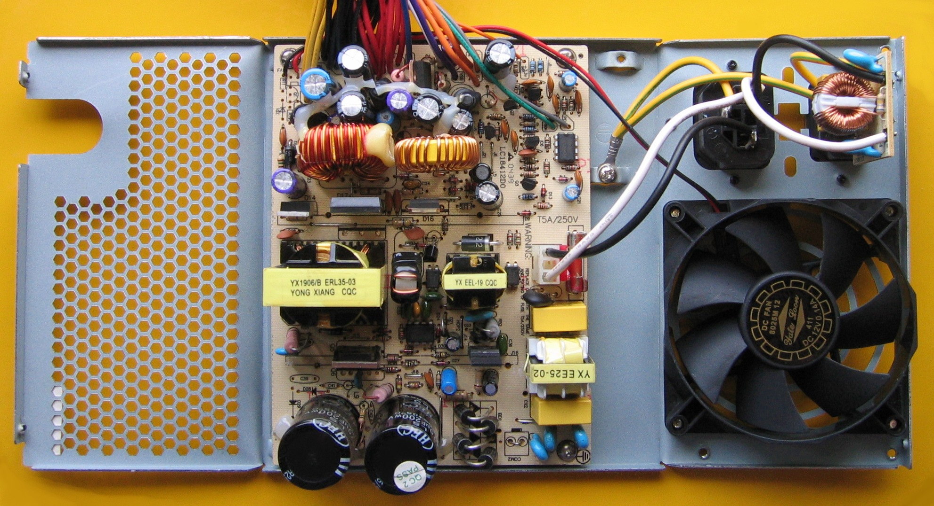
Examples: PC power supply

Slide 23
Structure of an embedded system
Communication / Networking
Applications
Libraries
Sensors
Operating System
Computing
Actuators
Drivers
Hardware
Storage
Power Management

Slide 24
Supply chain (in general)
Industry employs a supply chain pyramid with Tiers
…
OEM: Original Equipment Manufacturer
TIER 1: Module or system supplier
TIER 2: Component supplier
TIER 3: Sub-component supplier
TIER N: Natural resource supplier
Flaticons: Mehwish, Freepik

Slide 25
The electronics industry supply chain
Industry employs a supply chain pyramid with Tiers
…
OEM: Original Equipment Manufacturer
TIER 1: PCB supplier
TIER 2: Integrated circuit supplier
TIER 3: wafer supplier
TIER N: Minerals supplier
Flaticons: Surang, Kerismaker, Freepik, smashicons

Slide 26
What is an integrated circuit?
Digital ICs
Processor
Large microprocessor
Small microcontroller
Specialized processors (telecommunications, cameras, …)
Memory (data storage): ROM, RAM
Analog ICs
Amplifier, sensor, MEMS (Micro Electro Mechanical System)
Power integrated circuit
Mixed signals ICs
Radio Frequency IC…

Slide 27
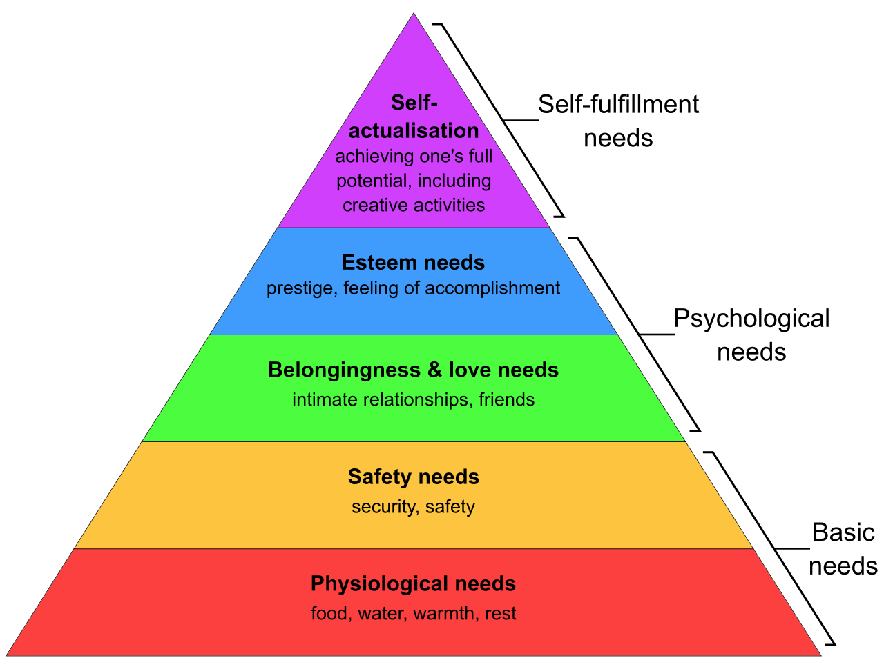
+/- Impacts of electronics
Electronics has + and – effects at all levels of the Maslow’s hierarchy of needs

Slide 28
Electronics, ethics and human rights
Challenges include:
Social standards for employees
Safe and healthy working conditions
Freedom of association and right to collective bargaining
Equality of opportunity and treatment and fair interaction
Remuneration
Working hours
Employment security
Social security
Professional development
Job satisfaction
Impacts on local communities
Impact on society

Slide 29
Electronics, ethics and human rights
Challenges include:
Social standards for employees
Impacts on local communities
Safe and healthy living
Human rights
Social and economic opportunities
Impact on society

Slide 30
Electronics, ethics and human rights
Challenges include:
Social standards for employees
Impacts on local communities
Impact on society
Unjustifiable risks
Employment creation
Corruption
Contribution to the national economy
Contribution to the national budget
Impacts on conflicts
Intellectual property rights

Slide 31
Electronics and pollution
Smartphones: 55 elements employed
Ashby, M. F. (2022). Materials and sustainable development. Butterworth-Heinemann.

Slide 32
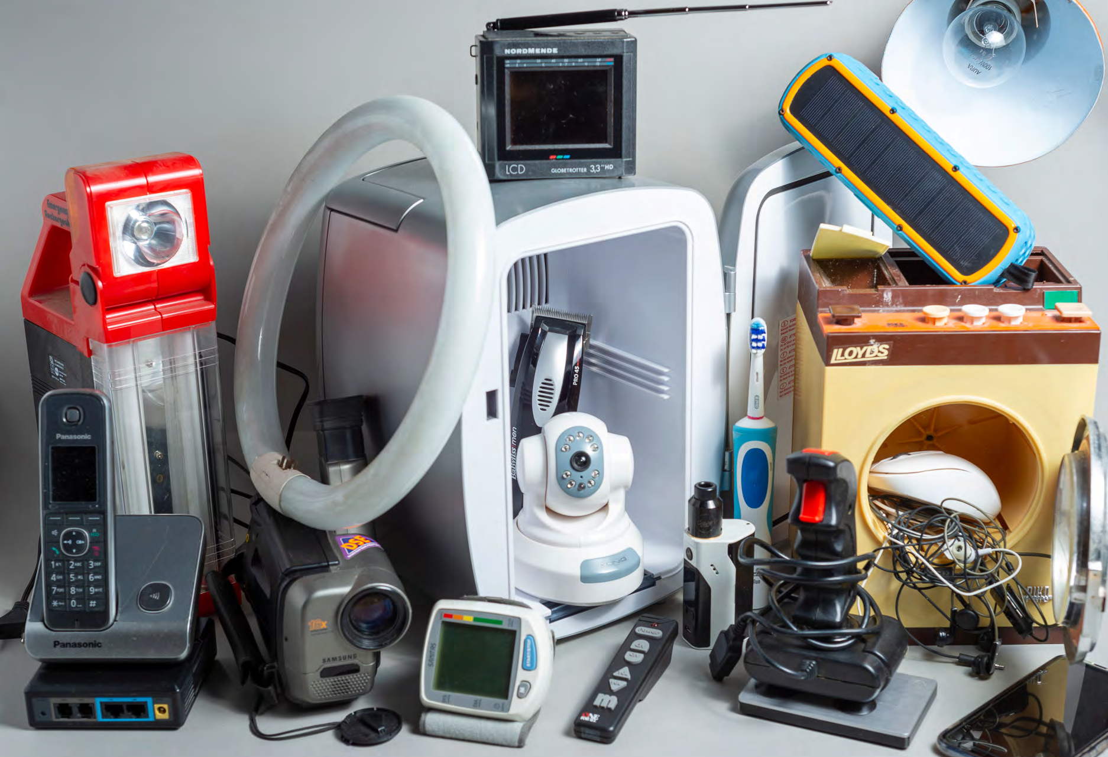
E-Waste
CC BY-NC 3.0 IGO - © UNU/UNITAR and ITU, 2020

Slide 33
E-Waste
E-waste
One of the fastest-growing waste categories, growing at a rate of 3–5% per year → includes product housing
In 2016, 44.7 million tons of e-waste were generated in the world , 6.1 kg per person; in 2019: 53.6 million tons
E-waste is classified as a hazardous waste.
“Only 17.4 per cent of 2019’s e-waste was collected and recycled. This means that gold, silver, copper, platinum and other high-value, recoverable materials conservatively valued at US $57 billion – a sum greater than the Gross Domestic Product of most countries – were mostly dumped or burned rather than being collected for treatment and reuse.” - Global E-waste Monitor 2020
Ilankoon, I. M. S. K., Ghorbani, Y., Chong, M. N., Herath, G., Moyo, T., & Petersen, J. (2018).
E-waste in the international context–A review of trade flows, regulations, hazards,
waste management strategies and technologies for value recovery. Waste Management, 82, 258-275.

Slide 34
Focus on Global Warming

Slide 35
Global Warming, in France
Aurélien Ribes et al. 2022, « Earth Syst. Dynam. », 13, 1397-1415 (CC BY-4.0)
Prediction for an intermediate scenario in which carbon emissions
neither increase nor decrease drastically
Notes:
Dans un deuxième temps, les chercheurs se sont projetés vers l’avenir afin d’anticiper le climat français à la fin du XXIe siècle. Ils ont pour cela utilisé les simulations climatiques en fonction de différents scénarios décrivant l’état du monde en 2100. Ces scénarios construits par le Giec vont du plus optimiste – un monde dans lequel un immense effort international a permis d’atteindre la neutralité carbone dès 2050 – au plus pessimiste – un monde divisé par de fortes inégalités et qui continue à carburer au gaz, pétrole et charbon. Entre ces deux extrêmes improbables, un scénario intermédiaire dans lequel les émissions de carbone n’augmentent ni ne diminuent drastiquement. D’après les experts, c’est ce scénario mitigé qui est le plus en accord avec les tendances actuelles et les engagements climatiques pris par les grands pays émetteurs pour les prochaines années.
Sur la base de ce dernier scénario, les chercheurs ont montré que la France de 2100 pourrait être 3,8 °C plus chaude que celle du début du XXe siècle. Une augmentation qui fait frémir. Une telle hausse des températures serait particulièrement marquée en été. En effet, les étés pourraient être en moyenne 5 °C plus chauds par rapport aux décennies 1900-1930. « Ceci aura des impacts très forts sur les écosystèmes et les cultures. On aura des pics de chaleur beaucoup plus fréquents et chauds, et des sécheresses plus intenses et prolongées. Dans ces conditions, l’un de points clés sera comment maintenir les ressources en eau et comment les utiliser », annonce Julien Boé. À 3,8 °C de hausse de températures moyennes, des écosystèmes entiers pourraient disparaître, et le paysage agricole en sera drastiquement modifié.

Slide 36
Data and Actions in France
Commission de l'aménagement du territoire et du développement durable du Sénat
rapport de la mission d'information sur l'empreinte environnementale du numérique, 2019
if nothing is done, by 2040 digital technology would be the source of 24 million tons of CO₂ equivalent, or about 7% of France's emissions, compared with 2% today.

Slide 37
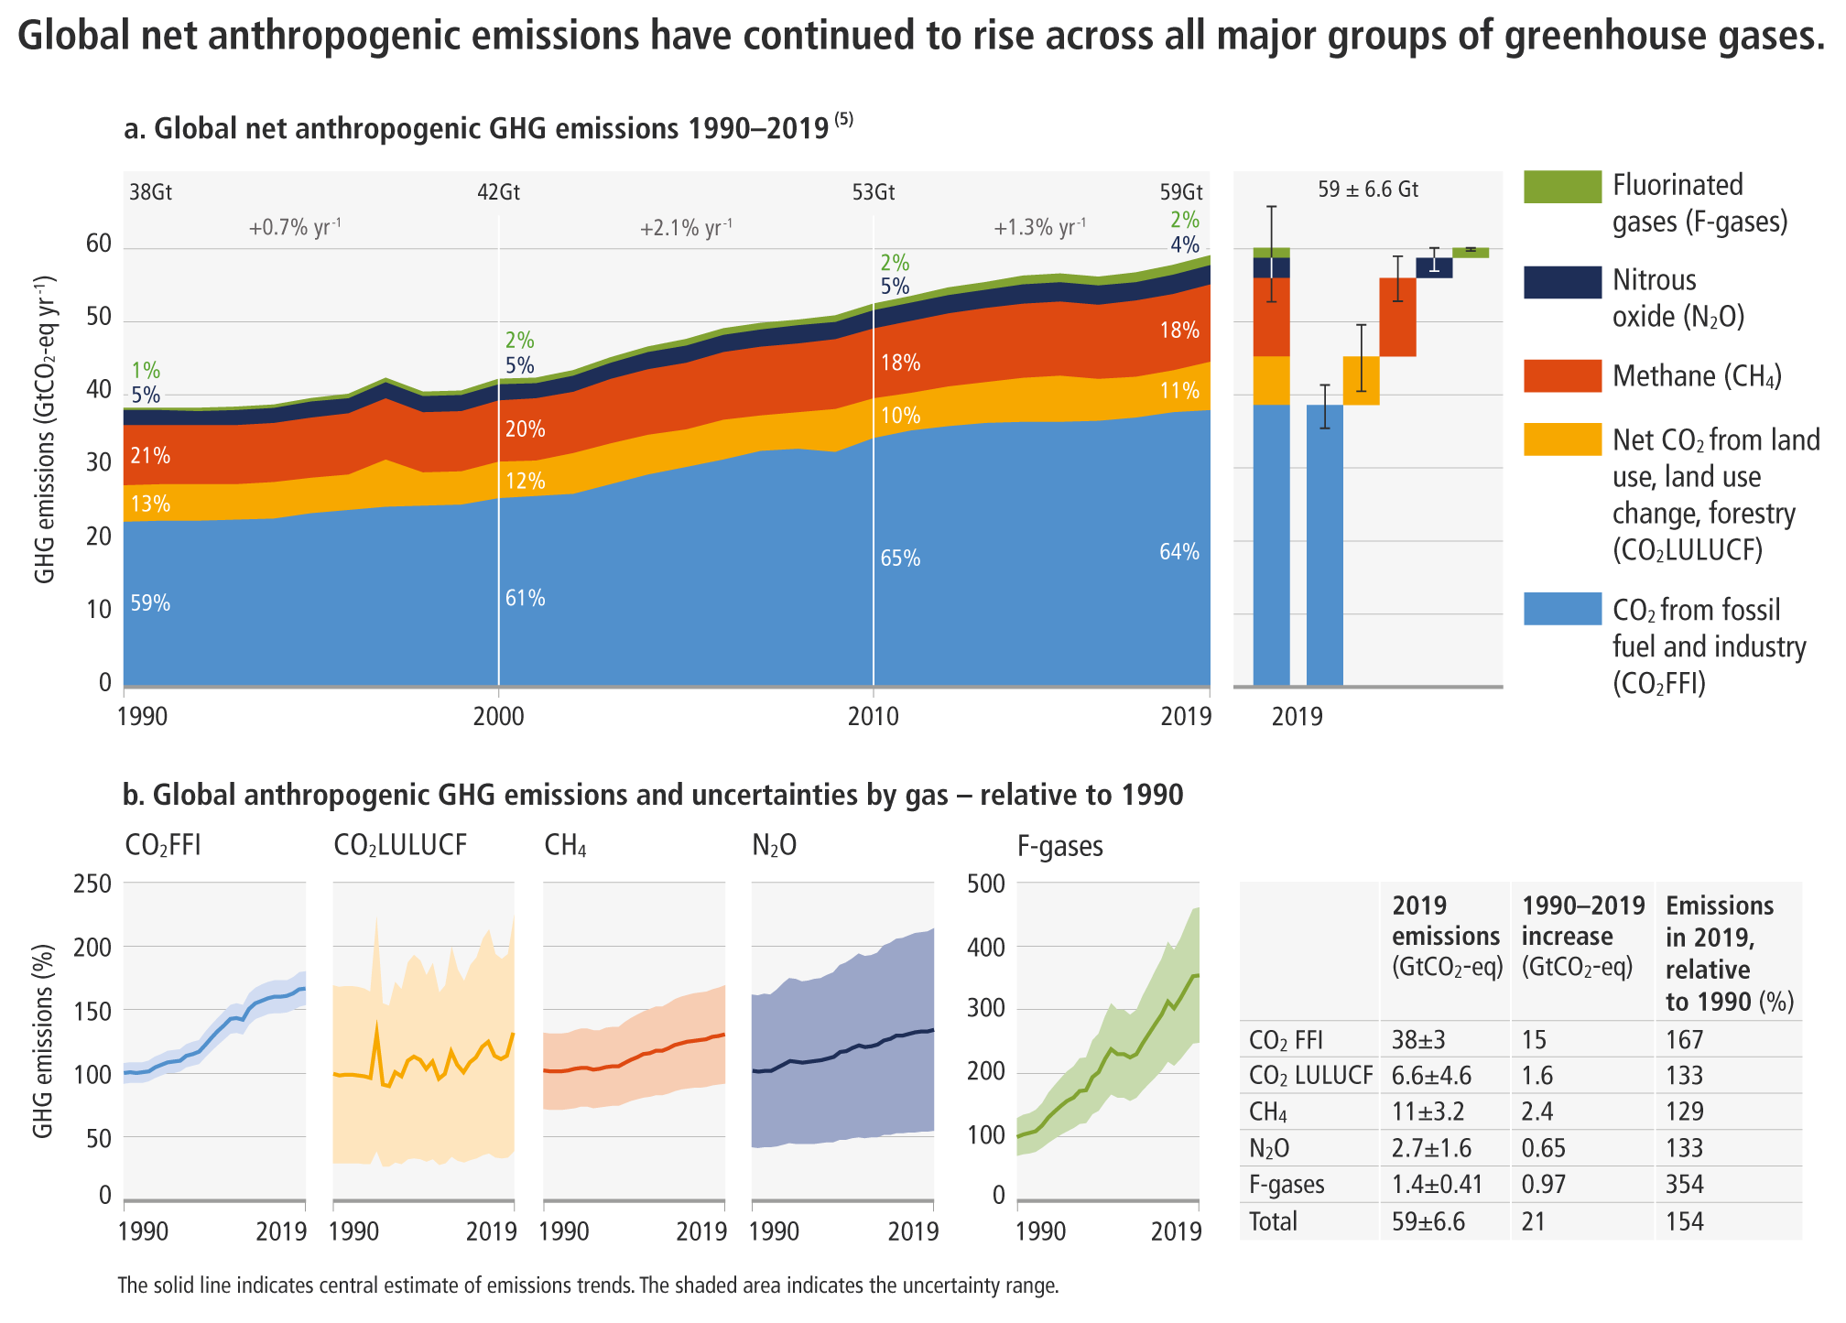
Goal on global warming
Scenario below 1.5°C (66% chance in 2100 with no or limited overshoot): 8 GtCO₂e in 2050 (gain of ~7×)
IPCC
The Closing Window:Climate crisis calls for rapid transformation of societies
UN environment programme 2022
Notes:
For 1.5°C objective, Paris Agreement
Other studies estimate the safe level of greenhouse gas concentrations between 350 ppm and 400 ppm of CO2-equivalent.
Total emissions from global livestock: 7.1 Gigatonnes of Co2-equiv per year, representing 14.5 percent of all anthropogenic GHG emissions.
https://www.oecd.org/tax/tax-policy/pricing-greenhouse-gas-emissions-turning-climate-targets-into-climate-action.htm
Land Use, Land-Use Change and Forestry (LULUCF)

Slide 38
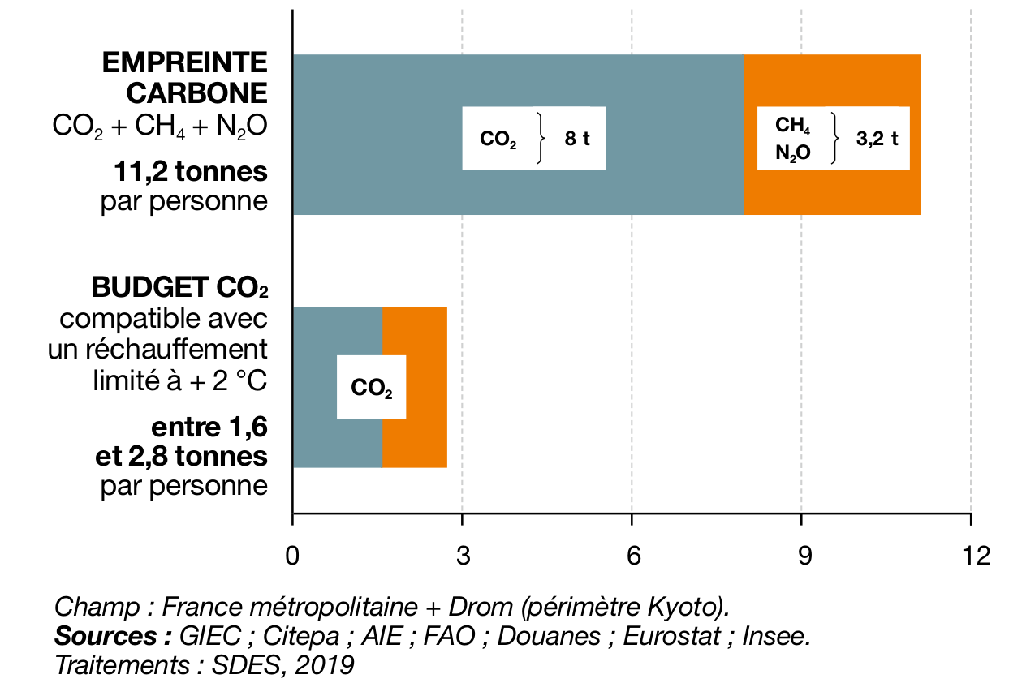
Goal on global warming
In developed countries, reductions shall be stronger: estimated 6× in France in 2050
Notes:
For 1.5°C objective, Paris Agreement
Other studies estimate the safe level of greenhouse gas concentrations between 350 ppm and 400 ppm of CO2-equivalent.
Total emissions from global livestock: 7.1 Gigatonnes of Co2-equiv per year, representing 14.5 percent of all anthropogenic GHG emissions.
https://www.oecd.org/tax/tax-policy/pricing-greenhouse-gas-emissions-turning-climate-targets-into-climate-action.htm
Land Use, Land-Use Change and Forestry (LULUCF)

Slide 39
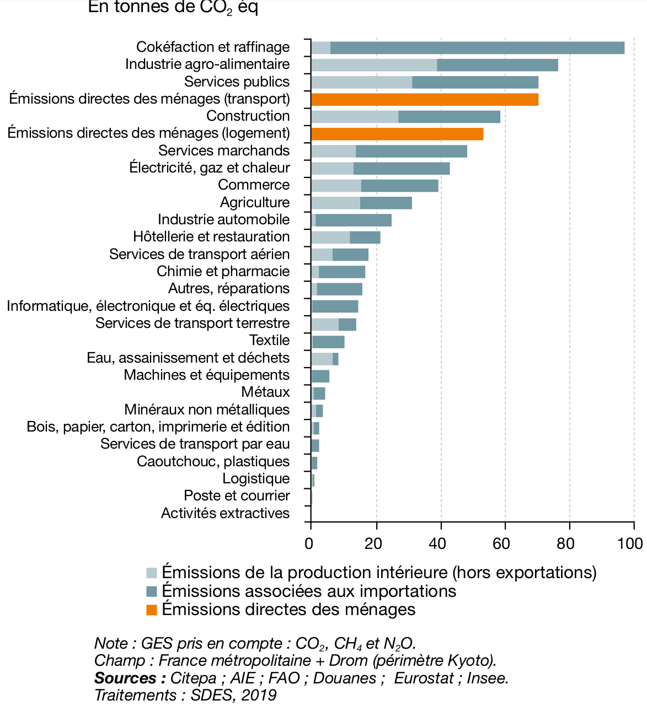
The case of global warming
All human activities produce CO2
Total: 749 Mt CO₂
in 2018
Mt CO₂ / year in France

Slide 40
The case of global warming
All human activities produce CO2
Total: 749 Mt CO₂
in 2018
Electronics is here
Mt CO₂ / year in France

Slide 41
The case of global warming
All human activities produce CO2
Total: 749 Mt CO₂
in 2018
Electronics is here
but not only
Mt CO₂ / year in France

Slide 42
Carbon accounting
Greenhouse Gas Protocol and ISO 14064
Employing an accounting method for carbon emission tracking (in tons of CO₂ equivalent) to avoid double counting
Scope 1: GHG direct emissions from activity
Scope 2: GHG emissions from energy consumption
Location-based: reflects the average emissions intensity of grids on which energy consumption occurs
Market-based: taking into account, derives emission factors from contractual instruments (e.g. REC)
renewable energy certificates (RECs)
Scope 3: Indirect emissions from value chain (up and downstream)

Slide 43
The electronics industry supply chain
Upstream and downstream
Downstream
Upstream
Client
TIER N: Minerals supplier
TIER 3: wafer supplier
TIER 2: Integrated circuit supplier
TIER 1: PCB supplier
OEM: Original Equipment Manufacturer
Distribution
Retail store
Flaticons: Surang, Kerismaker, Freepik, smashicons, Muhammad Atif,

Slide 44
Electronics Life Cycle (LC)
Nature
Raw Materials
Recycling
Manufacturing
Collection
Product (Consumer)
Nature
opex
End-of-life
Disposal
Gupta, U., Kim, Y. G., Lee, S., Tse, J., Lee, H. H. S., Wei, G. Y., ... & Wu, C. J. (2022).
Chasing carbon: The elusive environmental footprint of computing. IEEE Micro, 42(4), 37-47.

Slide 45
Electronics LC is strongly impacted by capex
Nature
Raw Materials
Recycling
Manufacturing
Collection
Product (Consumer)
Nature
End-of-life
Disposal
capex
Gupta, U., Kim, Y. G., Lee, S., Tse, J., Lee, H. H. S., Wei, G. Y., ... & Wu, C. J. (2022).
Chasing carbon: The elusive environmental footprint of computing. IEEE Micro, 42(4), 37-47.

Slide 46
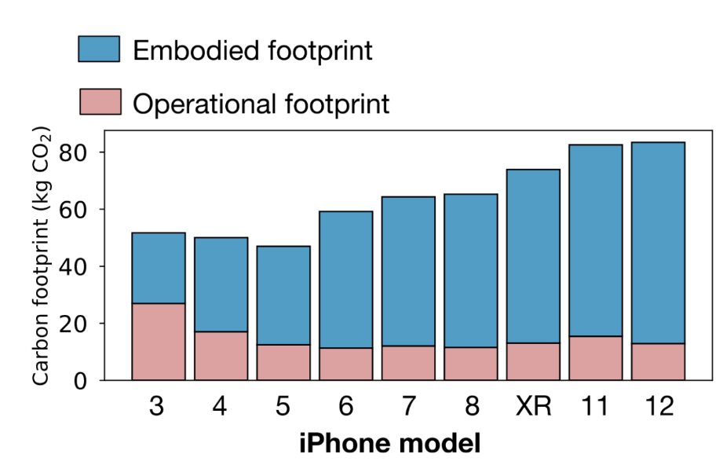
Electronics LC is strongly impacted by capex
Nature
Raw Materials
Recycling
Manufacturing
Collection
Product (Consumer)
Nature
End-of-life
Disposal
capex
Gupta, U., Kim, Y. G., Lee, S., Tse, J., Lee, H. H. S., Wei, G. Y., ... & Wu, C. J. (2022).
Chasing carbon: The elusive environmental footprint of computing. IEEE Micro, 42(4), 37-47.

Slide 47
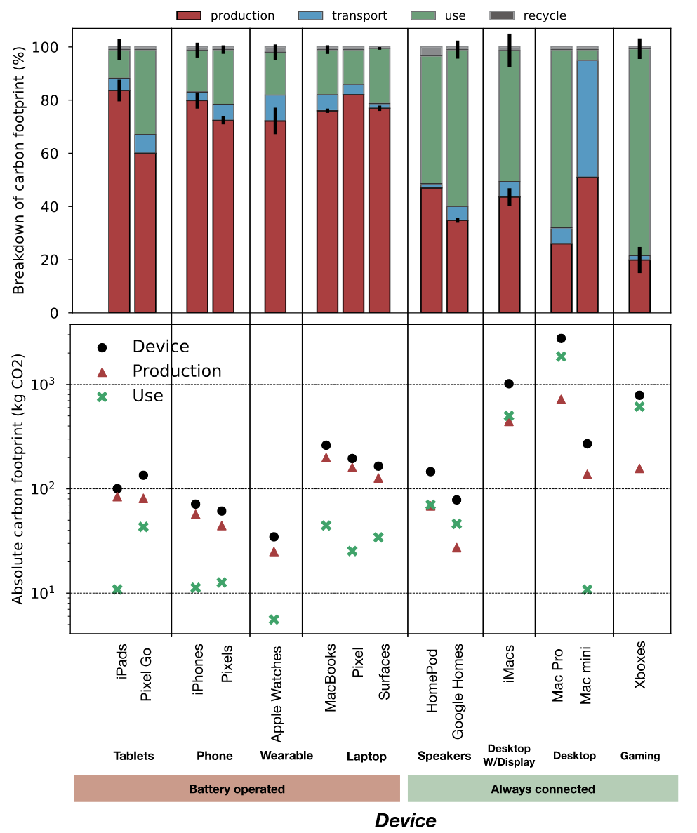
Electronics LC is strongly impacted by capex
Nature
Raw Materials
Recycling
Manufacturing
Collection
Product (Consumer)
Nature
End-of-life
Disposal
capex
Gupta, U., Kim, Y. G., Lee, S., Tse, J., Lee, H. H. S., Wei, G. Y., ... & Wu, C. J. (2022).
Chasing carbon: The elusive environmental footprint of computing. IEEE Micro, 42(4), 37-47.

Slide 48
Electronics LC is strongly impacted by capex
Gupta, U., Kim, Y. G., Lee, S., Tse, J., Lee, H. H. S., Wei, G. Y., ... & Wu, C. J. (2022).
Chasing carbon: The elusive environmental footprint of computing. IEEE Micro, 42(4), 37-47.

Slide 49
Electronics LC is strongly impacted by capex
Gupta, U., Kim, Y. G., Lee, S., Tse, J., Lee, H. H. S., Wei, G. Y., ... & Wu, C. J. (2022).
Chasing carbon: The elusive environmental footprint of computing. IEEE Micro, 42(4), 37-47.

Slide 50
Semiconductor industry GHG accounting
36% = 219,53 ↑
2021
Sources: companies CSR
Others are extrapolated from total market size

Slide 51
Scope 1: direct impact
2021
Sources: companies CSR
Samsung electronics GHG emissions are counted only for 31.3% (percentage of semiconductor in company revenues)
Others are extrapolated from market share

Slide 52
Scope 1: direct impact
fabless
fabless

Slide 53
Scope 2: impact from energy
*
*
fabless
fabless
*
*
*
*
*
*
Sources: companies CSR
Location-based scope 2 if available, otherwise market-based or non specified (marked with *)

Slide 54
Foundries carbon impact
2021

Slide 55
Foundries scope 1
2021

Slide 56
Foundries scope 2
2021

Slide 57
Some details on scope 1 emissions
Semiconductor industry heavily use F-Gases
HFC (hydrofluorocarbons): cooling
PFC (perfluorocarbons): etching and cleaning
SF6: 1kG = 22.8t CO₂eq

Slide 58
Semiconductor GHG accounting
Scope 1+2: 88Mt CO₂eq in 2021
+10% GHG emission from 2020
For +28% revenue
Efficiency has improved
Sustainability has not

Slide 59
Semiconductor GHG accounting Limitations
Mixing location-based and market-based scope 2
Underestimating scope 2
When both numbers are available, market-based is lower by 7 to 75% (for Intel)
Extrapolating to others
36% of revenues for semiconductor vendord
8% of revenues for foundries
Missing scope 3
Upstream: mining
Downstream: usage and end-of-life
Budget granularity is company per company
Retrieved from company estimations

Slide 60
Where is semiconductor industry in global GHG emissions?
Global ICT impact is estimated up to 4%*
55% from cloud and network infrastructure:
45% from manufacturing devices
88 Mt CO₂eq
0,15% of total
* Climat : l'insoutenable usage de la vidéo en ligne, the Shift Project, 2019

Slide 61
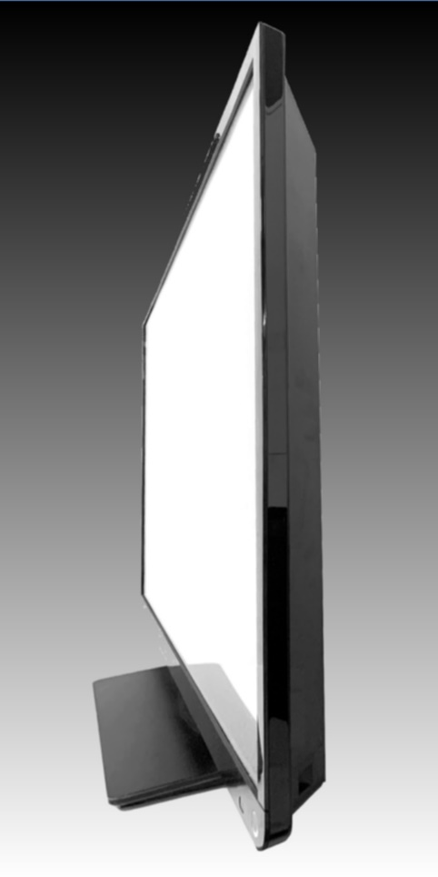
Where are the %s total GHG of ICT?
Mines, smelters and refiners
Cloud computing facilities (scope 3 downstream)
Including buildings, wiring…
Electronics cooling systems
Backbone fiber optics
Including fiber optic connection work
Photonics and underwater cables
Screens – 30Mt CO₂e in 2021
Batteries
…
CC-SA Project Kei

Slide 62
Some data on semiconductor scope 3
Intel evaluates Scope 3 downstream
22,9 Mt CO₂eq in 2021 for product energy usage
Use of yearly-produced electronics over lifetime
Average product lifetime is estimated 4 years and 4 months
Intel evaluates Scope 3 upstream
4,9 Mt CO₂eq in 2021 for supply chain
Does it include full mining impact or only part of the supply chain?

Slide 63
How to Act on Electronics Sustainability?

Slide 64
Actions towards Electronics Sustainability
Sustainable Development
Green IT
Sustainable ICT
Green Networking
Green Computing
Sustainable Electronics

Slide 65
Where can electronics and computer science engineers act?
Collect and report the environmental footprint of electronics design decisions
Build products:
With low energy consumption
Repairable and modular
Long-term upgradeable, with delayed obsolescence
With ethical sourcing
Favoring low carbon footprint and low waste suppliers
Favoring low carbon footprint and low waste technologies
ICs, batteries, PCBs, connectors, components, solar cells, supercapacitors…

Slide 66
Open source hardware for sustainability
Fighting against obsolescence
Long-term maintainance
Linux is from 1991 !
Superiority of community-based tools
Examples of compilers: GCC, LLCM/Clang, etc.
Stable APIs and interfaces
OSH tools for repair and reuse

Slide 67
Actions towards Electronics Sustainability
European Green Deal on climate change – 2019
National laws: many in France
Duty of vigilance 2017
AGEC: lutte contre le gaspillage et à l'économie circulaire 2020
REEN: réduire l'empreinte environnementale du numérique 2021
Labels and incentives
Projects: focus on open source hardware and ESOS

Slide 68
How can Open Source Hardware help?

Slide 69
What is open source hardware?
Open Source Hardware (definition by oshwa.org)
hardware whose design is made publicly available so that anyone can study, modify, distribute, make, and sell the design, or hardware based on that design.
In the form of mechanical drawings, schematics, bills of material, PCB layout data, HDL source code, and/or integrated circuit layout data
The hardware's source, the design from which it is made, is available in the preferred format for making modifications to it. Ideally, open source hardware uses readily-available components and materials, standard processes, open infrastructure, unrestricted content, and open-source design tools to maximize the ability of individuals to make and use hardware.

Slide 70
Types of open source hardware?
Open source hardware applies at three levels
Printed circuit boards design – RPi, Arduino …
Reconfigurable hardware design (FPGA)
Integrated circuits design (ASIC)
Open source hardware applies in three forms
Open source design tools
Open source IPs (for Intellectual Property Block)
To be integrated in own system
Open source systems
To be duplicated, repaired, transformed, enhanced, combined with

Slide 71
A few open source hardware projects
Front-end design-level OSH
gem5, GPGPUSim, McPAT, GPUWattch, SystemC simulation SoC simulators
Verilator, Ghdl RTL simulators
Gaut, LegUp, XLS, ScaleHLS High-Level Synthesis
Back-end design-level OSH
ASIC
Open-road and Alliance VLSI/CAD System
FPGA
IceStudio and open source FPGAs, openFPGA
Fabrication-level OSH
Google Skywater PDK 130nm process

Slide 72
Technological opportunities for sustainability
Slow performance improvement of single cores
Open hardware boom in digital ICs
Large investments in RISC-V
AI open-source developments reaching hardware

Slide 73
The ESOS Project

Slide 74
Part 2: ESOS
Electronics: Sustainable, Open, Sovereign
Compétences et Métiers d'avenir - France2030, 2023-28
Notes:
PIA: depuis 2010, dispositifs interministériels

Slide 75
The ESOS project
Consortium led by INSA Rennes
Consortium including INSA Rennes, University of Rennes, ENS Rennes, UIMM Bretagne, Novatech Industries (electronics courses covering a wide range of electronic design professions)
Consortium teaching electronics in Bac+3/5/8, strong links with research
30+ industrial partners
6.38M€ of aid obtained, over 5 year
Long-term objective of self-funding
https://esos.insa-rennes.fr

Slide 76
ESOS: Sustainable, Open, and Sovereign Electronics
Sustainable: that meets the needs of current generations without compromising the ability of future generations to meet their own needs.
Open: a decentralized development model that distributes source code publicly for open collaboration and peer production, called "the open source method.
Sovereign: the quality of the state being obliged or determined only by its own will, within the limits of the higher principle of law, and in accordance with the collective purpose it is called upon to achieve.

Slide 77
ESOS Objectives
Objective 1: attract more students to the electronics field
Raise awareness of the importance of electronics in environmental issues and increase the number of women in the industry
Inform high school students about the challenges and opportunities of sustainable electronics
Objective 2: train teachers in sustainable electronics
High school and university teachers
Objective 3: Train students in sustainable electronics
Train future electronics engineers in product life cycle and eco-design
Initial training and work-study programs in Bac+3, Bac+5, and Bac+8
Objective 4: train professionals in sustainable electronics
Train current electronics engineers in the various aspects of sustainable development; in-service and online training

Slide 78
Some ESOS courses to be developed
Life cycle analysis
Eco-design
Attributional and consequential GHG accounting
Open source HW
For PCB design, for architecture design
Contributing to large-scale open source projects
Electronics for the transitions
Power electronics: novel substrates and technologies
Sustainability and open source versus:
Cost, pure performance, safety, cybersecurity, …
Notes:
The most important GHG accounting concept you
may not have heard of: the attributional-
consequential distinction

Slide 79
Some ESOS courses to be developed
Sustainable business plans
Open source valorisation
Legal aspects of sustainable electronics
Lengthened guarantees
Reparation-permitting guarantees
Modification-permitting guarantees
Systems parts storage
Notes:
The most important GHG accounting concept you
may not have heard of: the attributional-
consequential distinction

Slide 80
Questions?

